Slide 1
Notes:
Today I am sharing how I build community and relationship within my on-line courses. I am working to bring together Western methods and Indigenous worldviews to provide the optimum conditions for learning based on a sense of community, connections through relationships and trust in people and the process.¹

Slide 2
Notes:
There is no doubt that the delivery method for online instruction is remarkably different from instruction presented in face-to-face classrooms. Attention to culture and student engagement in the on-line environment are critical factors affecting student success. It is easier to look a struggling student in the eye and say “see me after class” than provide support to a student who does not engage through the email, phone calls, or text messages.

Slide 3
Notes:
On- and off-line interactions with students using the social networks systems already in place are essential for connecting with students and building relationships. These systems, work to bridge the separation due to proximity and increase the sense of community and personal attention, and reduce feeling of disconnection, isolation, distraction?

Slide 4
Notes:
I often hear those who teach in the face-2-face environment wonder how they could possibly transfer the familiar pedagogies of their face-2-face structure to an environment where they believe that development of relationships is so difficult.³ They wonder, how is it possible to build strong connections with students absent the ability to read body language, have eye contact or share a smile.

Slide 5
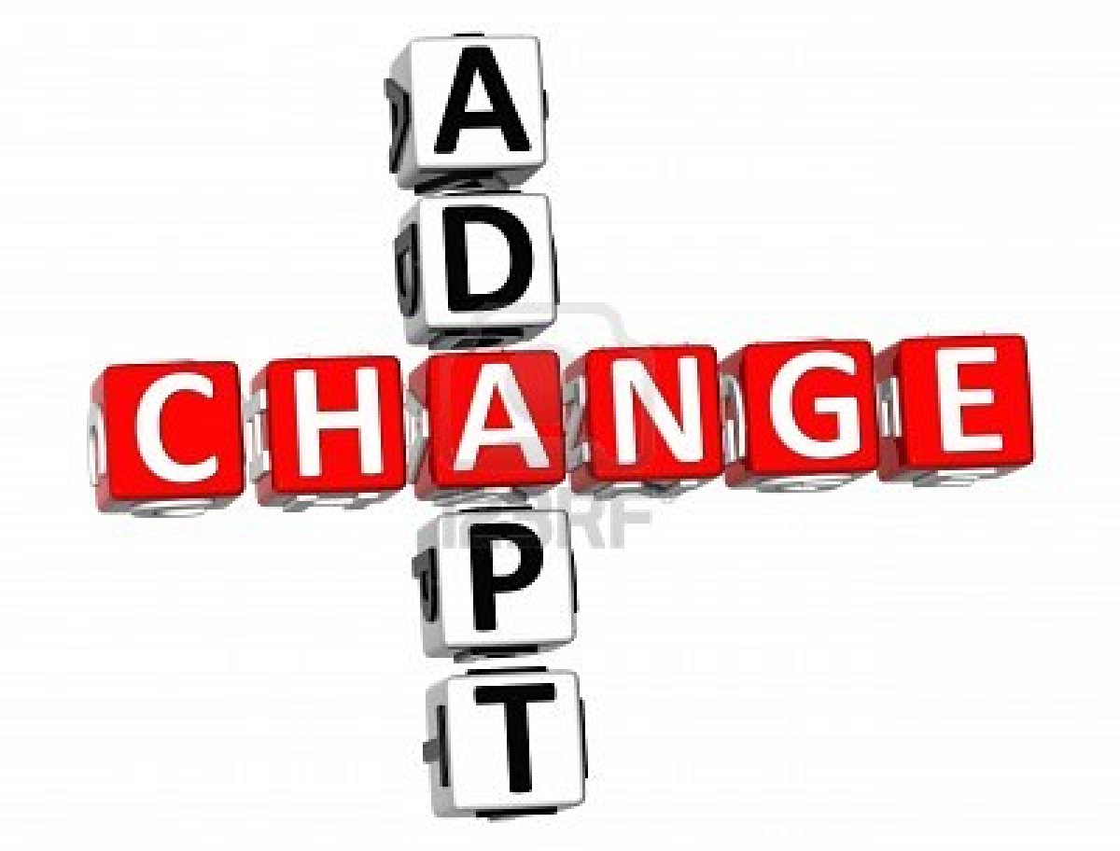
Notes:
those who flourish in the on-line learning environment boast about the flexibility of time and place and their ability to quickly build strong relationship through the use of web tools and social networks. For example, the web tool – Voice Thread allows faculty and students to move beyond the one dimensionality of email and discussion boards. And skype and google hangout provide a place for face-2-face interaction found in brick and mortar settings.

Slide 6
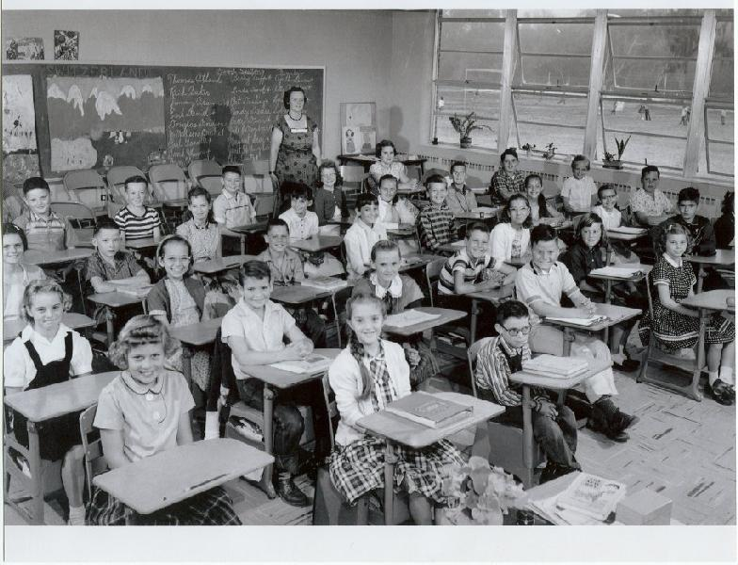
Notes:
While I believe that pure abandonment of one delivery methods for another is not practical or beneficial, I do believe that in today’s global economy, where time and distance are non-factors in connecting with people and cloud technology allow us to build a strong community of learners that how we build relationships is no longer defined by the physical presence of the group.⁴

Slide 7
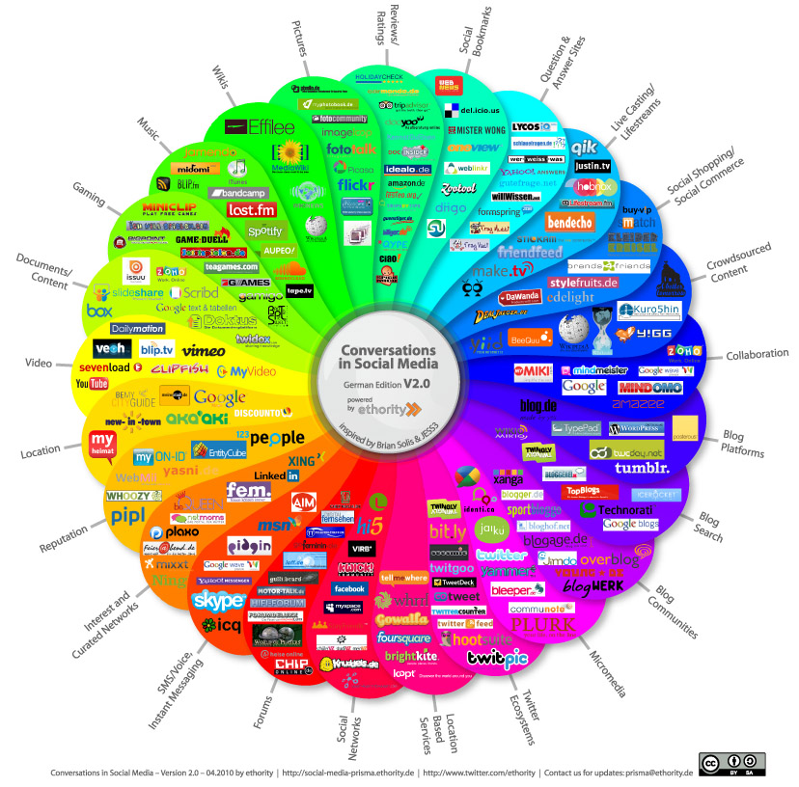
Notes:
The web is bursting with tools available to engage learners. These tools, which allow for the retrieval, processing and creation of content provide the vehicle for collaborative work. As you can see there is a vast array of bell and whistles for the choosing. However fun and flashy these tools may be, they do little to solidify relationships or increase student engagement. ⁵

Slide 8
RELATIONSHIP
noun, (re-la-tion-ship), \-shen-ship\ :
“the way in which two or more people, groups, countries, etc. talk to, behave toward, and deal with each other.”
http://www.merriam-webster.com/dictionary/relationships
Notes:
Establishing the framework for on-line teaching and learning from a integrated worldview can foster student connection and sense of community. Working in support of each other I believe the integration of Indigenous and Western worldviews can define and build a strong learning culture and optimize student engagement in the messy process of figuring it all out.

Slide 9
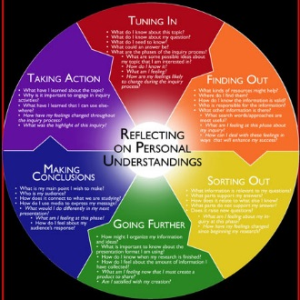
Notes:
Expanding our practice to include Indigenous Ways of Knowing reframes the on-line environment beyond the confines of the machines that transmit data, voice, and video. It shakes the status quo for learning that many have come to expect through years of schooling. We spend a great of time talking about how to connect with new technologies in a limited fashion.

Slide 10
Notes:
What has struck me as a key difference between the on-line learning environment and Face-2-Face gathering is the role of off-line interactions. Building relationships, and thus increasing the depth of student engagement, absent the ability to look into the eyes of the speaker or read body language requires the instructor to set the tone for learning thinking differently about relationship development.⁷

Slide 11
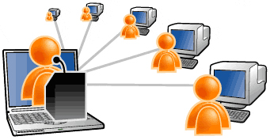
Notes:
There is an inherent anonymity to the on-line learning environment that can be significantly reduced through purposeful planning. Thinking differently and strategically, the use of email, announcement boards, video conferencing and virtual office hours help connect to students . I am also conscious that these tools allow for differing processing times so often missing from Western pedagogies.

Slide 12
Welcome students,
Introduce upcoming topics,
Check on the welfare of a student who did not show up for class,
To follow up with a student who may have seemed to struggle with the concept of the week (or struggling in general)
Notes:
University’s trying to increase retention, are going beyond traditional approaches to connection students and reduce dropout rates, such as friendly phone calls and emails from professors to students. However, these occur in an isolated off-line environment. And they are not unique to the on-line environment. mew ways of thinking when engaged synchronously is at the heart of bring students back to class each week.

Slide 13
Notes:
The use of these modern tools to connect with students fosters relationships. However, these tools alone do not build community. Integrating an Indigenous worldview with the Western structure of education reframes the traditional system of education many are accustom too. At the same time it provide a link to the experiences of those from native and rural communities.¹⁰

Slide 14
…how we talk to, behave towards and deal with each other
Treat Each Other with Respect
Everyone has Their Own Truth
Listen without Agenda
Be Polite, Courteous, and Thoughtful
Refrain from Interruptions
Affirm Other Speakers
Do Not Voice Disagreement or Use Violent Word
Respect Privacy – what is said here, stays here
Be Supportive of Each Other
Notes:
Specifically this semester I have given attention to three aspects of building relationships and thus increasing student engagement. Introducing guidelines for how we talk to, behave towards and deal with each other in the on-line environment from an Indigenous worldview has fostered divergent thinking and encouraged risk-taking early in the semester.

Slide 15
Notes:
Implementing those guidelines includes my attention to the silence that allows for different processing rates and further encourages each of us to “listen without an agenda.” Extended wait time honors and respects a style of discourse where each person can feel safe to enter the conversation from their place of reference and contribute similar and opposite worldviews¹²
Finally, ensuring that we Do Not Voice Disagreement or Use Violent Word and Respect Privacy breaks down the walls and encourage a free flow of new ideas.

Slide 16
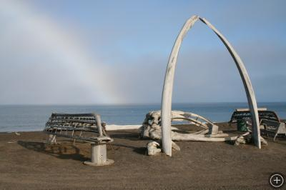
Notes:
For centuries in our Alaska native villages, learning was place-based and survival required connection with the land, water, animals and each other. A holistic approach to learning that required mastery where “knowing” is a verb. In contrast, Western educational practices dissect and disconnect knowledge and emphasize the accumulation of “knowledge” as a noun. ¹³ Moving students away from the technology reminds us that place-based learning in not an isolated practice. And that the technology is simply one tool to learning.

Slide 17
Notes:
Each of my on-line classes begins outside. This created a simple shift of focus from a Western view of lost learning time if we are not engaged in content to an Indigenous view where pace and process are relative to the learner. The impact of this shift is noticeable in the decrease of the activity in the chat box and the increase in verbal interactions during class. As one student states helps students better focus their thoughts for class by allowing them time to close thoughts from the day.

Slide 18
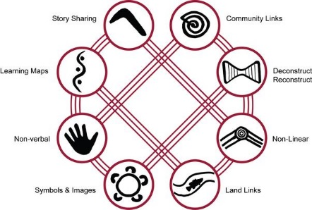
Notes:
I asked students last night to spend 5 minutes outside thinking about how (and why) does out taking time to connect with the planet support our work in the on-line environment. Which often feels some removed from the natural world?
Here are few of their responses:
It feels similar in that there is a building of intimacy and familiarity leading to building of trust and a feeling of safety and comfort
Allows us to decompress from the daily stress
Helps us to remember there is more than just the space we occupy
Keeps us grounded to reality and present life
Helps us state on the same page each day along with focusing our thoughts
helps to ground us and reset so that we can be engaged in the online learning environment.

Slide 19
BREATHE
Notes:
Intentionally providing the opportunity to connect with our planet at the start of each class allow each of us the opportunity to literally stop and breathe. Taking the first 8-10 minutes of class outdoors, regardless of where each person is logged in, provides the opportunity to remind us that we are a part of something greater.¹⁵

Slide 20
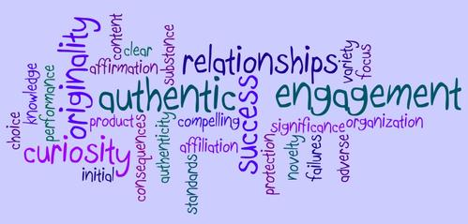
Notes:
This time allows for students to shake the pressures and demands of the day and practice the agreed upon behaviors that build trust and strengthen relationships. Taking the time to connect with the planet helps clear the mind and provide a space for hearing others, processing the work. All contributing to a strong culture for increased levels of student engagement.¹⁶

