Slide 1
Planning for Program Assessment across an Assessment Cycle: A Program Example
Our plan for implementing the new assessment cycle for the BA/BS in Anthropology
September 2023
UA is an AA/EO employer and educational institution and prohibits illegal discrimination against any individual: www.alaska.edu/nondiscrimination

Slide 2
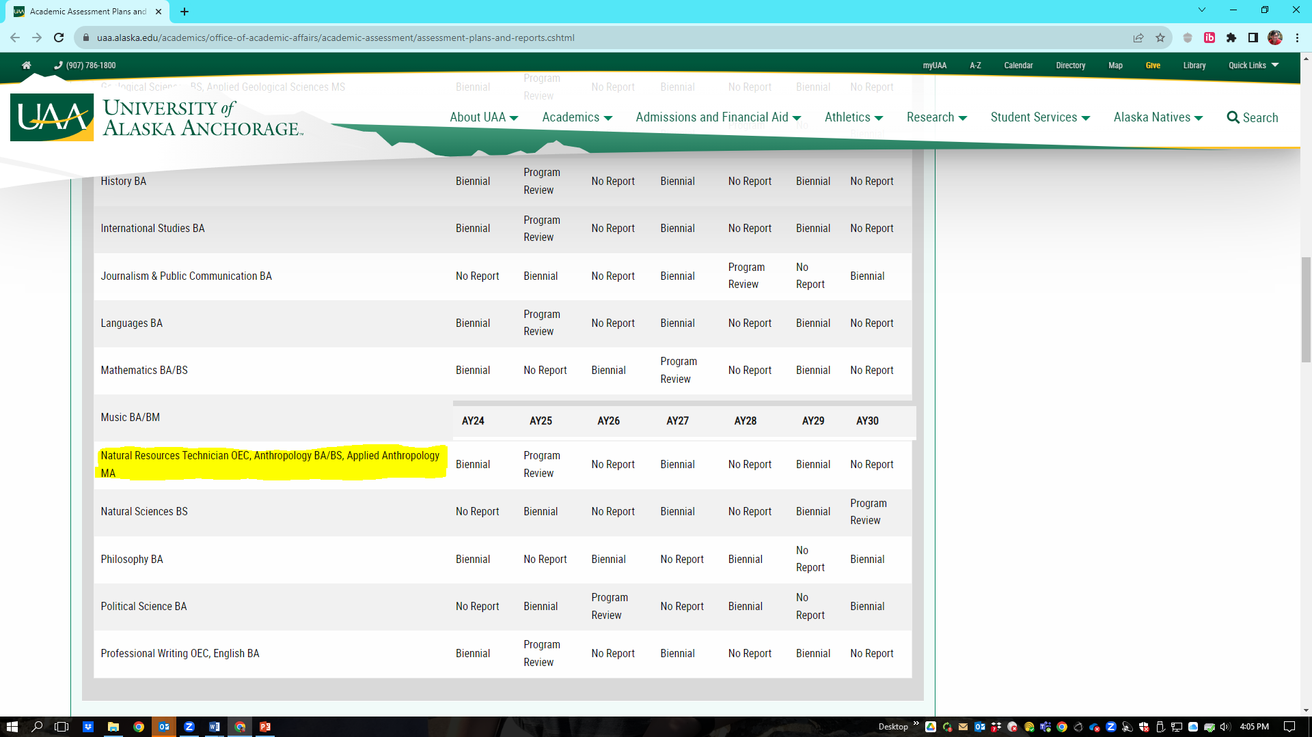
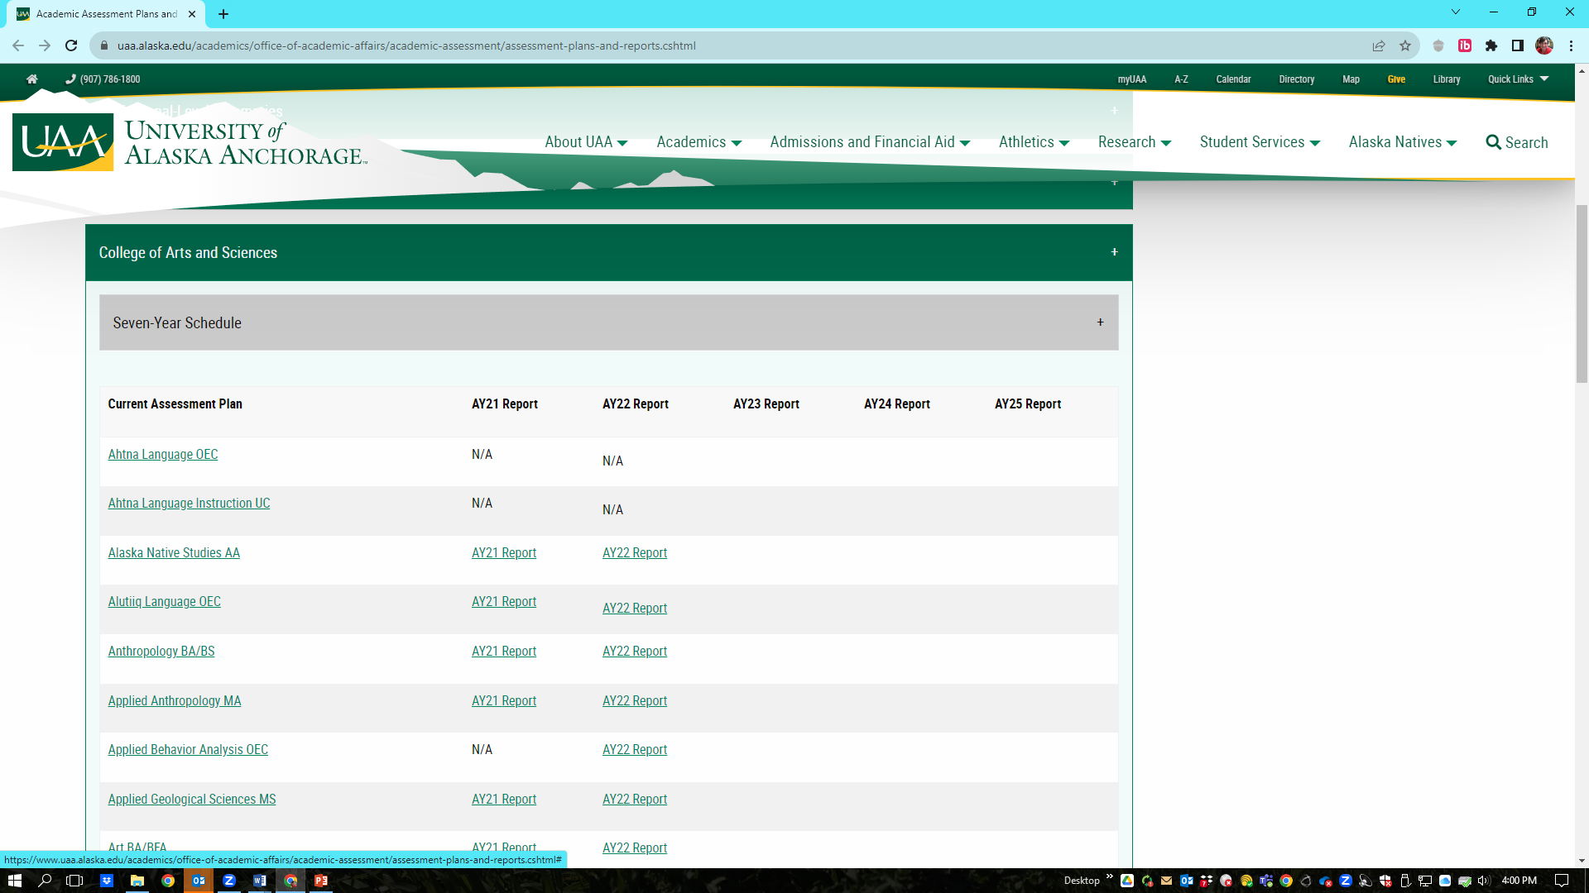
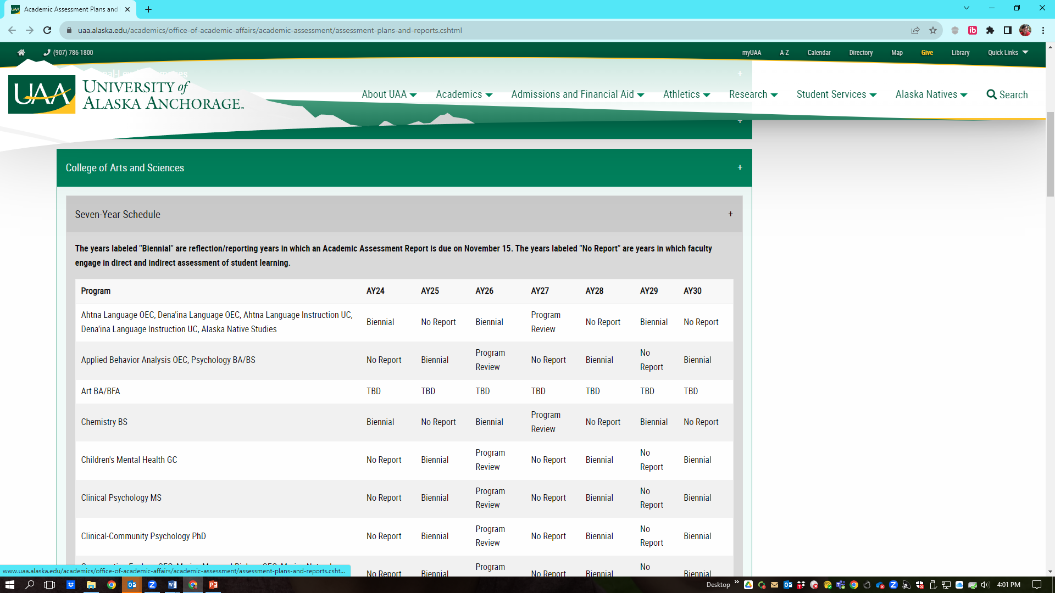
Finding our Assessment Schedule

Slide 3
Mapping the Anthropology Outcomes
Required Program Coursework
200-Level
5 Core Courses in 4 Subfields and Alaskan
Anthropology
300-Level
2 Ethnographic Courses, including 1 Arctic
400-Level
2 Topical-Theoretical, 1 Ethics, and 2 Methods Courses
Culminating
1 Senior-Level Seminar Course with ePortfolio
BA/BS in Anthropology
Program Student Learning Outcomes
Introduced Developed Mastered/Applied
Formative Assessment
Synthesize knowledge of anthropological theory, highlight information literacy and communication skills, and reflect on program outcomes and anthropological education
1. Four-Field Anthropological
Knowledge ❸③⑤⑥⑧
Baseline Assessment
Build foundation of knowledge in four subfields of anthropology, including theory, ethics, information literacy and communication conventions, methods, and Alaska-specific knowledge
Formative Assessment
Integrate four-field knowledge into holistic and comparative perspectives on theory, ethics, and methods while developing anthropological information literacy and communication skills
Strengthen and apply theoretical knowledge, topical and methodological expertise, and anthropological, information literacy, and communication skills
Formative Assessment
Summative Assessment
2. Anthropological Knowledge of Alaska and the Circumpolar North ❸❹⑤⑧
3. Awareness of Ethical
Practice in Anthropology ❷❹⑨
4. Anthropological Information Literacy and
Communication Competency ❶❷❹①⑦⑨
5. Methodological Skills in
Anthropology ❷❹②⑤⑥⑨
Foundational and Developed Core Competencies and General Education Student Learning Outcomes in the UAA Anthropology Baccalaureate Programs:
UAA Core Competencies: ❶ Effective Communication; ❷ Creative and Critical Thinking; ❸ Intercultural Fluency; and ❹ Personal, Professional, and Community Responsibility; UAA General Education Student Learning Outcomes: ① Effective Communication; ② Analytic Reasoning; ③ Historical Context Understanding; ⑤ Social Context Understanding; ⑥ Scientific Thinking; ⑦ Information Literacy; ⑧ Global and Diverse Perspectives; and ⑨ Integrative and Critical Thinking

Slide 4
BA and BS in Anthropology Learning Outcomes
Outcome Category | Program Student Learning Outcome (PSLO)
1. Anthropological Knowledge | Demonstrate a familiarity with the development of anthropological thought and the contemporary concepts, theories, and application of the four subfields.
2. Alaska-Specific Anthro Knowledge | Use anthropological perspectives to describe the past and present cultural diversity of Alaska and analyze contemporary social topics in the Circumpolar North.
3. Ethical Awareness | Identify ethical principles that guide anthropological practice and ethical issues encountered in anthropological research.
4. Information and Communication Skills | Exhibit proficiency in documenting, evaluating, and communicating anthropological information.
5. Anthro Methods | Explain how to apply anthropological methods and techniques to research questions and practical social problems.

Slide 5
7-Year Assessment Based on Schedule on Web
AY24 | AY25 | AY26 | AY27 | AY28 | AY29 | AY30
Biennial | Program Review | No Report | Biennial | No Report | Biennial | No Report
Review and reflect on AY23 assessment and make adjustments as needed | Use data from past cycle of assessment to complete review | Assess PSLOs #1 Anthropological Knowledge and #2 Alaska-Specific ANTH | Reflect and report on PSLOs #1 and #2 and make adjustments as needed | Assess PSLOs #3 Ethical Awareness and #5 ANTH Methods | Reflect and report on PSLOs #3 and #5 and make adjustments as needed | Assess PSLO #4 Information Literacy and Communication Skills
Submit report by November 15 | Submit program report by March 1 | -- | Submit report by November 15 |  | Submit report by November 15

Slide 6
Academic Assessment = Improving Student Learning

Slide 7
Full 7-Year Assessment Cycle
YEAR 1 | YEAR 2 | YEAR 3 | YEAR 4 | YEAR 5 | YEAR 6 | YEAR 7 | YEAR 1
AY25 | AY26 | AY27 | AY28 | AY29 | AY30 | AY31 | AY32
Program Review | No Report | Biennial | No Report | Biennial | No Report | Biennial | Program Review
Use data from past cycle of assessment to complete review, assess any changes, and set goals | Assess PSLOs #1 ANTH Knowledge and #2 Alaska Specific ANTH | Reflect and report on PSLOs #1 and #2 and make adjustments as needed | Assess PSLOs #3 Ethics and #5 ANTH Methods | Reflect and report on PSLOs #3 and #5 and make adjusted as needed | Assess PSLO #4 Information Literacy and Communication Skills | Reflect and report on PSLO #4 and make adjustments as needed | Use data from past 6-year cycle of assessment to complete review, assess any changes, and set goals
Submit program report by March 1 | -- | Submit report by November 15 | -- | Submit report by November 15 | -- | Submit report by November 15 | Submit program report by March 1

Slide 8
Questions?
Comments? Thoughts?

