Slide 1
Using Data to Promote Student Success and the Closing of Equity Gaps
September 27, 2022

Slide 2
Session Overview
Why Are We Doing This? NWCCU and Equity Data
Current UAA Student Success Metrics and Equity Gaps
Closing Gaps with Student Success Programs and the Alaska Native Success Initiative
NWCCU Data Equity Fellowship Goals
Discussion: UAA Equity Data Needs
Q&A

Slide 3
NWCCU & Equity Data
Dr. Susan Kalina
Vice Provost for Academic Affairs & Institutional Effectiveness

Slide 4
NWCCU & Equity Data: What NWCCU Wants
NWCCU Standards
UAA Institutional Accreditation Website

Slide 5
UAA Student Success Metrics & Reports
Dr. Daniel Campbell
Director of Institutional Research

Slide 6
Institutional Level (Accreditation)
Typically include Banner Demographics (Gender, Ethnicity, Age, First Gen, Pell)
Persistence (1st Fall to 1st Spring)
Retention (1st to 2nd Fall and 1st to Subsequent 3rd Fall)
Graduation Rates at the Bachelors (6,8,10) and Associate Levels (4,6,8)
Junior Graduation Rate (Achieve Bachelors after hitting 60 credits)
Semesters to Degree (Graduate Programs)
Leading Indicators
Tier 1 GER Completion in first 30 credits
Course pass rates by course level

Slide 7
UAA Student Success Metrics & Equity Gaps
Jennifer Booz
Chief Diversity Officer

Slide 8
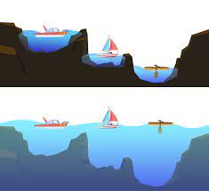
Student Success Metrics & Equity Gaps
What is an Equity Gap?
What do our UAA reports tell us?
Alaska Native
African American
Part time
+25
Programs that address equity gaps benefit all students.
“A rising tide lifts all ships”

Slide 9
Closing Gaps with Student Success Programs
Dr. Melanie Hulbert
Vice Provost for Student Success
&
Dean of the Honor’s College

Slide 10
Whose Job is it Anyway?
If we recognize that there are economic and social imperatives to…….
Programming must start with:
Conversations
Adoption of Equity Mindset toward all institutional decisions
Becoming race (and other inequity)conscious and aware
Intentionally gather and use data to understand UAA patterns
Focus on the “system” not on the “deficits”
Notes:
This is a story about four people named Everybody, Somebody, Anybody and Nobody. There was an important job to be done and Everybody was sure that Somebody would do it. Anybody could have done it, but Nobody did it. Somebody got angry about that, because it was Everybody’s job. Everybody thought Anybody could do it, but Nobody realized that Everybody wouldn’t do it. It ended up that Everybody blamed Somebody when Nobody did what Anybody could have.

Slide 11
A tailored approach:
Success programming:
Tailored to particular student equity gaps
Tailored for the provider
Use disaggregated and aggregated data
No silver bullets – but specific targets

Slide 12
Student Success Initiatives

Slide 13
Closing Gaps with the Alaska Native Success Initiative (ANSI)
Dr. Michele Yatchmeneff
Executive Director of Alaska Native Education & Outreach

Slide 14
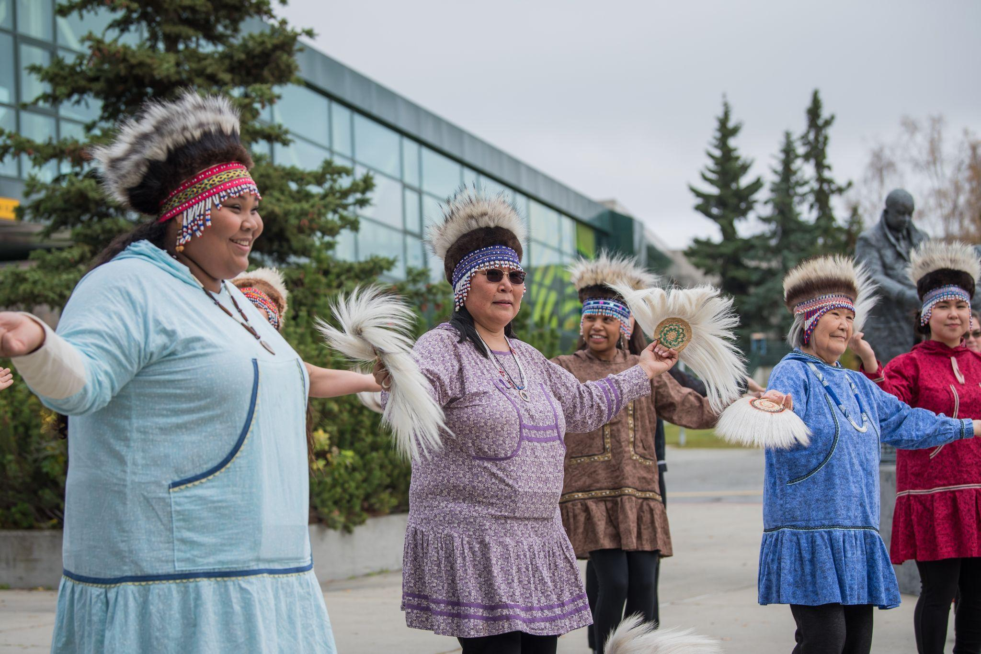
Alaska Native Success Initiative (ANSI)
ANSI VISION: Build an Alaska Native community within UAA and be a global leader in Alaska Native student success, teaching, and scholarship.

Slide 15
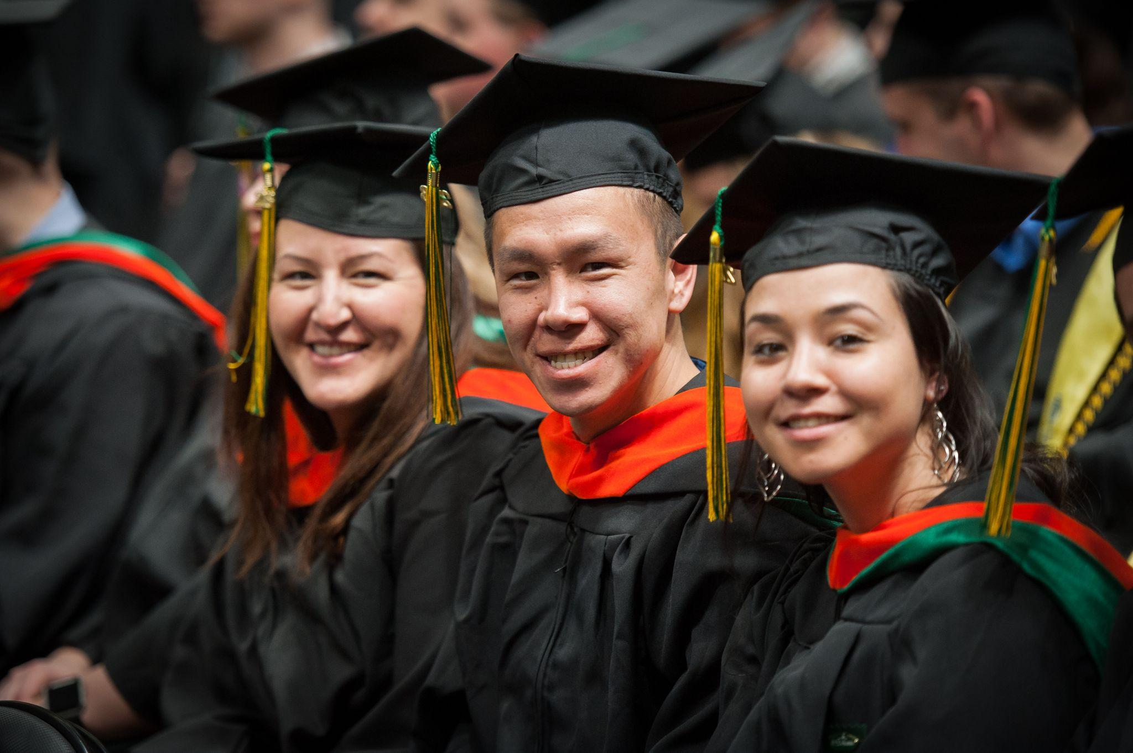
Alaska Native Success Initiative (ANSI) Strategic Plan 2022-2027
PRIORITY 1: ALASKA NATIVE STUDENTS
Increase Alaska Native student preparation, recruitment, retention, and graduation rates.
Goal 1: Eliminate the need for remediation and reduce the time to earn their degree for graduated high school students.
Goal 2: Have 15% of the total enrolled students be Alaska Native.
Goal 3: Increase Alaska Native retention and graduation rates.
UAA 2025 Aspiration 1
We put students first

Slide 16
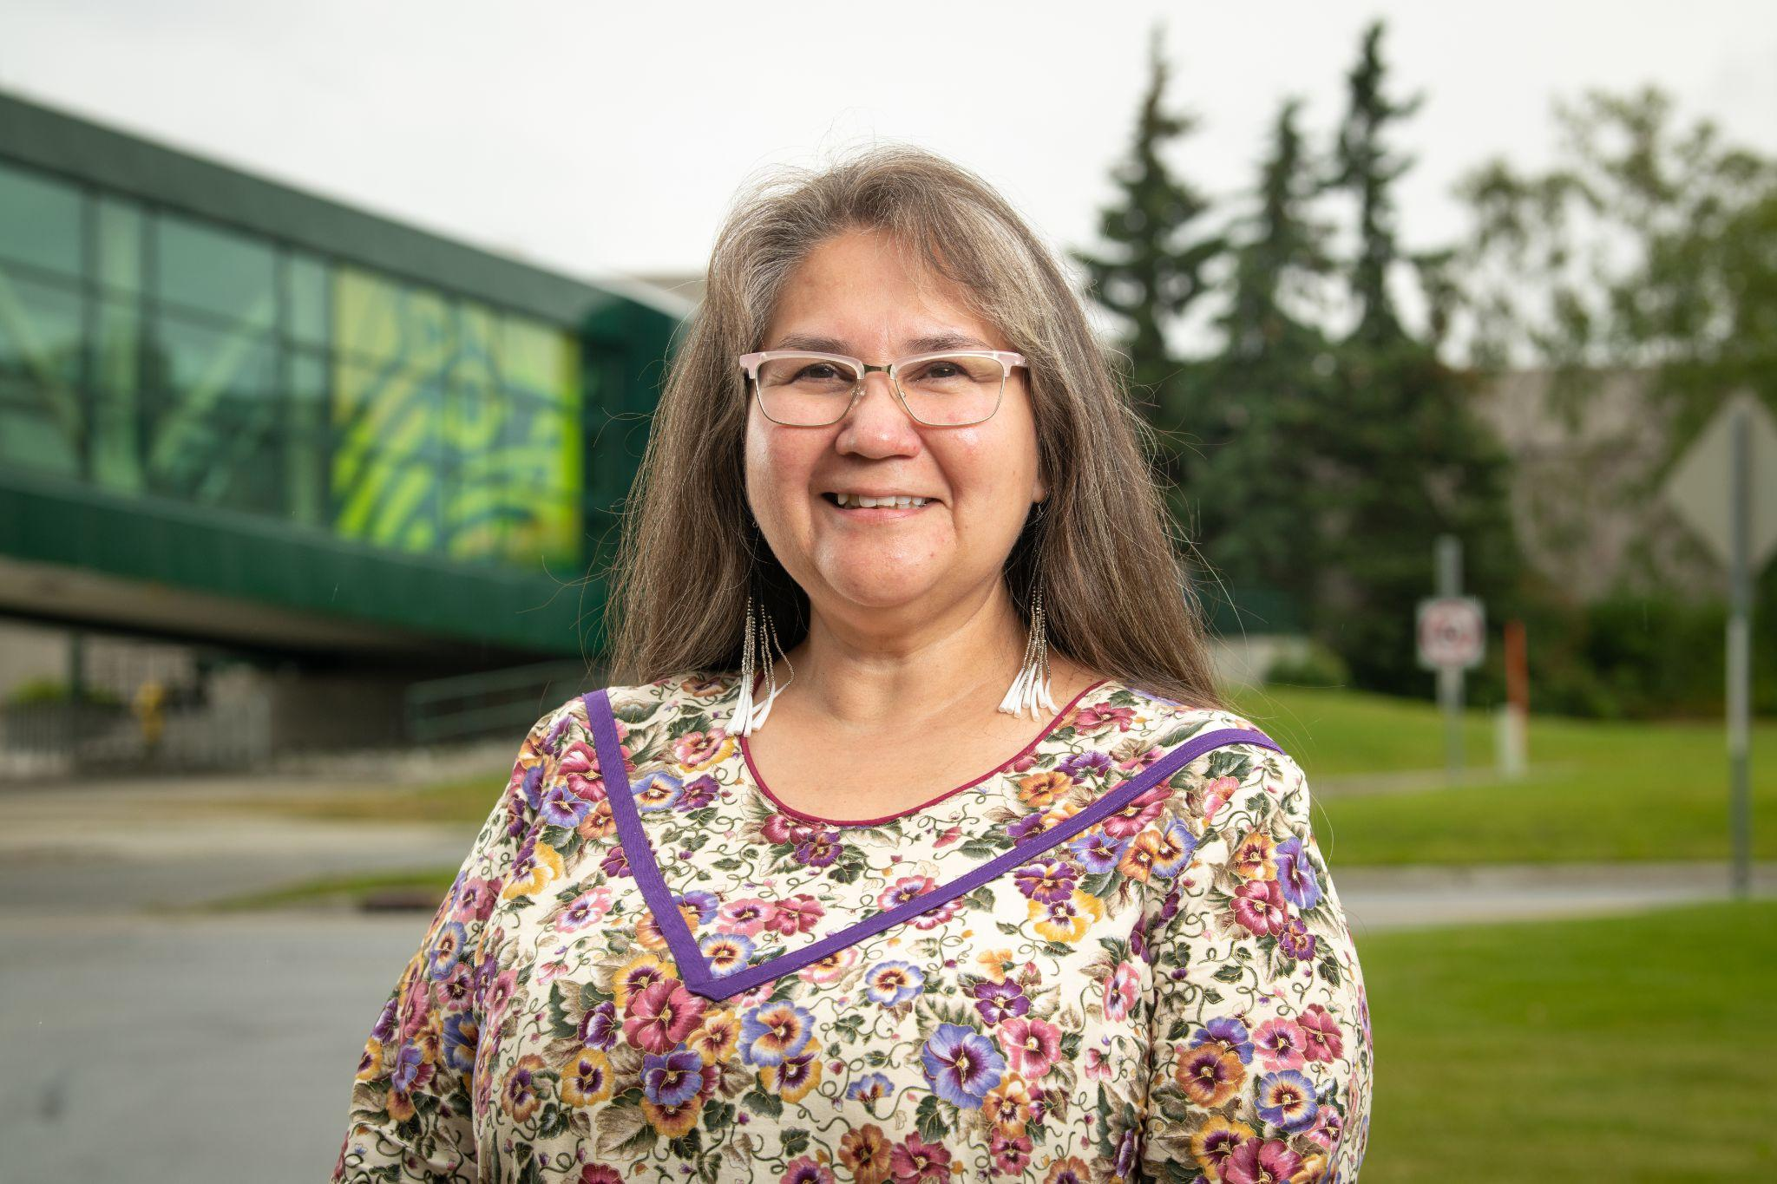
Alaska Native Success Initiative (ANSI) Strategic Plan 2022-2027 (1)
PRIORITY 2: ALASKA NATIVE FACULTY & STAFF
Increase recruitment and retention of Alaska Native faculty and staff.
Goal: Increase the percentage of Alaska Native faculty and staff from 3% to 20%.
UAA 2025 Aspiration 2
We create a culture of equity and inclusion by embracing our diversity

Slide 17
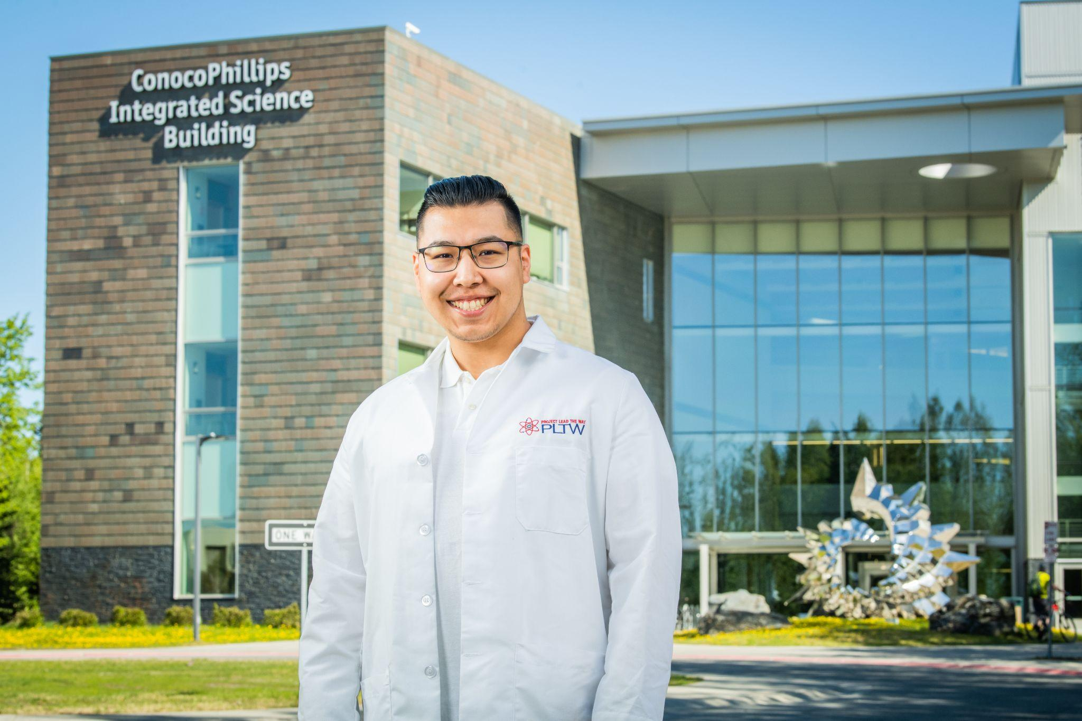
Alaska Native Success Initiative (ANSI) Strategic Plan 2022-2027 (2
PRIORITY 3: INSTITUTION (Internal & External)
Create a culture of belonging for Alaska Native students, faculty, staff, and community organizations.
Goal 1: Resource Alaska Native Academic Departments and Student Support Programs.
Goal 2: Increase Alaska Native representation both internally and externally.
Goal 3: Improve Human Resources’ policies and practices.
UAA 2025 Aspiration 2
We create a culture of equity and inclusion by embracing our diversity

Slide 18
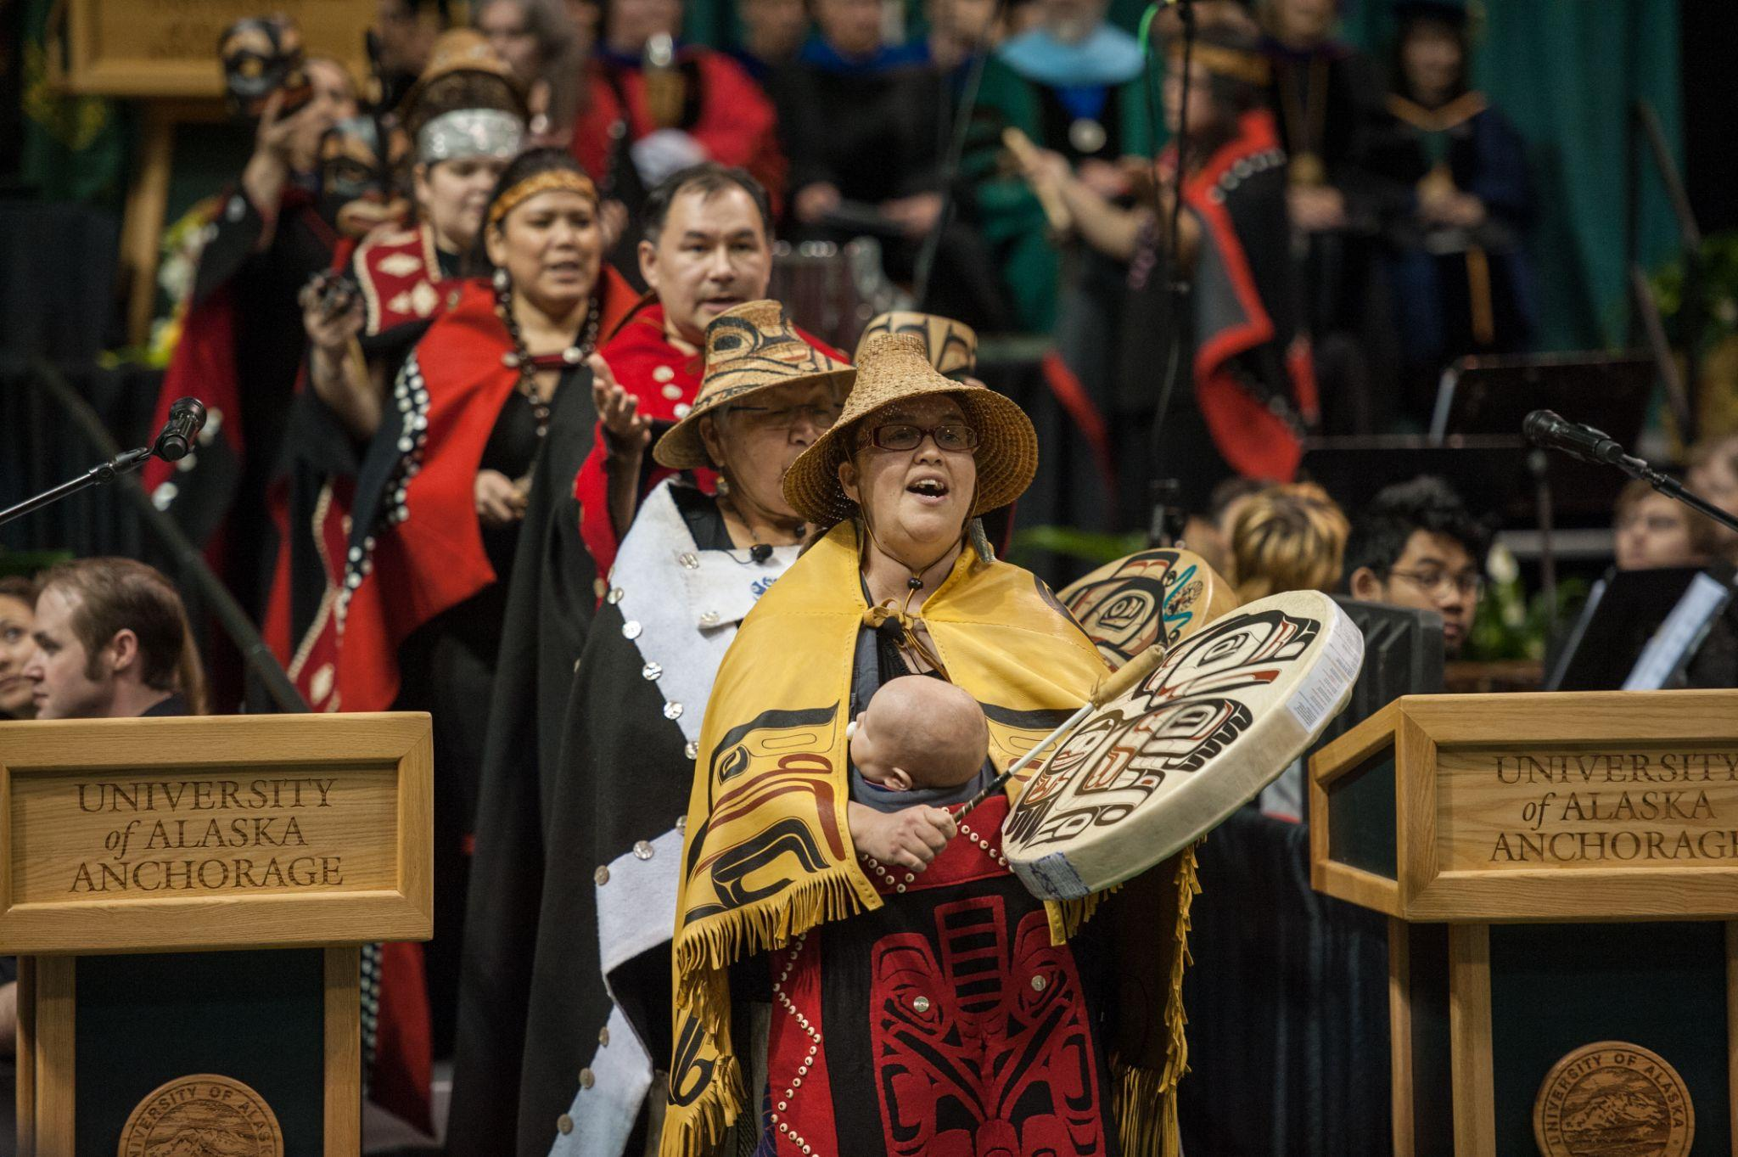
Incorporate ANSI into Everything We Do
Because it will take ALL of us working together to complete this great work
Makes ANSI sustainable
Utilizes current framework for accountability
Resources
ANSI Co-Chairs
ANSI Strategies

Slide 19
NWCCU Data Equity Fellowship Goals
Dr. Kathryn Schild
Lead Instructional Designer, FD&IS

Slide 20
Data Equity Fellowship
GOAL: Improve equitable outcomes at UAA
STRATEGY: Bring together data-focused and equity-focused roles to collaborate on a meaningful data-informed project, supported by national experts, facilitation, and peer education
TEAM: Jennifer Booz, Chief Diversity Officer
Melanie Hulbert, Vice Provost of Student Success
Michele Yatchmeneff, Exec. Dir. of Alaska Native Education & Outreach
Daniel Campbell, Director of Institutional Research
Kathryn Schild, Lead Instructional Designer

Slide 21
Data Equity at UAA
UAA 2025 Aspiration #1: We put students first.
UAA 2025 Aspiration #2: We create a culture of equity and inclusion by embracing our diversity.
To meet these goals, we need:
Accurate and useful metrics to evaluate our progress
Sustainable data practices that put students first
Data stories that treat students and our communities with respect

Slide 22
UAA Data Equity Fellowship Project
GOAL: Improve equitable outcomes at UAA
Synthesize national best practices and equity conversations with Alaska’s specific circumstances to define what data equity looks like at UAA
Evaluate our current data practices from an equity perspective
Develop a project that makes equity data collection and reporting more useful for programs working to close equity gaps

Slide 23
Discussion: UAA Data Equity Needs

Slide 24
What Do You Need?
What equity data does your program use?
Does your program collect equity data?
What questions does your program have around equity gaps? Do you have the data to answer them?

Slide 25
Questions? Ideas?

Slide 26
Thank you!

