Slide 1
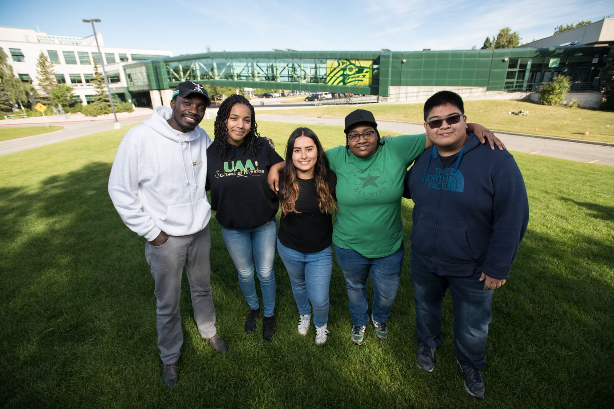
Intercultural Fluency as a Path toward Diversity, Equity, and Inclusion
www.uaa.alaska.edu/diversity
2022 Annual Accreditation/Assessment Seminar Friday, September 16, 2022
Jennifer Booz Chief Diversity Officer
UA is an AA/EO employer and educational institution and prohibits illegal discrimination against any individual: www.alaska.edu/nondiscrimination

Slide 2
Learning Objectives
As a result of participating in today’s seminar, you should be able to:
Articulate a preliminary definition intercultural fluency (IF)
Understand the measurement of IF using a rubric
Brainstorm and list possible IF activities
Describe next steps for the IF Core Competency

Slide 3
The Why
According to the National Association of Colleges and Employers (NACE), intercultural fluency is one of the most important transferable skills students can have when transitioning from college to the workforce.
This Photo by Unknown Author is licensed under CC BY-SA

Slide 4
The Why (cont.)

Slide 5
Developing a Shared Understanding
At UAA
Intercultural Fluency: The knowledge and skills necessary to promote effective and appropriate interaction in a variety of cultural contexts, particularly in terms of the diverse populations of Alaska.
Cultural Competency

Slide 6
Developing a Shared Understanding (2)
AAC&U Value Rubric
VALUE rubrics are open educational resources (OER) that enable educators to assess students’ original work. AAC&U offers a proven methodology for applying the VALUE rubrics to evaluate student performance reliably and verifiably across sixteen broad, cross-cutting learning outcomes.
Have informed our processes in the past.

Slide 7
AAC&U Value Rubric

Slide 8
A Common Definition
Intercultural Knowledge and Competence is “a set of cognitive, affective, and behavioral skills and characteristics that support effective and appropriate interaction in a variety of cultural contexts.” (Bennett, J. M. [2008]. Transformative training: Designing programs for culture learning. In M. A. Moodian [Ed.], Contemporary leadership and intercultural competence: Understanding and utilizing cultural diversity to build successful organizations [pp. 95-110]. Sage.)

Slide 9
A Common Definition 2
cognitive, affective, and behavioral skills
cultural contexts

Slide 10
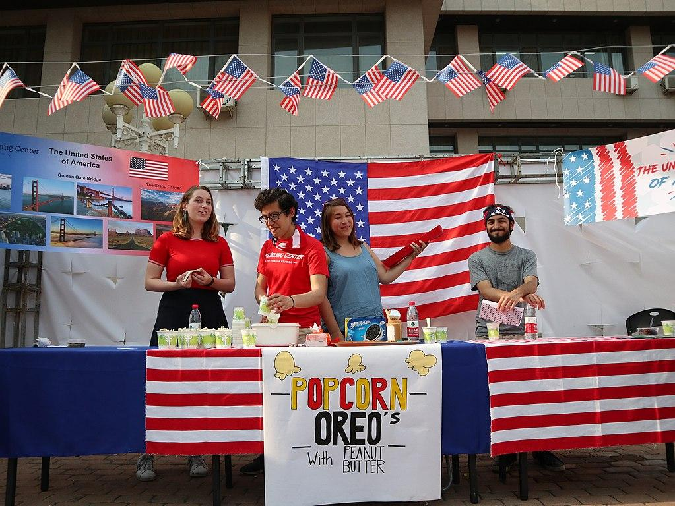
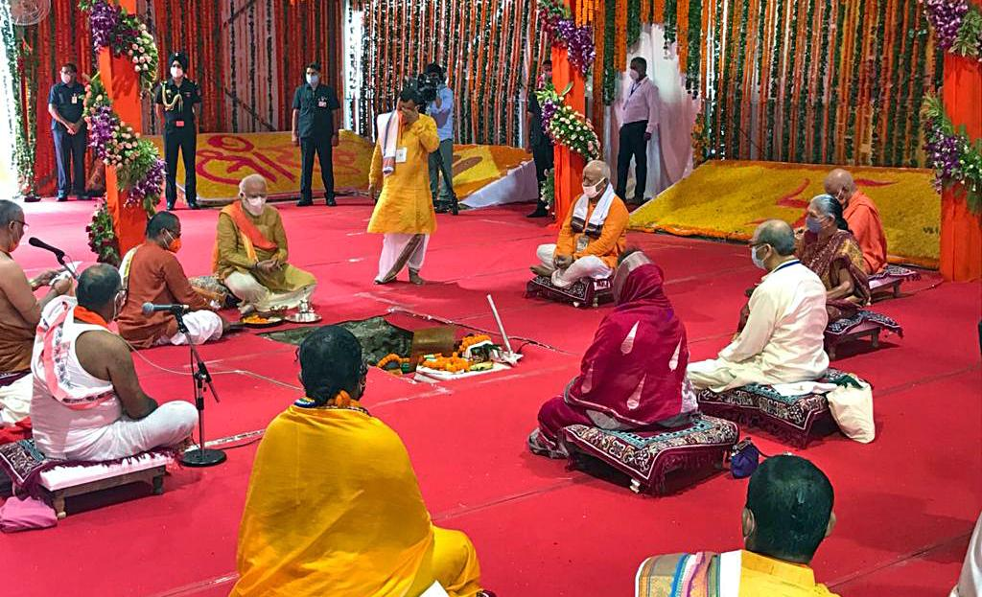
A Common Definition 3
cognitive, affective, and behavioral skills=
think feel act
cultural contexts= Values, norms, beliefs
Anywhere, anytime
This Photo by Unknown Author is licensed under CC BY-SA
This Photo by Unknown Author is licensed under CC BY
This Photo by Unknown Author is licensed under CC BY-SA

Slide 11
UAA Specific
“particularly in terms of the diverse populations of Alaska”
What does this mean for us at UAA?

Slide 12
Glossary
Common terminology:
AAC&U Value Rubric
Chief Diversity Officer Office
UAA Institutional Effectiveness

Slide 13
Rubric

Slide 14
Rubric 2
What else might we at UAA need in our rubric?

Slide 15
Let’s Take a Break!
Up
Next:
Brainstorming
And Reporting
On
Assignments
And
Activities!
This Photo by Unknown Author is licensed under CC BY-SA-NC

Slide 16
Brainstorming Activity
How can you engage students in thinking, feeling, and acting appropriately in a variety of cultural contexts?
Assignments, activities?
Curricular
Co-curricular

Slide 17
Brainstorming Activity 2
10 minutes- solo brainstorming
10 minutes-group share, additional idea generation
15 minutes- report out

Slide 18
Institutional Examples
Curricular
Study Abroad
Languages
Electives
Non-Eurocentric perspectives
DEI GER and AN GER

Slide 19
Institutional Examples 2
Co-curricular
Multicultural student organizations
History and heritage month events
Multicultural Student Services (MSS) and Native Student Services (NSS) events

Slide 20
Next Steps
Rubric adaptations
October 28th Open Forum- finalize
Generate assignments
Best practice examples to be shared-volunteers?
Reach out for more information/assistance
What else do we need to consider?

Slide 21
Next Steps-What We Learned
As a result of participating in today’s seminar, we can:
Articulate a preliminary definition intercultural fluency (IF)
Understand the measurement of IF using a rubric
Brainstorm and list possible IF activities
Describe next steps for the IF Core Competency

Slide 22
Thank you!
www.uaa.alaska.edu/diversity

