Slide 1
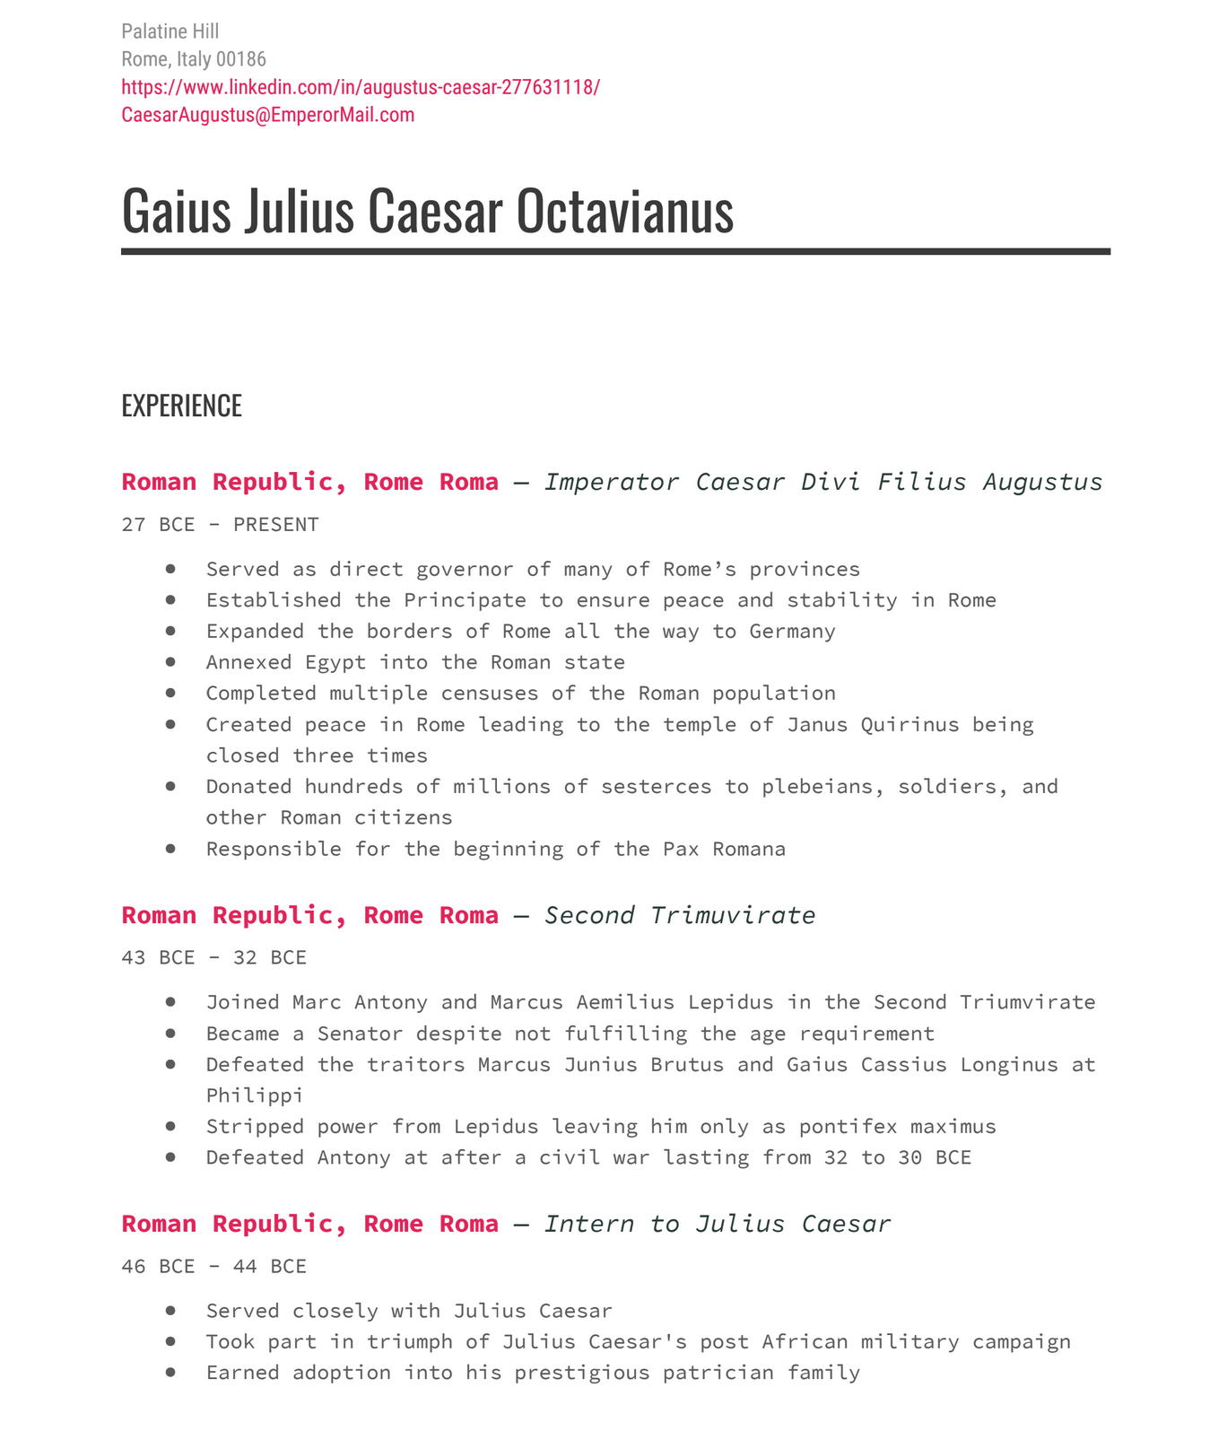
Integrating the Core Competencies into CAS’s College to Career Project with AAC&U
Survey level course and Gen Ed
Many students outside major and outside of CAS
Numerous first-generation, Middle College/ANSEP students
Online and asynchronous
Higher DNF/F challenges but also opportunities
Close reading and note-taking
An introduction to ideas of different genres of sources and different kinds of audiences
Historical empathy and appreciation of diversity of cultures and ways of living/belief/knowing → intercultural fluency

