Slide 1
Integrating Core Competencies at Kodiak College – ANTH A200 Alaska Native Cultures
2023 Accreditation Kickoff – Libby Eufemio, Asst. Prof. of Alaska Native Studies
Alutiiq Studies Program, Kodiak College

Slide 2
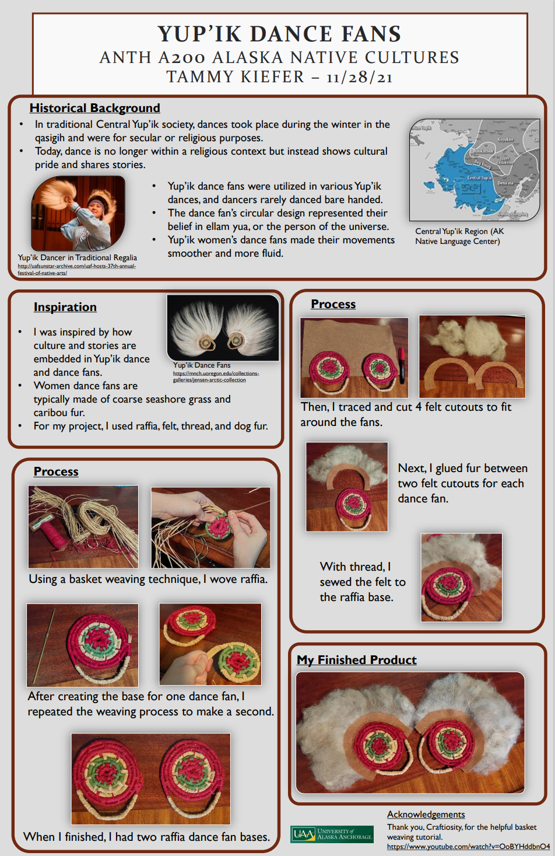
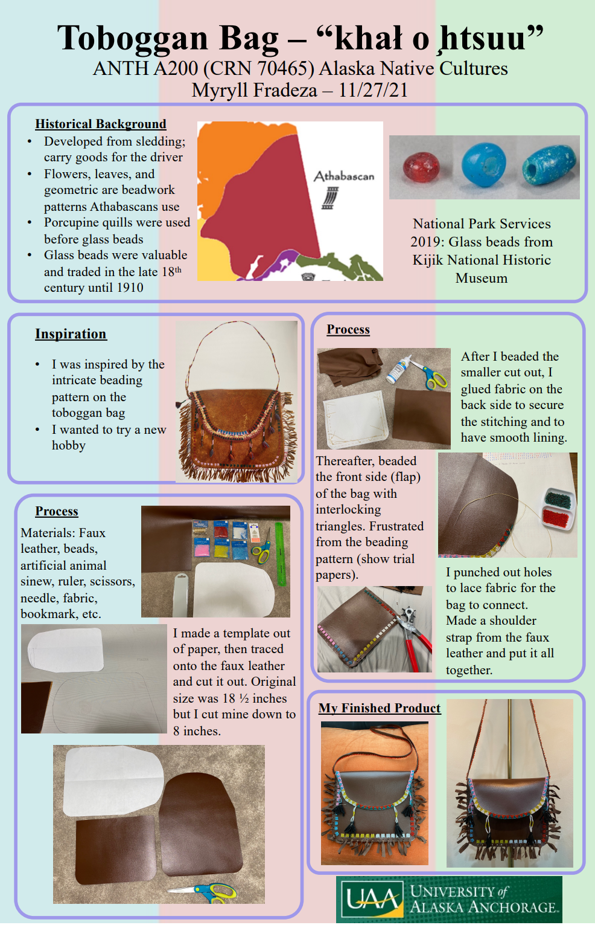
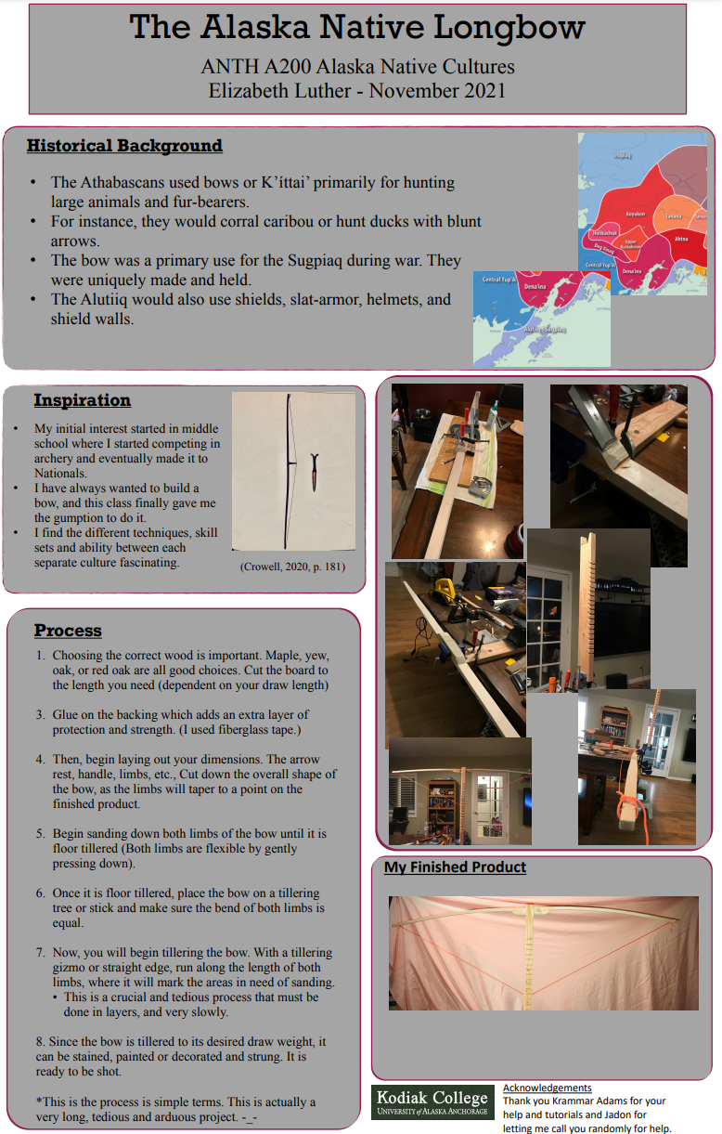
ANTH A200 Final Project – Make, do, or recreate an object or process inspired by Alaska Native Culture
Effective
Communication
Intercultural
Fluency
Project requirements:
Poster, in-class presentation
& written paper
Creative & Critical Thinking

Slide 3
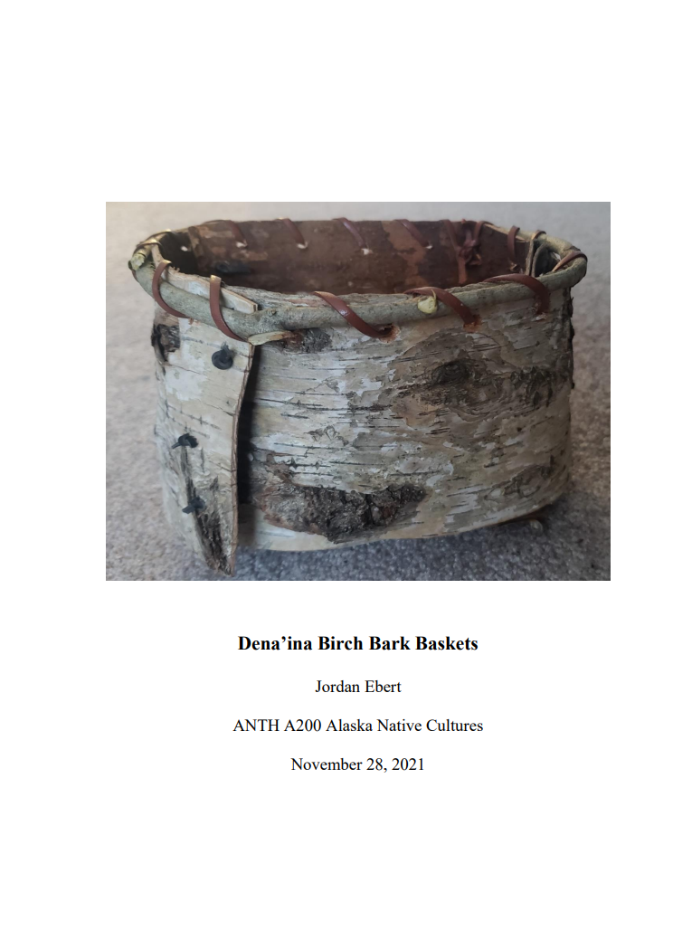
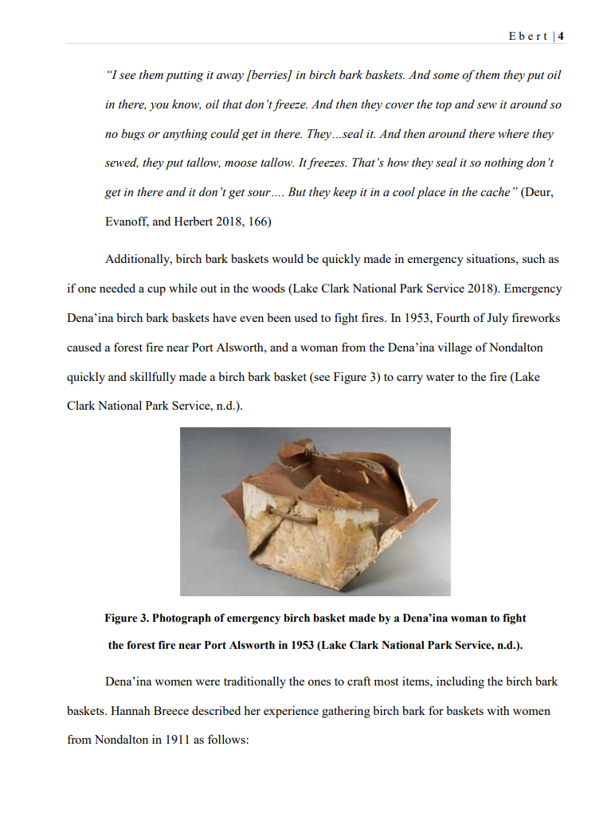
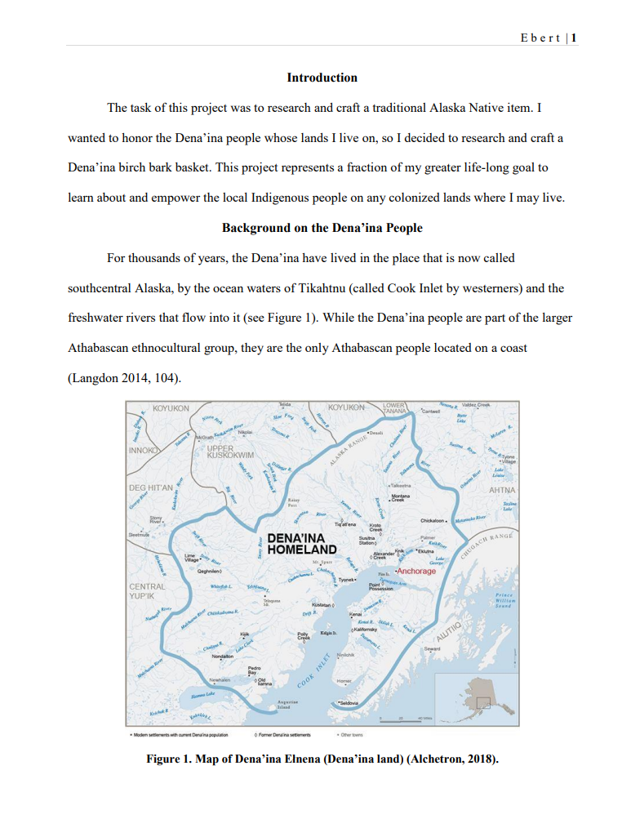
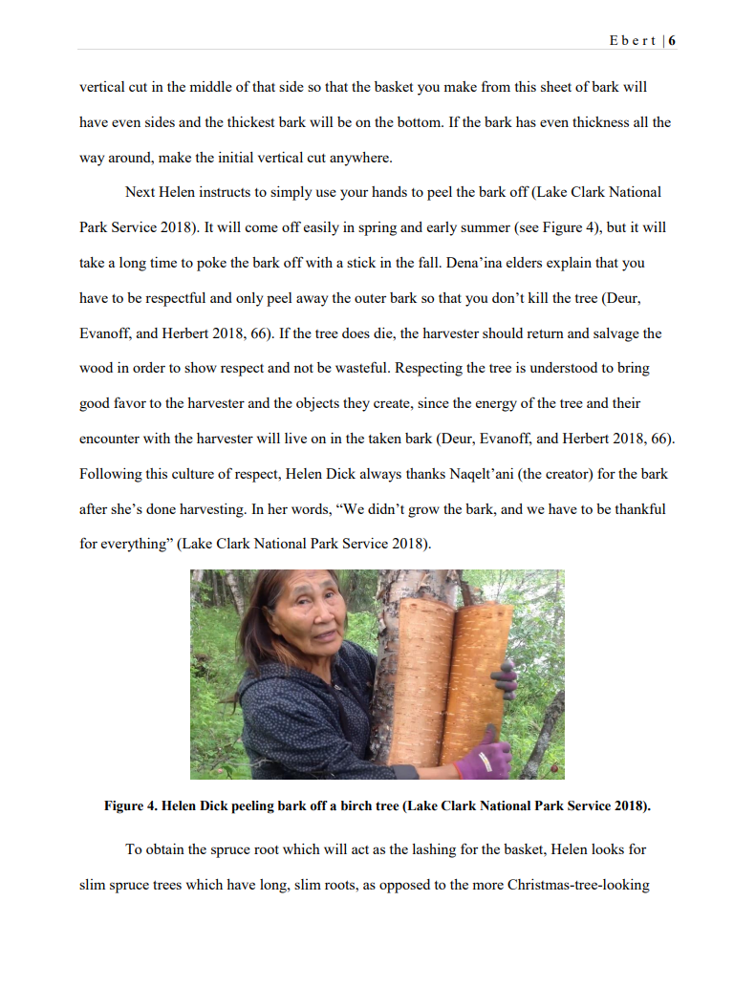
A Journey of Discovery through the Core Competencies
“After this project, it is also more obvious to me how much skill it takes to create the beautiful, symmetrical, waterproof Dena’ina birch bark baskets. I have so much respect for the Dena’ina people’s ingenuity, skill, and hard work to live off the land via artful creations like the birch bark basket, and for their resilience to keep these traditions alive throughout modern colonized times.”

