Slide 1
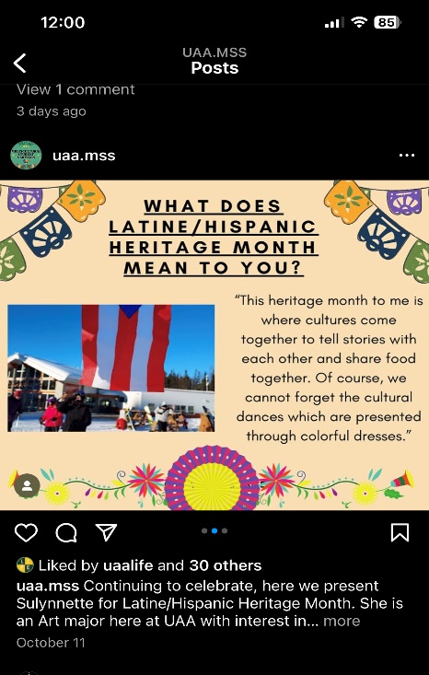
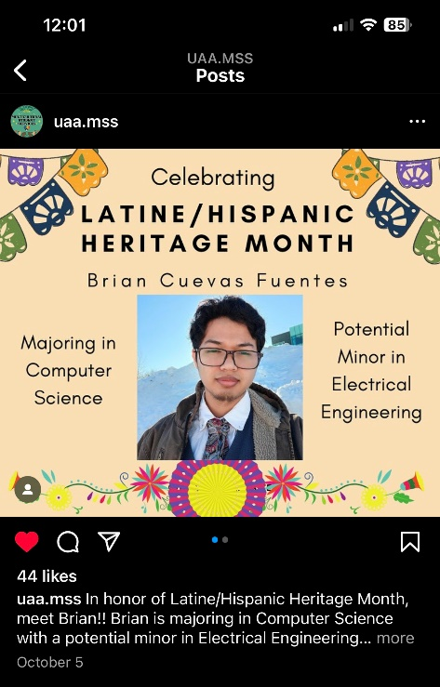
UAA Student Affairs
Integrating and Modeling Effective Communication
Effective Communication: The knowledge and skills necessary to engage in effective communication in diverse contexts and formats.

