Slide 1
Cash Handling, PCI Compliance, AR Billing
Charlene Robertson and Michelle Weaver

Slide 2
UNIVERSITY OF ALASKA CASH POLICIES
Timely Deposits
Funds in excess of $200 of currency or $500 in checks must be deposited daily.
Funds must be stored in a locked container in a secure facility.
Lesser amounts must be deposited weekly.
No funds should be held over one week in ANY circumstance.
Exceptions to these restrictions may be authorized by the MAU Chief Financial Officer.
BOR section 100: Accounting and Finance

Slide 3
UNIVERSITY OF ALASKA CASH POLICIES CONT’D
Other
Pre-Numbered receipts
Checks must be for amount of purchase only
Checks may not be cashed
Credit Card refunds will be processed in accordance with current credit card regulations.
Under no circumstances may any member of the faculty, staff or student body realize personal gain through the handling of University funds.
BOR section 100: Accounting and Finance

Slide 4
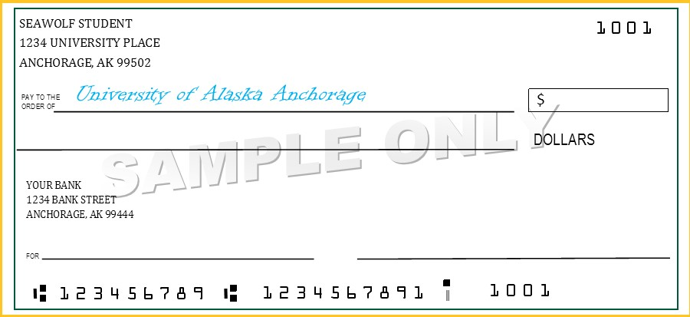
Paper Checks
No post dated checks
No cashed checks
No 3rd party checks
No International checks
Make sure the spelled out dollar amount to the numerical dollar amount
Get a phone number if it’s not printed on the check
All routing numbers are a total of 9 digits, anything more or less should draw a red flag
All checks need to be signed
What does a completed check look like?
10/10/17
10.00
Ten dollars and no/100
Suzie Seawolf

Slide 5
PHYSICAL SECURITY OF CASH
Cash and checks need to be protected at all times.
Lock the cash and checks in a safe or locking fire-proof cabinet
Ensure the safety of those transporting the cash
Make sure the security bag is locked/sealed
Utilize armored courier service
Travel in 2’s which will ensure dual custody
Use the drop box at the University Center (next to Cashiering window 1)
Keep minimum cash on hand
Mail which may contain cash/check payments should be opened under dual control
Log checks upon receiving
Document custody of cash/checks start to finish (mail to UC drop box)

Slide 6
Fraud Controls
Know your bills!
Feel the paper for texture, if they are too smooth– they could be counterfeit
Use the Fraud pen
Paper checks should be written by the account holders, verify ID if needed
When processing credit card payments, verify ID to ensure they are the card holder

Slide 7
TIPS ON CASH CONTRILS
When in doubt, dual control
Segregation duties
Management or Supervisor review. When you sign the bottom of the cash transmittal…you are validating the form
Lock your drawer, use your safe
Issue receipts
Train, retrain, and provide refresher-training for your staff
Remember that controls are in place to protect the employees and the University
Verify the controls you put in place are used

Slide 8
Cash Handling Resources
You Tube- https://www.youtube.com/watch?v=CtnVYZpClZE
UA Cash Management Policy: http://www.alaska.edu/controller/acct-admin-manual/acct-and-finance/C-07.pdf
US Currency Education Program- bill identification and security features (images): https://www.uscurrency.gov/seven-denominations
US Dept of Treasury instructions on what to do when you suspect Counterfeit currency: https://www.treasury.gov/about/organizational-structure/offices/Treasurer-US/Pages/if-you-suspect.aspx

Slide 9
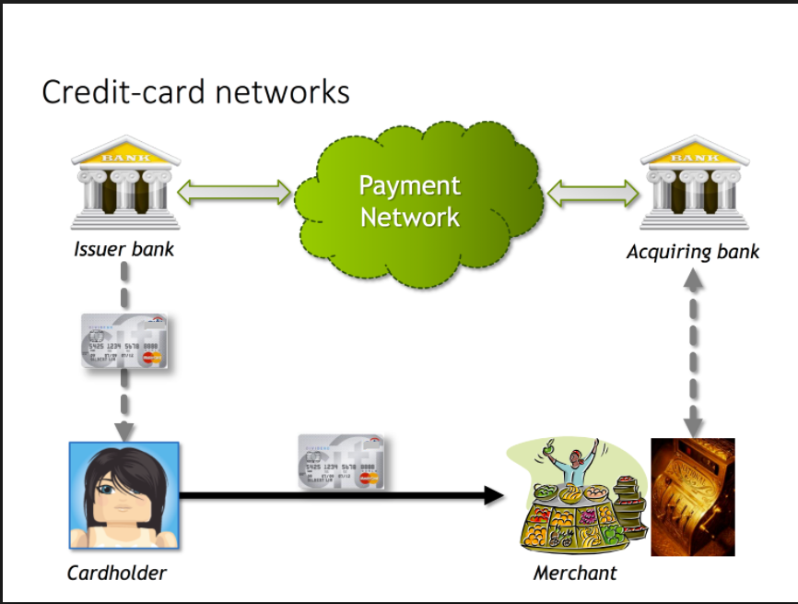
PCI COMPLIANCE
The Payment Card Industry Data Security Standard (PCI DSS) is a set of security standards designed to ensure that ALL companies that accept, process, store or transmit credit card information maintain a secure environment.

Slide 10
TIPS FOR MERCHANTS
Process credit card transactions immediately
Never write down the CC #, expiration date, and the CVV2 code
When you make changes to your hardware, software or website that interacts with CC information please notify Accounting Services immediately; this includes moving your office or any hardware associated with credit card payments
Secure your machine when not in use
Monitor the traffic through your MID to make sure its relative to your revenue deposits
Provide PCI training for your cash handlers

Slide 11
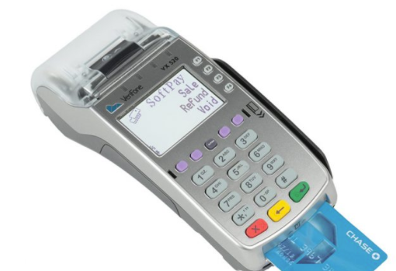
Ecommerce and credit card machines
UAA uses Touchnet for all online payments
Departments may request a Touchnet store front, cost to the department is only the CC fees
In person credit card payments
For special events, Accounting Services owns a wireless, PCI compliant, CC device you may rent ($50/day)

Slide 12
AR Billing
Outside company billed by UAA department for services rendered
Purchase Order
Please secure a purchase order or letter of agreement from each outside agency before providing any services.
Ensure that any agreement includes an agreement to pay, and our collections wording.

Slide 13
AR Billing
Required Information on the Invoice
Description of services
Authorized price
Billing address
Telephone number
Email address
Complete company legal name
Contact person at the organization
Due date (should be no more than 60 days from the time it was invoiced)
Invoice Form
Complete the pre-numbered Financial Services invoices (electronic format)

Slide 14
AR Billing
Deadline for Year End
Invoices are due no later than five (5) working days prior to the last day of the month to ensure that the revenue will be recorded in the correct month.
Payments
All payments remitted to the University must include the Financial Services Invoice Number to accurately and efficiently apply the payments to the accounts.
Please do not collect payment at your locations.
Paying by Check
University of Alaska Anchorage
Attn: Cashiering
P.O. Box 141609
Anchorage, AK 99514-1609

Slide 15
UAA Student Accounts
Student refunds and financial aid disbursements
Agency funded students
Military Billing
Private donor scholarship posting
Setting up of UAA course fees in Banner (via curriculum workflow)
Programming of Banner tuition and fee structure
Facilitate and calculate International tax withholdings for UAA students

Slide 16
UAA Collections Department
Provide assistance with Tuition Management Systems payment plans
Provide assistance with Employee payroll deductions (pmt to student accounts)
Review and apply holds to student accounts
Negotiate with students to collect payment
Review and refer student accounts to collections agencies
Manage PFD garnishment process for UAA

Slide 17
AR & CASHIERING DEPARTMENT
UAA Accounting Services
LOCATION: 3901 Old Seward Highway, Anchorage AK
PHONE: 907-786-1440
EMAIL: uaa_cashiering@alaska.edu, uaa_collections@alaska.edu, uaa_depart_billing@uaa.alaska.edu
HOURS:
Monday 11AM – 5PM
Tuesday 11AM – 5PM
Wednesday 11AM – 5PM
Thursday 11AM – 5PM
Friday 11AM – 5PM
Don’t forget to check out our website: https://www.uaa.alaska.edu/about/administrative-services/departments/financial-services/accounting-services

Slide 18
QUESTIONS?
Charlene Robertson
UAA Accounting Services Manager
cerobertson3@alaska.edu
907-786-1089

