Slide 1
Governance Basics
System Governance at the
University of Alaska

Slide 2
UA
Board of Regents
Decision-making authority

Slide 3
UA Board of Regents
AUTHORITY
  The University of Alaska is established by the Constitution of the State of Alaska
  The Constitution states the University of Alaska will be governed by a Board of Regents
  The Board of Regents sets policy for the University
  The Board of Regents appoints the President

Slide 4
UA Board of Regents
MEMBERSHIP
  UA Regents are appointed by the Governor and confirmed by the Legislature
  11-member Board, including Student Regent
  Serve 8-year terms
  Student Regents serve 2-year terms
  Members are not nominated to the position but rather apply to serve

Slide 5
UA Board of Regents
MEETINGS
  UA Board of Regents meets five times each year
  January, March, June, September and November
  Four business meetings and one retreat
  Committee meeting are held by video the week before business meetings
  Actions approved by committee are added to a consent agenda for approval by the full board

Slide 6
UA Board of Regents
MEETINGS in FY19
  September 13-14, 2018 – Juneau
  November 8-9, 2018 – Fairbanks (budget)
  January 17-18, 2019 – Anchorage (retreat)
  February 28 – March 1, 2019 – Anchorage
  June 6-7, 2019 – Fairbanks

Slide 7
UA Board of Regents
COMMITTEE MEETINGS in FY19 (by audio)
  September 6-7, 2018
  November 1-2, 2018
  February 21-22, 2019
  June 1-2, 2019

Slide 8
UA Board of Regents
AGENDA PREP – MATERIALS ARE DUE EARLY
  Materials are typically due to the president’s office for review a month before the BOR meeting
  After president’s review, passed to the Board Office to be added to the agenda
  Agendas are distributed to regents and published online two weeks in advance of regular meetings

Slide 9
UA Board of Regents
COMMUNICATION
  UA Board accepts comments and questions at any time
  Public testimony is now held by audio the week before business meetings
  Community forums are held for in-person interaction the evening of the first day of business meetings
  Email contact available for the Board Office and for individual regents
  ua-bor@alaska.edu

Slide 10
summit team& System-wide councils
System-wide groups for system-wide issues

Slide 11
SUMMIT TEAM
RE-ORGANIZATION
  Originally created by President Gamble and made up of the president, chancellors, provosts, and vice presidents
  President Johnsen re-organized the Summit Team in summer 2017
  The group now consists of over 30 key decision makers across the University
  Now includes chairs of the system governance groups

Slide 12
SUMMIT TEAM
MEETINGS & MEMBERSHIP
  4-hour monthly meetings via video
  Twice yearly in-person meetings
  Direct line of communication from system-wide councils to Summit Team
  Includes chancellors, provosts, vice chancellors, vice presidents, associate vice presidents, and chief officers
  Chairs of the four system governance groups

Slide 13
SUMMIT TEAM
MEETINGS in FY19
  July 19
  August 16
  September 20
  October 18
  November 15
  December 13
  January 10
  February 7
  March 7
  April 4
  May 2
  June 13

Slide 14
SYSTEM-WIDE COUNCILS
NEW COUNCILS
  Academic
  Research
  Student Services
  Human Resources
  Information Technology
  Business (formerly Finance)
  Development & Alumni
  University Relations
  Institutional Research
  Community Campus Directors

Slide 15
SYSTEM-WIDE COUNCILS
COUNCIL OBJECTIVES
  Tasked with supporting collaboration and aligned development of policies, programs and processes
  Councils review proposals made by Staff Alliance
  Academic Council and HR Council are working on the proposed revisions to the emeritus regulations
  Business Council is working on automating processes

Slide 16
SYSTEM-WIDE COUNCILS
MEMBERSHIP
  Chair of each council serves on the Summit Team
  Several members serve on multiple teams
  The one member of governance (system or campus) can serve on each of the system-wide councils

Slide 17
SYSTEM-WIDE COUNCILS
MEMBERSHIP
  Governance representatives will need to be approved by the Alliance, the UA president and the council chair
  Provide Staff Alliance with regular written updates

Slide 18
System governance at ua
System-wide groups for system-wide issues

Slide 19
System governance
Chapter 03.01 – Faculty, Staff, and Student Governance
REGENTS’ POLICY
  Establishes authority of groups
UNIVERSITY REGULATION
  Details specific rules for system and MAU governance

Slide 20
System governance
UA System Governance is comprised of:
  Staff Alliance
  Faculty Alliance
  Coalition of Student Leaders
  System Governance Council
These groups take up matters that affect the university system as a whole.

Slide 21
System governance
STAFF ALLIANCE
  Eight (8) staff representatives
  Two from UAA, UAF, UAS, and SW
  Works on system-wide staff initiatives
  Reviews policy/regulation changes

Slide 22
System governance
FACULTY ALLIANCE
  Nine (9) faculty representatives
  Three from UAA, UAF, and UAS
  Works on system-wide faculty or academic related initiatives
  Reviews policy/regulation changes

Slide 23
System governance
COALITION of STUDENT LEADERS
  Ten (10) student representatives
  One from each campus: Anchorage, Fairbanks, Juneau, Kachemak Bay, Kenai, Ketchikan, Kodiak, MatSu, Prince William Sound, Sitka
  Works on system-wide student initiatives
  Reviews policy/regulation changes
  Advocates with the legislature

Slide 24
System governance
SYSTEM GOVERNANCE COUNCIL
  Nine system representatives
  Two staff, faculty, and student representatives
  Three alumni representatives
  Works on system-wide initiatives that affect multiple groups
  Reviews policy/regulation changes

Slide 25
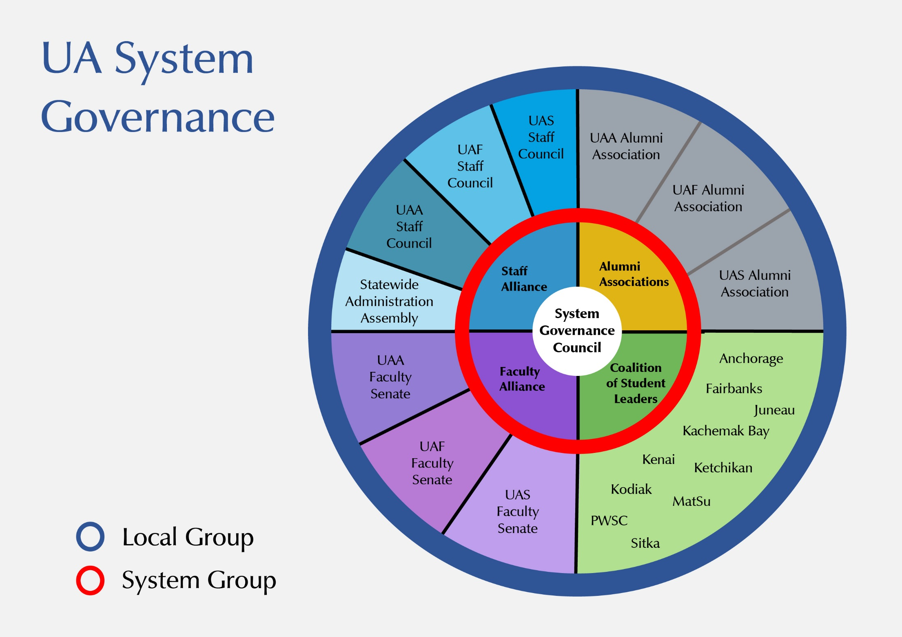

Slide 26
Staff
Alliance
Providing input and representation on issues that impact staff at UA

Slide 27
Staff Alliance
COMMITTEES
  Staff Health Care: provide input on the staff health care and benefits package; communicate to UA staff
  Compensation: provide recommendation on compensation increase to UA president
  Morale: help assess and boost morale across UA

Slide 28
Staff Alliance
POLICY & REGULATION REVIEWS
  Review proposed changes or new drafts
  Respond within thirty (30) days
  Can request an additional thirty (30) days

Slide 29
Staff Alliance
ALLIANCE LEGISLATION – PRESIDENT
  Sent to the president for approval
  President has forty-five (45) days to respond
  Generally consists of approval, rejection, or modification of the Alliance proposal

Slide 30
Staff Alliance
ALLIANCE LEGISLATION – BOR
  Sent to the BOR for approval
  Regents have ninety (90) days to respond
  Generally consists of approval, rejection, or modification of the Alliance proposal

Slide 31
Review Process – best practice
New items are brought to Staff Alliance by members, administration, or staff
Alliance members review and discuss
Items are shared with local staff councils for review
Staff council feedback is sent back to Staff Alliance
If proposal is initiated by governance, Staff Alliance works with other governance (Faculty Alliance and Coalition of Student Leaders) as well as system councils on vetting (HRC, AC, ITC, BC, etc.)
Once feedback has been received from governance and system councils, Staff Alliance can pass a resolution and share with the president

Slide 32
Review Process – best practice
If Staff Alliance just passes a resolution without seeking feedback from other governance groups and the system councils, it may delay the outcome.
Working with other groups encourages collaboration and increases the chances the proposal will be approved.

Slide 33
Staff alliance
STAFF MAKE STUDENTS COUNT
  UA President’s Staff Award
  Staff members who have made a contribution to the student experience
  Solicitations made by Staff Alliance
  Local groups make award recommendations

Slide 34
Staff alliance constitution & bylaws
Basic rules relating to SA

Slide 35
SA Constitution
PURPOSES
  Opportunity for UA staff to play a meaningful role in matters affecting their welfare
  Provide consultation to the UA president and BOR
  Address matters through legislative action
  Advise the UA president and VPAAR
  Communication to UA staff information of interest
  Provide representatives to UA System Governance Council

Slide 36
SA Constitution
RESPONSIBILITIES
Include but not limited to:
  Staff affairs personnel policies and regulations
  Compensation
  Benefits
  Any other issues affecting the work environment and general welfare of university staff

Slide 37
SA Constitution
MEMBERSHIP
  Two representatives from UAA, UAF, UAS, and SW
  Local groups decide on representative selection
  Representatives serve a 1-year term (minimum)
  Any other issues affecting the work environment and general welfare of university staff

Slide 38
SA Constitution
OFFICERS
  The chair and vice chair are elected annually from current Alliance members. Officers serve a term of one year or until a successor is elected.

Slide 39
SA Constitution
MEETINGS
  The Staff Alliance is required to meet at least six (6) times per year.
  All meetings are open to the public.

Slide 40
SA BYLAWS
IN the BYLAWS
  Section1. Officer Duties
  Section 2. Meetings
  Section 3. Quorum
  Section 4. Parliamentary Authority

Slide 41
SA BYLAWS
Section1. Officer Duties
  Chair: preside over meetings, represent the Alliance, and serve as primary contact to the UA president and Board of Regents

Slide 42
SA BYLAWS
Additional chair duties not in bylaws
  Write the staff portion of the governance report for the Board of Regents agenda
  Attend both days of the Board meeting
  Meet monthly with UA president
  Serve on System Governance Council
  Attend monthly Summit Team meetings

Slide 43
governance resources
Staff support & communications

Slide 44

SW Office
Morgan Dufseth
Executive Officer
mdufseth@alaska.edu
Butrovich 208D
907-450-8042

Slide 45
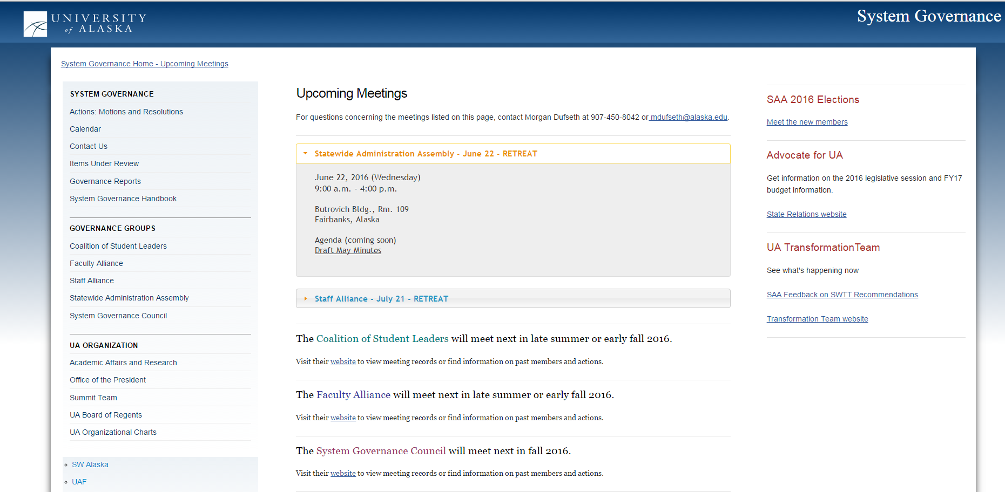
Governance website
Upcoming meeting information & materials
System group information
Items under review

Slide 46
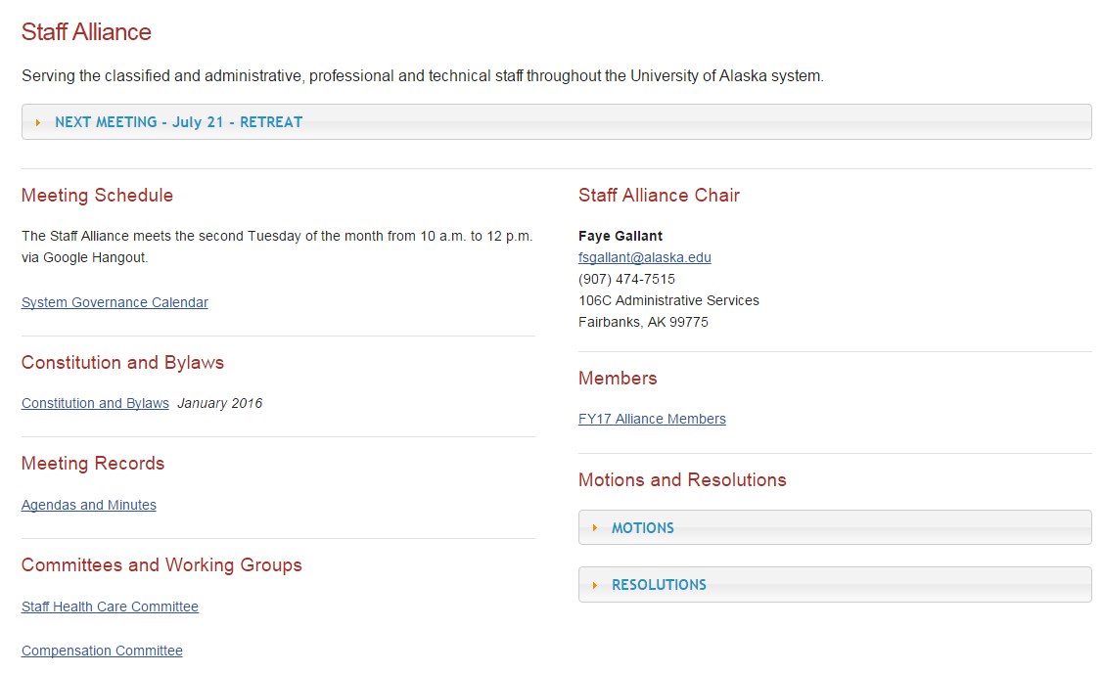
SA website
Past Agendas & Minutes
Alliance-specific information
Alliance Resolutions & Motions

Slide 47
URLs
alaska.edu/governance/
alaska.edu/governance/staff-alliance/

Slide 48
Sender beware
COMMUNICATIONS
Staff Alliance* List Serv:
ua-sygov-staff@lists.alaska.edu
All SW Staff* List Serv:
uasw-l@lists.alaska.edu
* Moderated list serv All messages will be reviewed by a moderator prior to being released to the list

Slide 49
Want
More?
OTHER RESOURCES
Google Forms
Free to all UA-employees
Survey Monkey
System Governance has a paid account
Let me know if there are other resources SA could utilize

Slide 50
Questions

