Slide 1
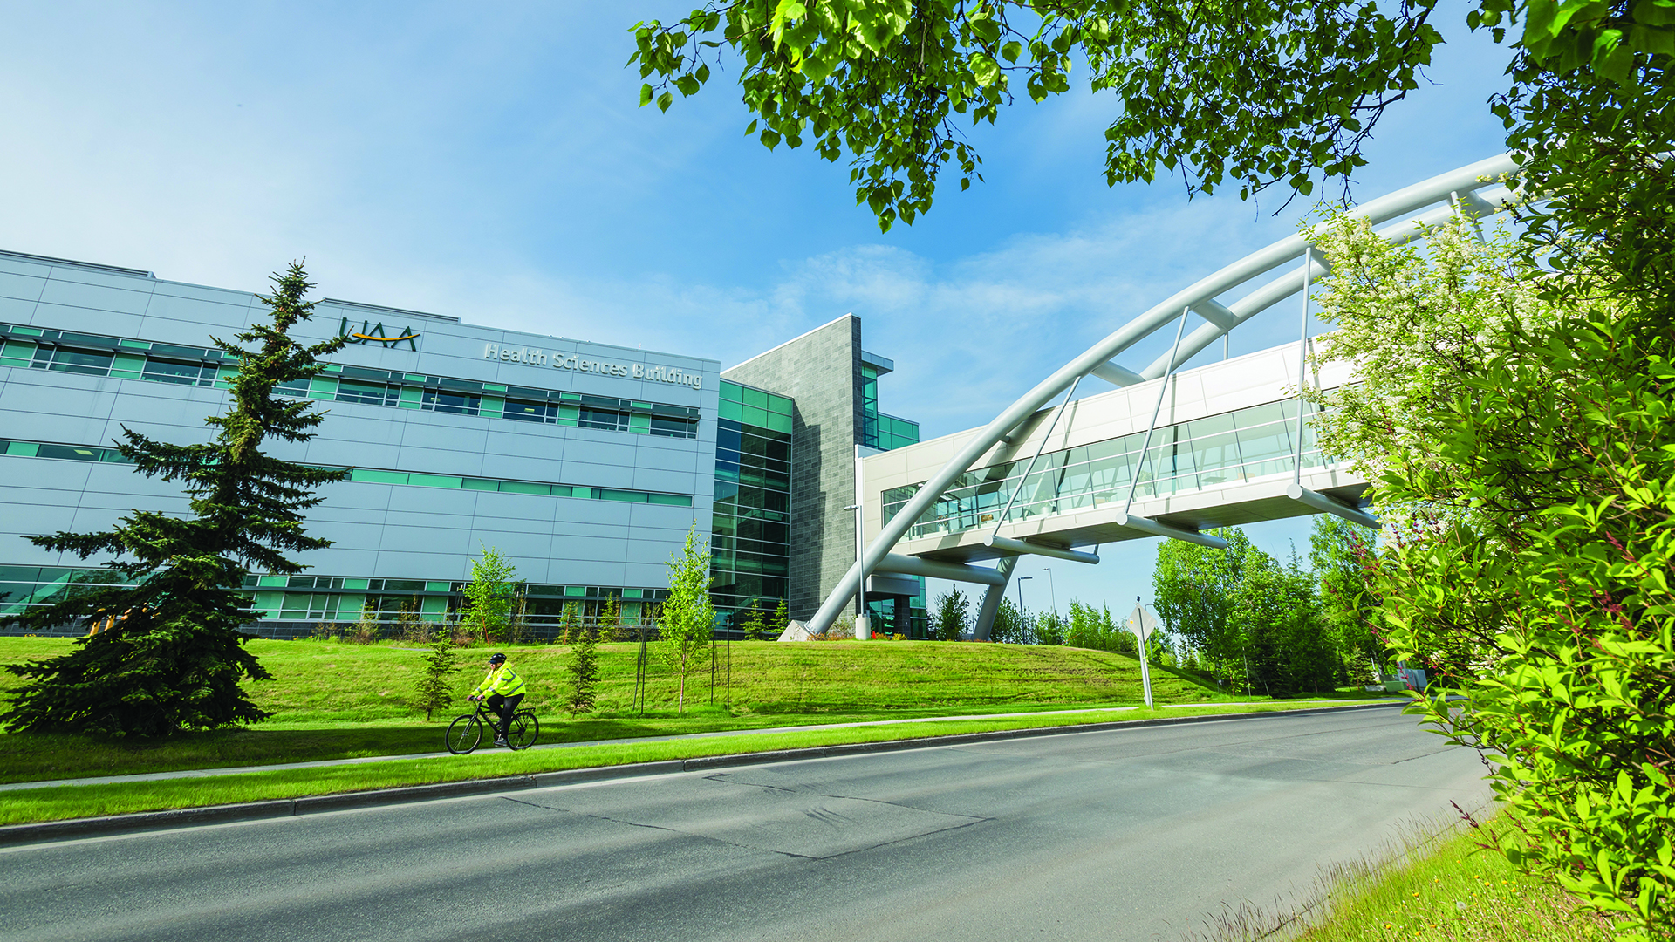

Headline goes here
To replace the above logo with your unit logo, hold down the CONTROL key (or right click), then click on the logo. In the menu that appears, click “Change Picture” choose From file… and then navigate to your logo file on your computer.
Use the Green and Gold with reverse type version of your logo, the name should look like this - “YOURDEPTNAME-GG-Rvrs.png”. To change the background photo show the notes below this slide for more info. Delete these instructions once you’re done.
UA is an affirmative action/equal opportunity employer, educational institution and provider and prohibits illegal discrimination against any individual: www.alaska.edu/nondiscrimination.
Notes:
To replace the logo with your unit logo, hold down the CONTROL key (or right click), then click on the logo. In the menu that appears, click “Change Picture” choose From file… and then navigate to your logo file on your computer.
Use the Green and Gold with reverse type version of your logo, the name should look like this - “YOURDEPTNAME-GG-Rvrs.png”. To change the background photo go to the Design Tab, select Format background, for Fill select Picture, then click the insert button and navigate to the photo you want to use on your computer. More photos can be found on the UAA Photo Bank website - https://uaaphotobank.smugmug.com.

Slide 2
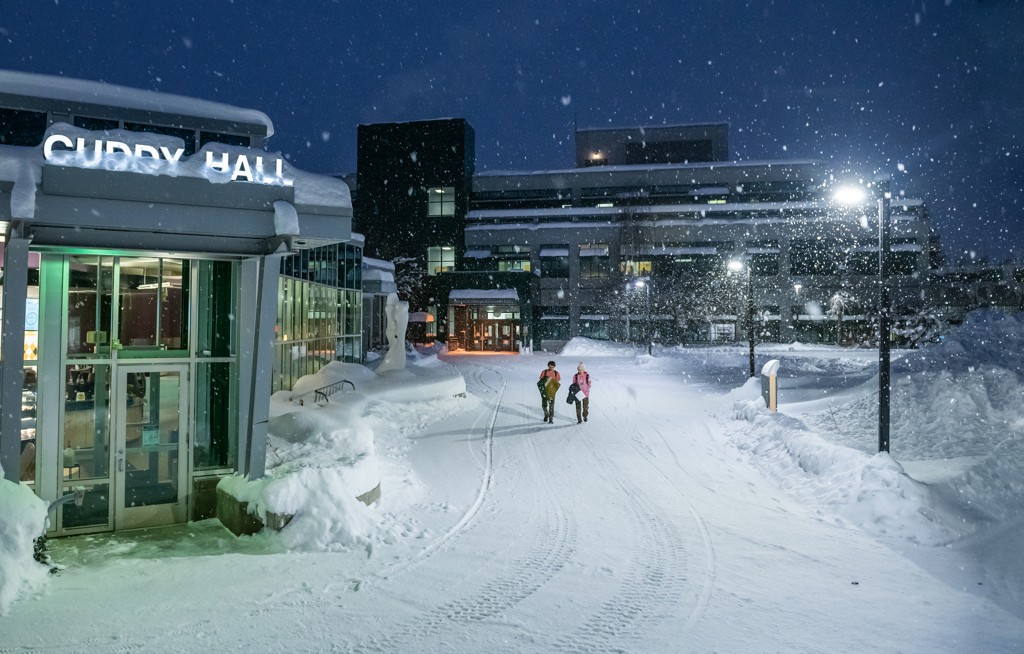
Headline goes here
UA is an affirmative action/equal opportunity employer, educational institution and provider and prohibits illegal discrimination against any individual: www.alaska.edu/nondiscrimination.

Slide 3
uaa.alaska.edu/address

Slide 4



uaa_name@alaska.edu
X – COH? (twitter.com/????)
Facebook – COH? (facebook.com/????)
Instagram – COH? (instagram.com/????)
UA is an affirmative action/equal opportunity employer, educational institution and provider and prohibits illegal discrimination against any individual: www.alaska.edu/nondiscrimination.

