Slide 1
Language as a tool in e-learning Informed by the field of technical communication and the science of e-learning
Trish Jenkins
Department of English

Slide 2
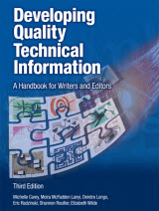
Source: Developing Quality Technical Information: A Handbook for Writers and Editors
“Direct from IBM’s own content design experts, this guide shows you how to design product interfaces and technical information that always place users front and center.”

Slide 3
E-learning and the Science of Instruction: Proven Guidelines for Consumers and Designers of Multimedia Learning

Slide 4
What I plan to do in this presentation:
Introduce you to task-oriented writing
Show how it manifests itself in the online environment
Talk about how it engages students
Back up my claim with arguments from the science of instruction research

Slide 5
How we provide a rich online experience

Slide 6
Most important tool: Language

Slide 7
We have choices with regard to how we use language

Slide 8
What is task-oriented writing?

Slide 9
Guidelines for task-oriented writing
Write for an intended audience
Present information from the user’s point of view
Focus on real tasks—not products or product functions
Use headings that reveal tasks

Slide 10
A “before” example
The system could not be shut down during processing. If such a shutdown occurs, the system should be restarted with the recover command.

Slide 11
Revised using task-oriented writing
If you shut down the system during processing, you might lose data. Use the RECOVER command to restart the system and recover any data.

Slide 12
Here’s another example
This section explains how to use the following menu choices under File:
Open: Opens an existing file
New: Creates a file
Save as: Saves to a new file with a different name

Slide 13
Revised using task-oriented writing
This section explains how to work with a document. You can do the following tasks:
Create a document. To do this…
Open an existing document. To do this…
Rename a document. To do this…

Slide 15
Typical weekly tasks folder

Slide 16
Excerpt from Task #4

Slide 18
How does this engage students?
Task oriented writing places the user front and center.
We can replace “user” with “student”

Slide 19
Avoid the information delivery view of learning
According to this view, the instructor’s job is to present information and the learner’s job is to acquire information
But
Research on discourse processing shows that people work harder to understand material when they feel they are in conversation with a partner rather than simply receiving information

Slide 20
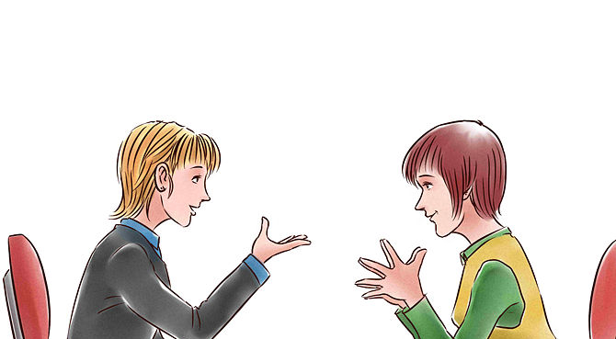
Look to research on the science of instruction
According to this research, conversational style (which features using second person) can activate a social response and that can increase active cognitive processing and lead to better quality of learning.

