Slide 1
Keynote: Trauma Informed Approaches at the Division of Juvenile Justice Shannon Cross-Azbill (Mental Health Clinician IV) Shannon Dilley (Juvenile Probation Officer III) Vincent Yadao (Juvenile Justice Unit Supervisor)
12th Annual “Reducing Recidivism Through Successful Reentry” Conference: Transition Though Cross-Collaboration
YOUTH TRACK
Tuesday, March 7, 2017
Hotel Captain Cook

Slide 2
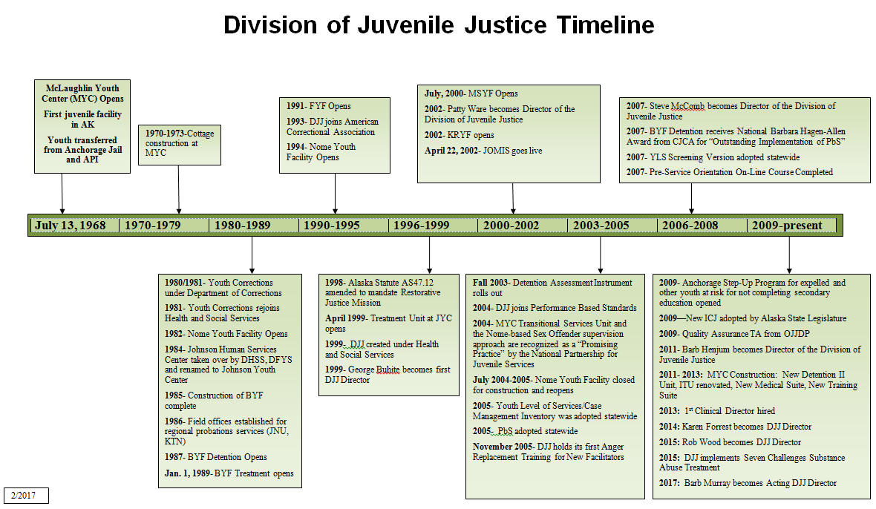

Slide 3
Strength Based Trauma Informed Care Trauma Resiliency Tool CRYM12
2006- Johnson Youth Center trained in Strength Based Approach
2009- The Division of Juvenile Justice launched a demonstration project at McLaughlin Youth Center.
Training and consultation were provided to staff on two units.
After the successful pilot project, DJJ has provided Trauma Informed Care Training to all staff throughout the division.
As trauma informed care expanded across the Division, Johnson Youth Center began a pilot program where they implemented a Trauma and Resiliency screening tool.
Collaboration between DJJ Probation, Treatment and Detention. . . As well as OCS

Slide 4
Strengths approaches are
Scientifically grounded
Related to restorative justice approach
Based on research related to assets, protective factors, resiliency
Ecological – taking into account the youth in her/his environment

Slide 5
Strengths approaches are (cont.)
Attentive to diversity
Based on behavioral science – people with hope and support change more effectively
Compatible with research on adolescent development – youth are changing rapidly, testing
- Remember the potential impact of trauma on youth development

Slide 6
Protecting Youth from High-Risk Behaviors

Slide 7
Promoting Positive Attitudes and Behaviors

Slide 8
Brain Development
The brain plays a part in all that we do.
Brain develops from the inside out
Physical (first to develop) responsible for life functions such as breathing, heart rate, blood pressure
Emotional development (feelings such as anger, happy, sad)
Cognitive development is the thinking part of the brain such as planning, reasoning, consequences, impulsivity

Slide 9
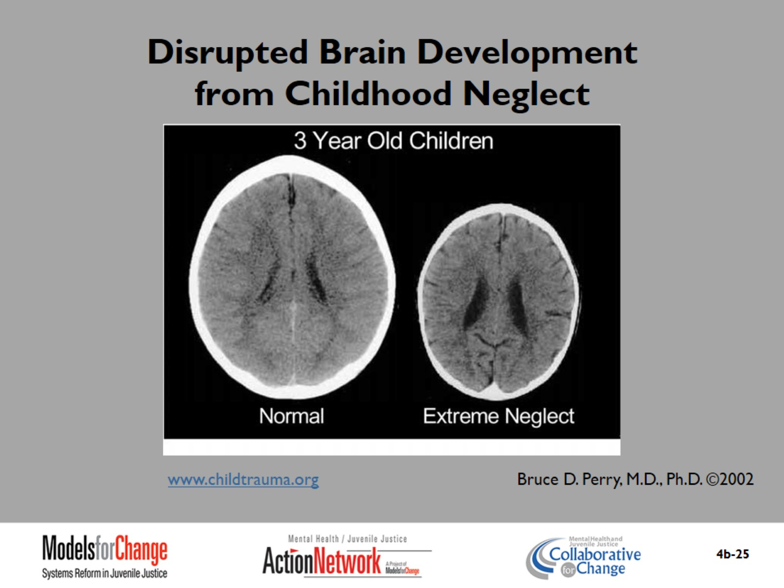
Disrupted Brain Development from Childhood Neglect

Slide 10
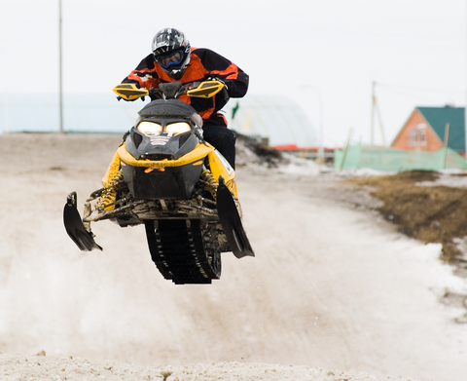
Adolescent Brain Development
Adolescence is like giving a teenager a snow machine with :
A new engine with a lot of horsepower (physical growth)
A sensitive throttle that can go from 0 to 80 in a few seconds (emotions)
And poor brakes with no repair parts due to come in for years (thinking)

Slide 11
Long-Term Impact of Trauma
Long-term impact of trauma can increase an individual’s risk for:
Mental health or behavior problem
Post-Traumatic Stress Disorder
Depression
Isolation/Withdrawal
Sleep problems
Substance abuse
Alcohol, drugs and tobacco can harm the teenage brain
Teenagers with trauma are higher risk to become addicts than adults
Physical health problems (bedwetting, stomach aches, headaches)
Problems in school (learning difficulties)

Slide 12
DJJ Trauma Screening and Resiliency Tools(TST and CRYM-12)Pilot Project
Started March 4, 2016, at JYC Probation, Detention and Treatment

Slide 13
When Trauma Resiliency Tool and CRYM-12 are Administered
Detention – All admits within 24-72 hours
Treatment – All admits within 7 days
Probation – All Adjudicated, Held in Abeyance and Formal Diversion Cases

Slide 14
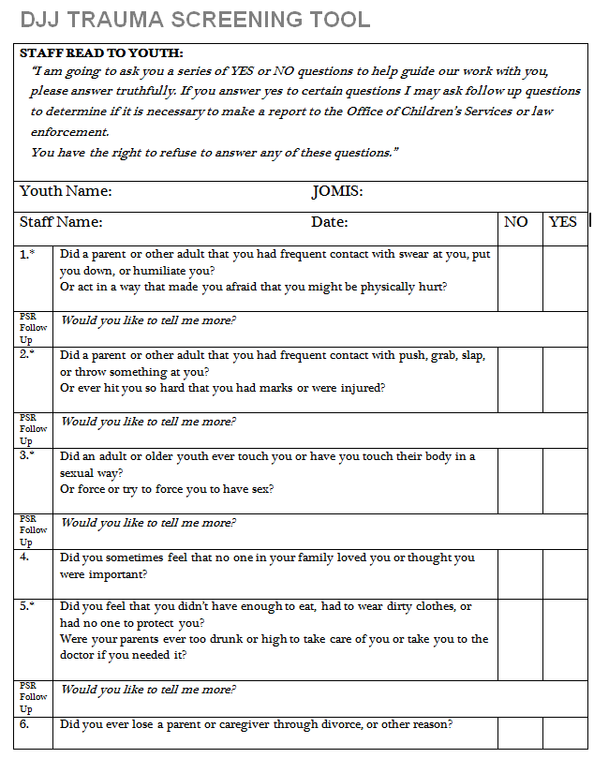
DJJ Trauma Screening Tool
Consists of 15 questions
The higher the score the more trauma Indicated

Slide 15
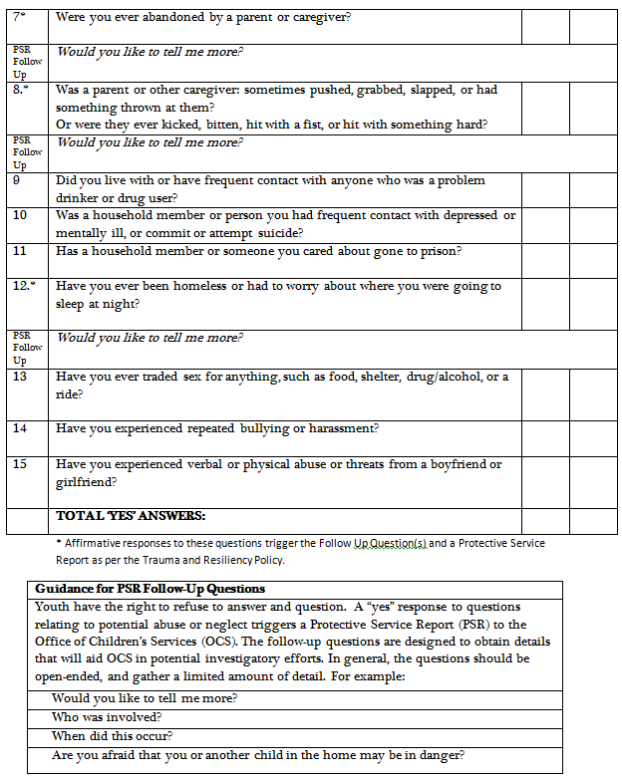
DJJ Trauma Screening Tool

Slide 16
Trauma Tool Results
Detention conducted 67 assessments with an average score of 3.38
Treatment conducted 15 assessments with an average score of 4.33
Probation conducted 10 assessments with an average score of 3

Slide 17
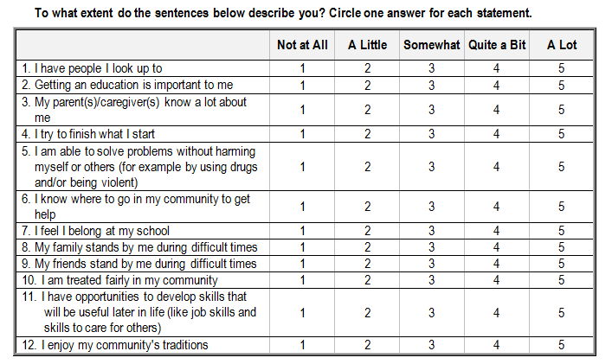
CRYM 12
Consists of 12 questions
The higher the score the more resilient

Slide 18
Resiliency Tool Results
Detention conducted 67 assessments with an average score of 49.6
Treatment conducted 15 assessments with an average score of 79.5
Probation conducted 11 assessments with an average score of 47

Slide 19
PRO’S
The Tools are easy to complete and are not overly time consuming.
The information is valuable in understanding and dealing with residents.
Helps guide JJO/JPO interaction strategies and responses to behaviors.
Helpful to Treatment Team Planning and Clinical Intervention

Slide 20
CON’S
Out of the 67 assessments conducted, 39 resulted in a Protective Service Report (PSR) being generated
Meaning that 39 incident reports were required
It is noteworthy that of those PSR’s three CAC interviews were conducted and one adult is being prosecuted for sexual assault

Slide 21
Trauma Teams
Following trauma and strength based training we changed our approach to working with kids
Changed policy and rulebooks
Established Trauma Teams
By identifying trauma, we changed the culture
Established a trauma team involving JYC detention, treatment and probation
Meet every other week
Staffed clients presenting with behavioral issues related to trauma
Developed intervention strategies to meet the needs of the youth

Slide 22
Trauma Champions
Trial and error on selecting and training Champions
“Hug a Thug”
Culture Change
Champions need to have
Buy-in
Good rapport with management and staff
Think outside the box
Identify youth assets

Slide 23
What We Found Useful
Trauma information was shared at each units’ weekly staff meeting so all staff were made aware of the issues.
Trauma information shared with treatment teams to help devise effective treatment plans
Trauma information discussed at bi-weekly Trauma Champions Meeting. Helpful by gaining feedback and ideas to move forward with difficult youth.

Slide 24
TIC Highlighted Case Report
Case 1- Trauma Screening Tool Score = 1 CRYM -12 Score = 58
Case 2- Trauma Screening Tool Score = 2 CRYM-12 Score = 44
Case 3- Trauma Screening Tool Score = 11 CRYM-12 = 42

Slide 25
Resources Developed
Parent Handbook
Parent Brochure
Community Resources Guide
Detention Unit Brochure

Slide 26

DHSS Resources

Slide 27
Community Success
Intervention and Case Planning
Identify the youths trauma and resiliency
Support healing from their trauma
Build on the youths strengths
Build case plans for the youth
Incorporate asset building to strength and resiliency

Slide 28
Recovering from Trauma
What an adult or JJO/JPO can do:
Must create safety (from a trauma perspective, individuals act out when they feel unsafe)
Providing structure and consistency can help create a sense of safety
Setting limits can increase a sense of safety but set limits appropriately
No violence
No yelling
Provide support—anyone can do this
Ask the person what they are most worried about
Listen
Be available

Slide 29
Recovering from Trauma
What an adult or JJO/JPO can do:
Teach calming skills, coping skills, problem-solving skills
Learn to recognize physical signs of distress
Teach relaxation/meditation (drumming, deep breathing, fishing, berry picking)
Help them find ways to express their feelings (verbally, writing, art, story telling, singing, dance)
Encourage physical activity/sports

Slide 30
Recovering from Trauma
What you an adult or JJO/JPO can do:
Build on strengths which can include developing spiritual beliefs and cultural identity
Break the cycle
Remember there is always hope

Slide 31
Findings and recommendations:
Start administering trauma and resiliency tools
If DJJ decides not to move forward and mandate the tools JYC will continue to use them
The tools help identify the issues without stigma and implement meaningful care and plans
Don’t be afraid; if they lived it we can ask about it
Be inspired to help make change
Move from “I Can’t” to “I Can and Will”
You have the power to create a better future. Treat youth well!
Take care of yourself!
Treat each other well!

