Slide 1
Seven challenges: Trauma Informed Care and Strength-Based approach to Substance abuse treatment
Shannon Cross-Azbill, LCSW
Tenecia Lockard, MSW, CDC I

Slide 2
Seven Challenges:
Evidence Based Program
Culturally Sensitive
Teaches Life Skills
Focuses on making thoughtful decisions

Slide 3
Basic premise of the Seven Challenges is “meet the youth where they are at.”

Slide 4
Three choices of Seven Challenges
Choose to quit
Choose to cut back
Choose to stay the same

Slide 5
Holistic Vision/Program
Young people identify the desires and needs they are satisfying, or attempting to satisfy, through their drug use.
When self understanding increases- when young people see why they are using drugs- they have an opportunity to think about alternatives to drug use.
They can learn healthy, drug-free ways to meet those same needs and satisfy desires.

Slide 6
Cognitive/Emotional Decision-Making Model
Young people consider:
Why they are using drugs
What they like about drugs
How they harm themselves and others by using drugs
How their continued use might affect their future if they do not change

Slide 7
Redefining the role of the drug counselor
Counselor is not there to make them quit or take something away
We are on your side of the bullet
We are your problem solving partners
We are here to help you think about your options and to give you more options

Slide 8
Redefining the role of the drug counselor
The counselor’s role is to help the youth think through things for themselves
Groups are focused on helping youth follow through on decisions
Youth get support in making any behavior changes they have chosen to make, such as learning anger management or learning to cope with stress in positive ways

Slide 9
Core Components of Seven Challenges
Readings in Seven Challenges
“Journaling” in the Seven Challenges Journals
Educational/counseling sessions in one-to-one and/or group settings
Family or multi/family sessions, when feasible and appropriate

Slide 10
The Seven Challenges
Challenge One: We decided to open up and talk honestly about ourselves and about alcohol and other drugs.
Challenge Two: We looked at what we liked about alcohol and other drugs, and why we were using them.
Challenge Three: We looked at our use of alcohol and other drugs to see if it had caused harm, or could cause harm.
Challenge Four: We looked at our responsibility and the responsibility of other for our problems.

Slide 11
The Seven Challenges
Challenge Five: We thought about where we seemed to be headed, where we wanted to go, and what we wanted to accomplish
Challenge Six: We made thoughtful decisions about our lives and about our use of alcohol and other drugs.
Challenge Seven: We followed though on our decisions about our lives an our drug use. If we saw problems we went back to earlier challenges and mastered them.

Slide 12
Mad Rush for Abstinence
The “Mad Rush” is an attempt to convince youth that drugs are dangerous, that they personally have been harmed by drugs and they should quit
The “Mad Rush” is out of caring and also a response to political pressure. Everyone wants drug free kids immediately
The “Mad Rush” can lead to four “F’s”

Slide 13
Results of the “Mad Rush”
Faker
Fighter
Fleer
Follower

Slide 14
Slow the Rush
We need to start where the kids are at
Not where we wish they should be
Not where they pretend to be
Not where they may be for a fleeting moment of time

Slide 15
Reminder: Three choices of Seven Challenges
Choose to quit
Choose to cut back
Choose to stay the same

Slide 16
What is Success?
Is success only abstinence and graduation?
What do we as a group consider success?

Slide 17
Idea to Ponder…
If treatment is set up where kids do not have to fake it to complete a program how “successful” will they be?

Slide 18
Graduation… What does completion of Seven Challenges look like?

Slide 19
Re-Entry into the Community
12-Step Program
Most universally support group in the community- Seven Challenges supports orienting youth to 12-step programs
Seven Challenges supports 12-step programs for youth who are ready to stop using drugs
12-step programs support Seven Challenges youth wanting a spiritual approach to maintaining abstinence

Slide 20
Challenge 1: Continuing Care—Counselor Summary

Slide 21
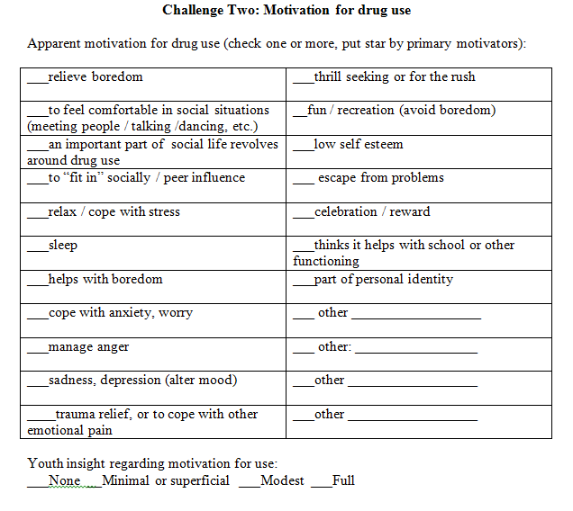
Challenge 2: Continuing Care—Counselor Summary

Slide 22
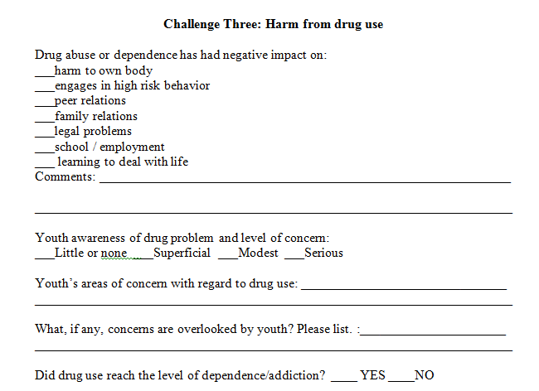
Challenge 3: Continuing Care—Counselor Summary

Slide 23
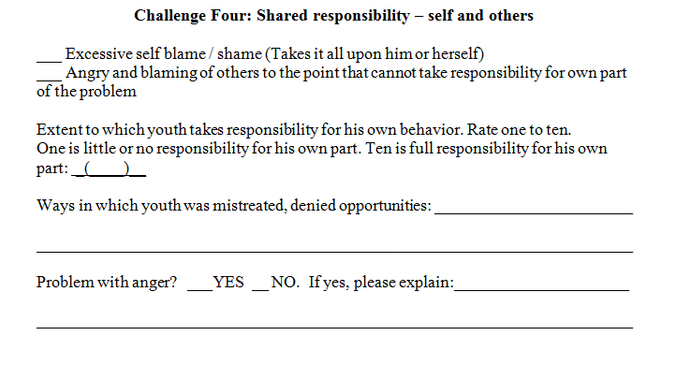
Challenge 4: Continuing Care—Counselor Summary

Slide 24
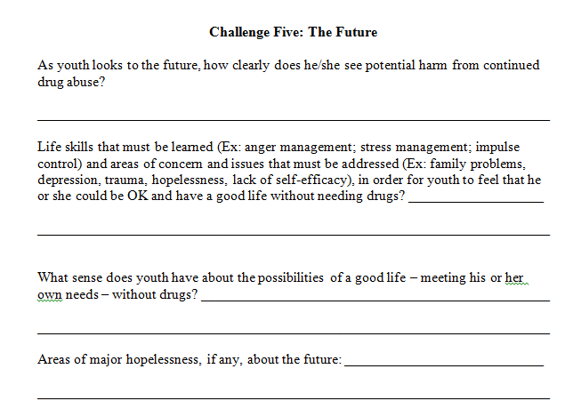
Challenge 5: Continuing Care—Counselor Summary

Slide 25
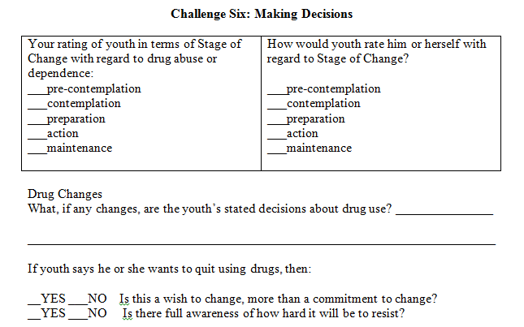
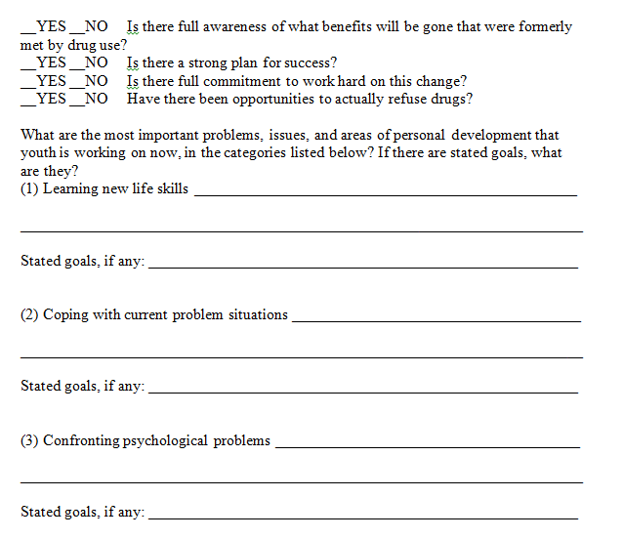
Challenge 6: Continuing Care—Counseling summary

Slide 26
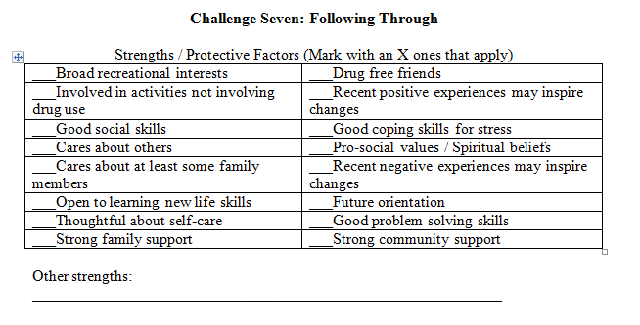
Challenge 7: Continuing Care—Counselor Summary

Slide 27
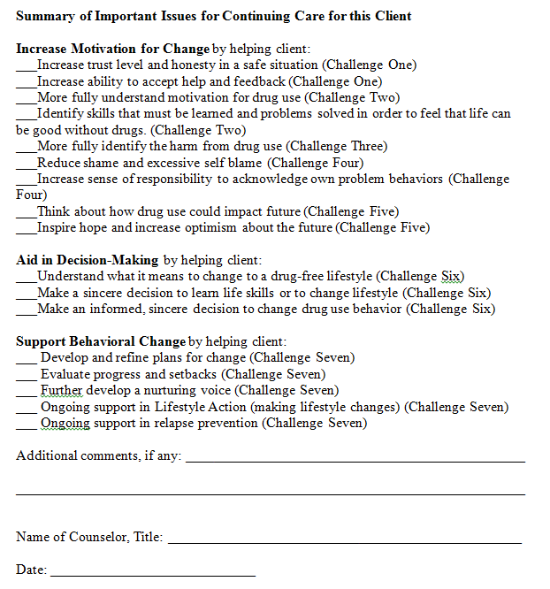
Continuing Care—Counselor Summary

Slide 28
Questions?

Slide 29
Contact Information:
Shannon Cross-Azbill, LCSW
shannon.cross-azbill@alaska.gov
Tenecia Lockard, MSW, CDC I
tenecia.lockard@alaska.gov
Seven Challenges Website
http://www.sevenchallenges.com/

