Slide 1
OCCUPATIONAL STRESS
The Impact on You and Your Work With Others
Presenter: Wendi Shackelford
UAA Center for Human Development - AKTC
Anchorage Police Department CIT officer (retired)

Slide 2
Agenda
My Story
Understanding terms
  Burnout
  Empathy fatigue
  Compassion fatigue
Common reactions or symptoms
Create self awareness using assessment tools
  Compassion Fatigue Self-Test
  Life Stress Inventory
  ProQOL 5
Making healthy choices
  Actions you can take to maintain your integrity to others
What is being trauma informed?
Practical exercises
Next steps
Citation of sources
Contact information

Slide 3
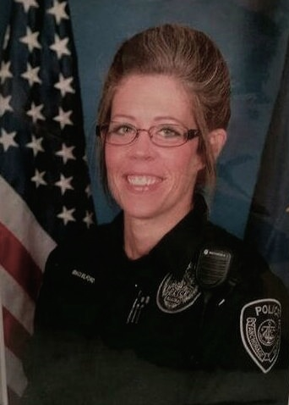

My Story
Notes:
My story – see word document

Slide 4

Who is at risk?
Helping professions
High ideals
Motivated
Committed
Empathetic-
Source: Dr. Naomi Paget
Notes:
SOLICIT: Examples of those in helping professions

Slide 5

Burnout
too much to do
too little time
insufficient resources
lack of validation
unrealistic expectations
cumulative physical and emotional distress-
Source: Dr. Naomi Paget

Slide 6
Burnout
Reactions and Symptoms
Emotional and physical fatigue
De-personalization
Reduced vocational productivity
Reduced personal accomplishment
Lack of confidence or self-esteem
Changes in beliefs, values, and view of workplace or world
Chronic fatigue
Cynicism
Chronic lateness
Pessimism
Questioning one’s own faith
Difficulty experiencing happiness
Sense of foreshortened future-
Source: Dr. Naomi Paget
Notes:
De-personalization – “the kidney transplant in room 205”
Reduced vocational productivity – “I’ve worked hard my entire career, I’ve earned the right to leave a little early”

Slide 7
Burnout
Caring for Yourself
Delegate
Negotiate
Redefine success and what it looks like
Set personal boundaries
Create “margins”
  erase something or make small changes
Make changes in your life-
Source: Dr. Naomi Paget

Slide 8

Empathy Fatigue
Emotional and physical fatigue resulting from empathizing with other people’s pain, grief, anger, and other strong emotions over extended period of time
Source: Dr. Naomi Paget

Slide 9
Empathy Fatigue
Reactions and Symptoms
Emotional fatigue
Many distressful encounters
Extended period of time
Cumulative
Unspecified source
Direct impact to the caregiver-
Source: Dr. Naomi Paget

Slide 10
Empathy Fatigue
Caring for Yourself
Systematic, strategic, and intentional breaks
Rest
Restoration periods
Set personal boundaries
Redefine ministry expectations
Listen, not fix-
Source: Dr. Naomi Paget
Notes:
Source: Dr. Naomi Paget

Slide 11

Compassion Fatigue
The costly result of providing care to those suffering from the consequences of traumatic events through:
  Empathetic connection to the trauma survivor
  Secondary traumatization (or vicarious trauma) from experiencing the traumatic event as though it was a personal experience
Source: Dr. Naomi Paget
Notes:
Source: Dr. Naomi Paget

Slide 12
Compassion Fatigue
Reactions and Symptoms
Secondary traumatic stress symptoms
  Intrusive memories
  Avoidance or distancing
  Stress arousal
  Nightmares
  Obsessive thoughts of trauma
Physical symptoms
  Exhaustion
  Insomnia
  Headaches
  Increased susceptibility to illness
  Startle reflex
  Addictions or compulsions-
Source: Dr. Naomi Paget
Notes:
Source: Dr. Naomi Paget

Slide 13
Compassion Fatigue
Reactions and Symptoms - continued
Excessive blaming
Bottled up emotions
Isolation
Receives an unusual amount of complaints from others
Voices excessive complaints about admin functions
Recurrent illness
Difficulty concentrating
DENIAL
Substance abuse to mask feelings
Compulsive behaviors like overeating, overspending, gambling, sexual addictions
Poor self care
Legal problems
Indebtedness-
Source: Compassion Fatigue Awareness Project

Slide 14
Organizational Compassion Fatigue
Reactions and Symptoms
Absenteeism
Constant changes in co-workers relationships
Inability for teams to work well together
Desire among staff members to break company rules
Inability of staff to complete assignments and tasks
Inability of staff to respect and meet deadlines
Lack of flexibility
Reluctance toward change
Negativism towards management
Lack of vision for the future-
Source: Compassion Fatigue Awareness Project
Notes:
Source: 2013 Compassion Fatigue Awareness Project

Slide 15
Compassion Fatigue
Caring for Yourself
Self awareness
Catharsis with team members
Clarifying options
Reframing circumstances or situations
Intercession
Relaxation techniques
Pastoral counseling
Therapeutic intervention
Be kind to yourself
Educate yourself
Accept where you are on your path at all times
Listen to others who are suffering
Clarify personal boundaries
Take positive action to change your environment
Remember what you have control over-
Sources: ICISF manual Grief Following Trauma
Compassion Fatigue Awareness Project
Notes:
Catharsis - the process of releasing, and thereby providing relief from, strong or repressed emotions.
synonyms: emotional release, relief, release, venting;
Source: ICISF manual Grief Following Trauma, January 2006

Slide 16
Free Self Assessment Tools

Slide 17
Life Stress Test
Assessing sources of stress and eustress in your life
Predicts susceptibility to stress-related illness, depending on coping skills (or lack thereof)
  Impact of culture
Authors: T.H. Holmes and T.H. Rahe
http://www.compassionfatigue.org/pages/lifestresstest.pdf
Source: Compassion Fatigue Awareness Project
Notes:
T.H.Holmes and T.H. Rahe. "The Social Readjustment Rating Scale," Journal of Psychosomatic Research. 11:213, 1967.

Slide 18
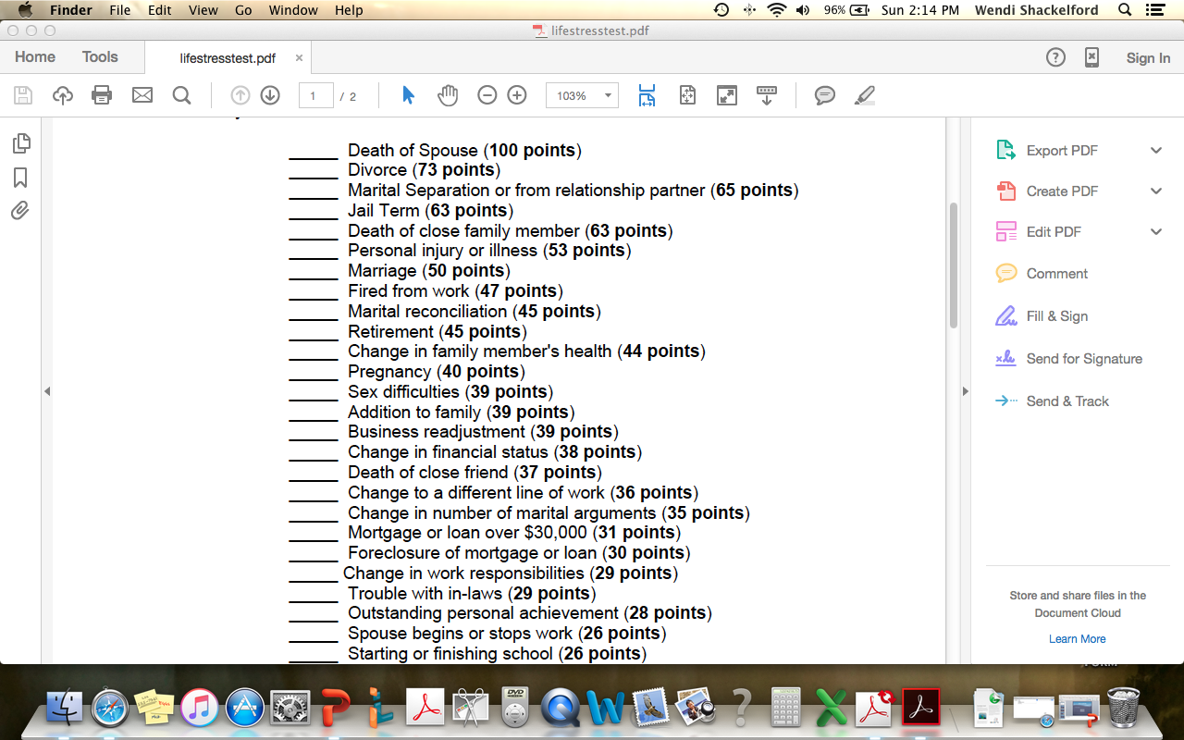
Notes:
Take this assessment

Slide 19
Compassion Fatigue Self-Test
Helps you review your self-care, along with your needs and action plans to meet those needs.
Author: Dennis Portnoy
http://www.compassionfatigue.org/pages/cfassessment.pdf
Source: Compassion Fatigue Awareness Project
Notes:
Author is Dennis Portnoy, 1996, from OVEREXTENDED AND UNDERNOURISHED: A SELF- CARE GUIDE FOR PEOPLE IN HELPING ROLES

Slide 20
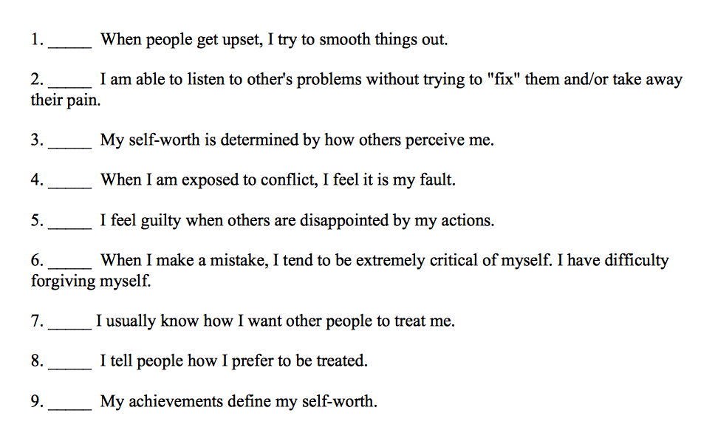
Notes:
Take this assessment

Slide 21
ProQOL 5
Measures the positive and negative effects of helping others who experience suffering and trauma
Sub-scales for compassion satisfaction, burnout, and compassion fatigue
Author: B. Hudnall Stamm
www.proqol.org
Source: Compassion Fatigue Awareness Project
Notes:
ProQOL 5 is the most recent edition
Comes in multiple languages
Measure that has been used since 1995
Author is B. Hudnall Stamm
Available on-line for download

Slide 22
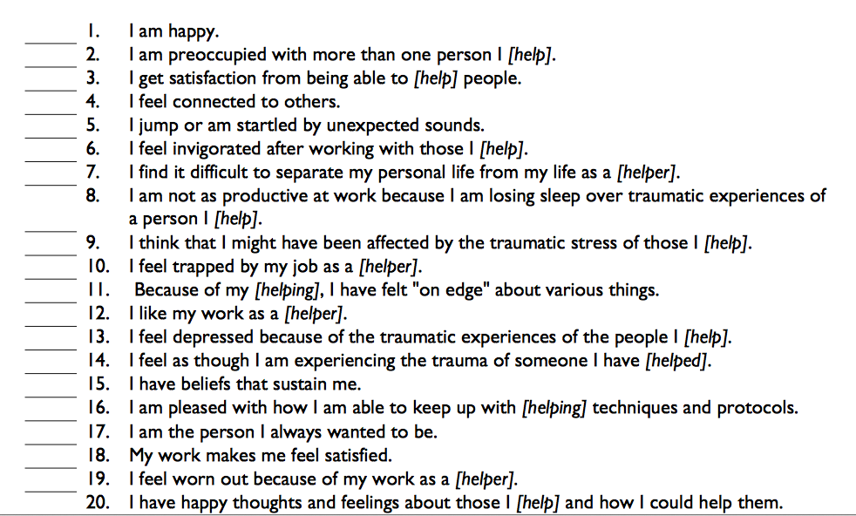

Slide 23

Healthy habits
Regular exercise
Restful sleep
Nutritious foods
Drink water
Connection to those who care about you/you care about
Enjoyable social activities/hobbies
Journaling
Allow yourself to say “no”
Practice balance
Cultivate and train your “rocks” of support
Pick the hill you want to conquer
Get a rubber ducky!
Notes:
Sources:
2013 Compassion Fatigue Awareness Project
Dr. Naomi Paget
ICISF trainings

Slide 24
What is being a “trauma-informed”
individual
You provide support and understanding
You are person-centered
You refrain from judgment and re-traumatization
You provide hope for recovery
You assist others in regaining a sense of control over their lives
You empower others by helping them access their own strengths
You help others access basic needs
You resist rescuing
You let others teach you about themselves
You know and take care of yourself as a priority

Slide 25
What is being a “trauma-informed”
organization
A safe, calm, and secure environment with supportive care
System-wide understanding of trauma prevalence, impact, and trauma-informed care
Cultural competence and humility
Consumer voice, choice and advocacy
Recovery, consumer-driven and trauma-specific services
Healing, hopeful, honest, and trusting relationships
Notes:
ASK: Do you see the impact on recidivism, recovery, and wellness? For the clients, for the employees, and for the agency….
Source: National Council on Behavioral Health – Nat Con 2016

Slide 26
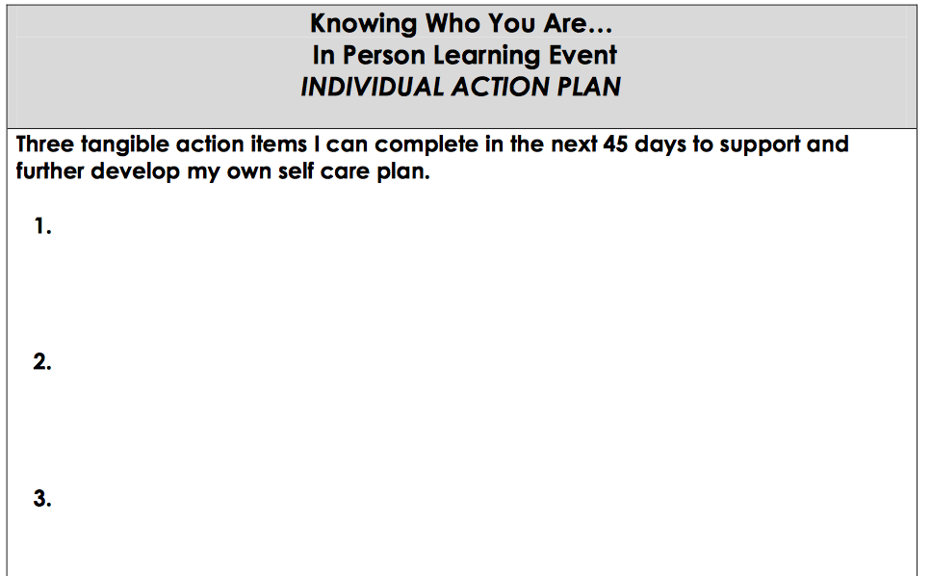
Practical Exercises
At your table, have a discussion on self care
6 minutes
  What is it?
    What does it look like?
    Sound like? Feel like?
  What things do you practice to take care of your own health and wellness?
    Daily? Weekly?
    Monthly? Yearly?
Complete your own Individual Action Plan (IAP)*
6 minutes
Share out
8 minutes

Slide 27
Next Steps
Individual
Organizational
Become trauma-informed as an individual
    Trauma-Informed Care (TIC)
    conference handout
Become self-aware in your service to others for occupational stress and compassion fatigue
  Life Stress test
  Compassion Fatigue
  ProQOL 5
Assess your agency for trauma-informed awareness
    Guide to Completing the Agency Self-Assessment
    conference handout
Create an Organizational Action Plan (OAP) for growth and implementation
    Organizational Action Plan
    online document

Slide 28
Citations of Sources
Dr. Naomi Paget
  https://crisisplumbline.com
Compassion Fatigue Awareness Project
  http://www.compassionfatigue.org
International Critical Incident Stress Foundation
  http://www.icisf.org
Notes:
Dr. Naomi Paget, on 3-12-16 given verbal permission to use 2013 handout, Comparing Burnout, Empathy Fatigue, and Compassion Fatigue
Resource List at the end of your packets

Slide 29

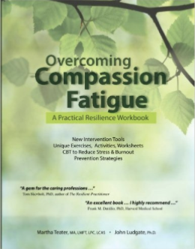



Resources

Slide 30
Every person has a story to tell and that story matters!
Wendi Shackelford, B.A.
Anchorage Police Department CIT officer (retired)
UAA Center for Human Development
Alaska Training Cooperative
Office: 907-264-6224
Cell: 907-632-3619
Email: wendis@alaskachd.org
Website: www.aktclms.org

