Slide 1
Reducing Recidivism through Successful Reentry
March 8, 2017
Statewide Reentry Efforts Panel Presentation

Slide 2
Panel Presenters
Morgen Jaco, Alaska Department of Corrections, moderator
Marian Lilley, Alaska Department of Corrections
Geri Fox, Alaska Department of Corrections
Kate Sumey, Alaska Court System Therapeutic Courts
Donald Revels, Department of Labor

Slide 3
Sequential Intercept Mapping
Illustrates how individuals with behavioral health needs come into contact with and flow through the criminal justice system
We want to divert individuals at various intercept points on the Sequential Intercept into behavioral health services

Slide 4
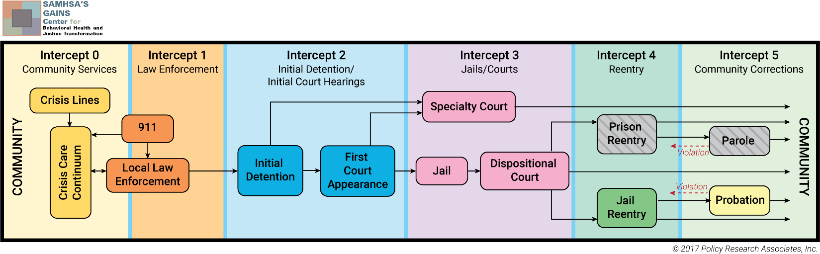

Slide 5
Programs discussed today
Improve cross-system communication and collaboration
Improve early identification of individuals with behavioral health issues as they come into the criminal justice system
Increase linkage to services
Reduce recidivism, enhance community safety and improve quality of lives

Slide 6
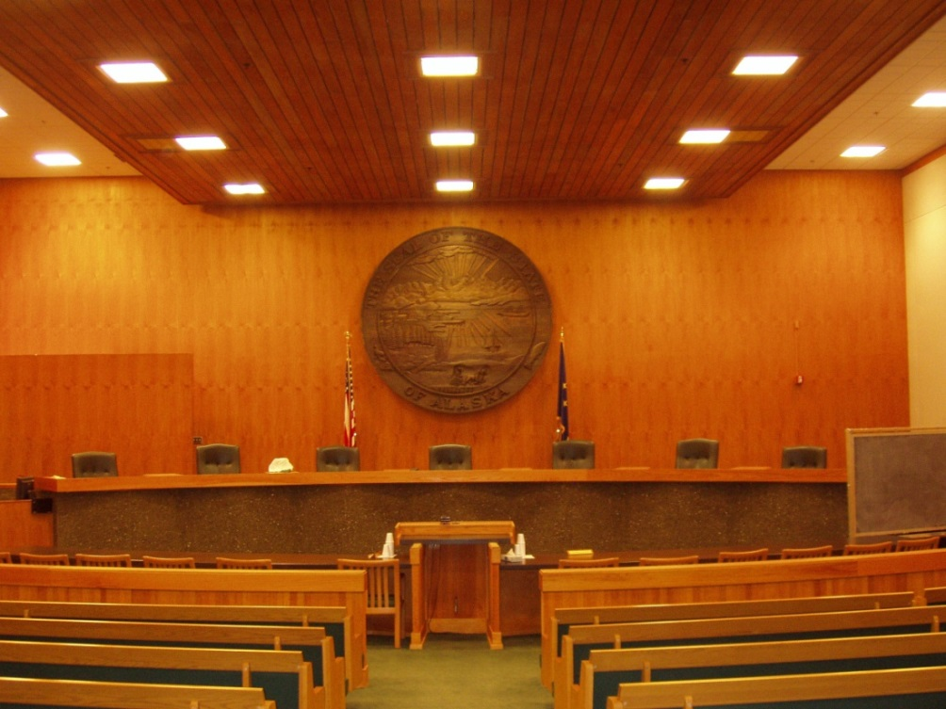
ALASKA COURT SYSTEM
Therapeutic Courts Overview,
Kate Sumey March 2017

Slide 7
Traditional & Therapeutic Justice Process
TRADITIONAL
  Dispute Resolution
  Legal Outcome
  Adversarial Process
  Rights-Based
  Emphasis on Adjudication
  Backward Looking
  Judge as Arbiter
  Efficient
  Few Participants
THERAPUETIC PROCESS
  Problem Solving/Dispute Avoidance
  Therapeutic Outcome
  Collaborative Process
  Interest or Needs-Based
  Alternative Dispute Resolution
  Forward Looking
  Judge as Coach
  Effective
  Wide Range of Participants & Stakeholders

Slide 8
Comparison of restorative, community, therapeutic, and reparative justice
Notes:
Adapted from Bazemore, 2005; Carns, Hotchkin, & Andrews, 2002; Kurki, 1999; OJJDP report, 1997

Slide 9
THERAPEUTIC COURTS MISSION STATEMENT
The mission of the therapeutic courts is to divert people with substance abuse and/or mental health diagnosis with open court cases (both criminal and civil) into community treatment and services to prevent further contact with the legal system.

Slide 10
Therapeutic Courts
Multidisciplinary Therapeutic Court Team works together to:
    Ensure public safety
    Protect due process rights
    Systematically address defendant’s substance abuse/mental health,
    family and/or criminality issues
Notes:
Alaska Therapeutic Courts – General Information
Therapeutic Model for these Courts
The therapeutic model is not an “easy way out” of a felony or misdemeanor, but an alternative justice model in which a collaborative court team made up of a supervising judge, district attorney, defense counsel, probation officer and/or substance abuse or mental health treatment provider, oversees and closely monitors participants who chose the treatment program in lieu of incarceration.

Slide 11
Therapeutic Courts Program Overview
A team approach to monitor and encourage a participant’s progress
Utilizes sanctions and incentives to help modify behavior change (see behavioral response list)
Upon successful completion of the program, participants’ sentences are imposed according to the initially negotiated agreements

Slide 12
They are an alternative for those who want to stop the downward spiral of a life of substance abuse and legal involvement.
Therapeutic Courts
are not the easy way out…

Slide 13
Traditional Courts Therapeutic Courts
Judge
Judge
Treatment
Providers
Defense
Prosecution
Participant
Prosecution
Defense
Defendant
Probation Officer/ Case Manager
Jury
Notes:
Traditional Court Characteristics Versus Therapeutic Court Characteristics
Traditional Court Therapeutic Court
Court team of judge, prosecutor, New court team created to achieve goals of
defense council, etc. supportive treatment interventions
Adversarial Non-adversarial
Goal=Process case; apply the law Goal=Restore defendant as a productive,
non-criminal member of society
Judge exercises limited role in Judge plays central role in monitoring supervision of defendant
defendant’s progress in treatment
Interventions for substance abuse Formalized and structured treatment
at discretion of judge interventions
Relapse may lead to increased Graduated sanctions used to respond to lapses
sentence in drug court program conditions
The judge is central to the overall success of the therapeutic court. The judge has all the traditional authority and responsibility – to make findings, impose sentence, issue orders, etc. – but the judge also does some coaching and offers positive reinforcement in some unusual ways. The participant talks directly wit the judge at time, instead of always through counsel. The judge lets the participant know what is expected of him or her regarding the program and recovery process, the legal aspects of the program (if the participant fails or decides to “drop-out”, and the possible sanctions and incentives. Ins some courts, there will be a specialized court clerk who handles the files of all therapeutic court participants and keeps the judge’s records organized.
Prosecutors are responsible for representing the interest of the state and the community, but once the therapeutic team is in place the prosecutors act in a generally less adversarial role than usual.
Public Defenders, while remaining in non-adversarial roles with the prosecutor, work with their clients (the participants) in a manner that is conducive to the therapeutic court program and in the best interest of the participants. Public defenders advise participants of their legal rights and the relative merits of entering the therapeutic court versus disposing of the case through the traditional adversarial process. Public defenders ensure that participants understand program requirements and the legal consequences of non-adherence. They ensure that participants’ due process rights are maintained throughout the period of program participation. Even after criminal charges are deferred or please are entered, public defenders provide positive reinforcements to assist with participants’ successful recovery.
Treatment providers are the therapeutic experts on the team. They generally have a number of roles and close, ongoing contact with the participants. They provide a range of substance abuse treatment services (counseling, education classes, group therapy, support groups, etc.). They provide ongoing reports of progress and/or problems that participants and their families may be experiencing. They provide insight into the recovery process and suggest strategies for the therapeutic court team to use to help participants progress in the program. The treatment provider can also educate the other team members regarding substance abuse/addiction, relapse and family dynamics affected by alcohol and other drug abuse. The treatment provider’s role is different in therapeutic courts than in regular courts because of the extent to which they provide ongoing confidential information regarding the participant’s progress. This requires special consents (waivers of confidentiality) – see Appendix B and Section IX for more discussion about confidentiality.
Case Coordinators ensure that all of the service participants need for their recovery are provided. These may include mental health, substance abuse, education, vocational, housing, parting, medical, and other services. Case coordinators also monitor participants’ progress in treatment and advise the teams of any problems that may warrant a change in the treatment plan and which the treatment provider may not already have noted. Not all programs have the resources to fund this position. When there is not funding available, the functions of the case coordinator are shared amount team members.
Office of Children’s Services workers are critical for family therapeutic courts. OCS social workers have the ability to assist professionally with social work skills and provide services to the families in the therapeutic court program.
Probation Officers, if available, may have some responsibility for ensuring that participants comply with the program requirements such as attending treatment sessions and appearing for drug tests. The probation officer may provide reports to the judge and other team members on participants’ activities while in the program. The probation officer will handle the intensive supervision of the client. The officer may act as liaison between the treatment provider and the court by coordinating the activities and schedule of the client.
Project Managers play a vital role with therapeutic courts from the planning to evaluation stages. They coordinate the efforts of the court, the treatment provider(s) and other member of the tam, and serve as liaison with other agencies and community organizations. They maintain the overall coordination of activities of the therapeutic court and they are responsible for finding funds for operation, writing RFPs and contacts for services, providing insight into the daily operations of the therapeutic courts for better processing, and assisting the team with on-going issues. Frequently, coordinators are also responsible for documenting program activities and accomplishments, supervising data collection for program evaluation, and submitting grant applications for program funding.
Therapeutic Court Administrators, if available, may play a vital role with therapeutic courts from the planning to evaluation stages. They maintain the overall coordination of activities of the therapeutic court and they are responsible for finding funds for operation, writing RFPs and contracts for services, providing insight into the daily operations of the therapeutic courts for better processing, and assisting the team with on-going issues.

Slide 14
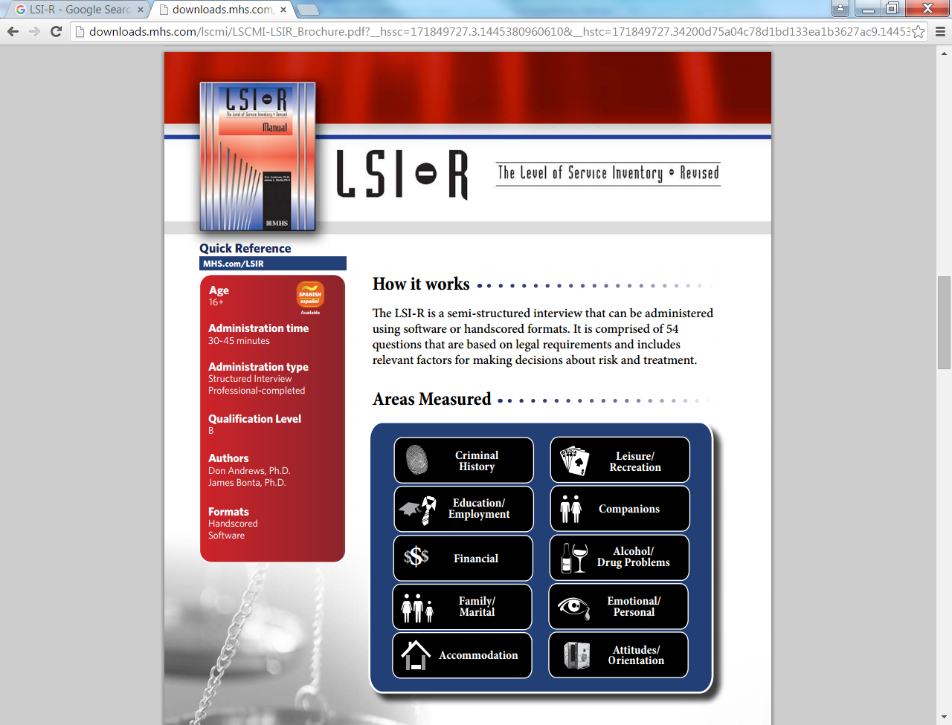
In addition to mental health and/or substance treatment assessment, all potential participants receive a risk/needs assessment that evaluates the following:

Slide 15
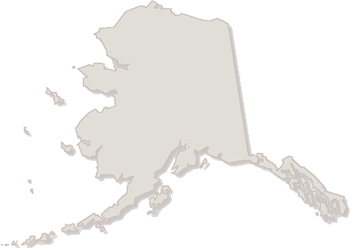
Alaska Therapeutic Courts
Fairbanks
Bethel
Palmer
Anchorage
Kenai
Juneau
Ketchikan

Slide 16
Anchorage Therapeutic Courts
CINA Therapeutic Court
Coordinated Resources
Project
Veterans Court
Family Reunification Cases
PC: Desireé Sang
dsang@akcourts.us
907-264-0466
Adult Mental Health Criminal Cases
PC: Kate Sumey
ksumey@akcourts.us
907-264-0886
Veterans with Felony and Misdemeanor Cases
PC: Desireé Sang
dsang@akcourts.us
907-264-0466

Slide 17
Anchorage Therapeutic Courts
Wellness Courts
Municipal Wellness Court
Felony Drug Wellness Court
Felony DUI Wellness Court
Misdemeanor Drug/DUI Cases
State Felony Drug Cases
State Felony
DUI Cases
PC: Jennifer Fredericks
jfredericks@akcourts.us
907-264-0892

Slide 18
Alaska Therapeutic Courts
Bethel Therapeutic Court
Fairbanks Wellness
Court
Fairbanks
Juvenile Treatment Court
Juneau Therapeutic Court
Felony/Misdemeanor
Drug/DUI Cases
PC: Lynn Kassman
lkassman@akcourts.us
907-543-1121
Felony/Misdemeanor
Drug/DUI Cases
PC: Amy Bollaert
abollaert@akcourts.us
907-452-9307
Juvenile Mental Health Cases
PC: Amy Bollaert
abollaert@akcourts.us
907-452-9307
Felony/Misdemeanor
Drug/DUI Cases
PC: Samantha Abernathy
sabernathy@akcourts.us
907-463-4758
Juneau
Coordinated Resources Project
Ketchikan Therapeutic Court
Palmer
Coordinated Resources Project
Adult Mental Health
Cases
PC: Samantha Abernathy
sabernathy@akcourts.us
907-463-4758
Felony/Misdemeanor Drug/DUI Cases
PC: Chris Pulju
chris.pulju@alaska.gov
907-225-8874
Adult Mental Health
Cases
PC: Kristin Hull
khull@akcourts.us
907-746-8142

Slide 19
Alaska’s Newest Therapeutic Courts
Palmer Wellness Court
Palmer
Safe Babies Court/Palmer Infant and Toddler Court (PITC)
Kenai/Henu’ Community Wellness Court
Drug/Alcohol court; collaboration between the Kenaitze Indian Tribe and the Alaska Court System
PC: Terri Telkamp
ttelkamp@akcourts.us
907-283-8552
www.kenaitze.org
Felony/Drug/DUI Cases
PC: Kristin Hull
khull@akcourts.us
907-746-8142
Therapeutic CINA court
PC: Jessica Clarkson
jclarkson@akcourts.us
907-746-8183

Slide 20
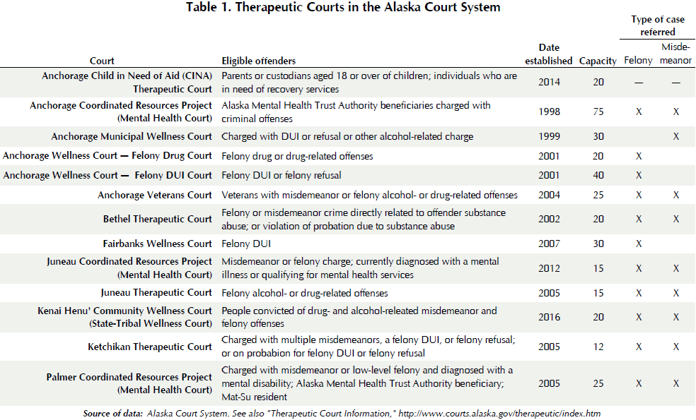
Notes:
Alaska Justice Forum Summer/Fall 2016

Slide 21
Benefits to Participants
Alcohol/drug-free lifestyle
Improved physical health
Self-sufficiency
Improved parenting and family relations
Reduction/dismissal of jail time to be served
Reduction/dismissal of fines ordered
Possibility of Limited Driver’s License in some cases

Slide 22
Benefits to Legal & Social Services Systems
Defense attorneys see their client getting help
Prosecutor has control over who gets admitted
Coordinated team effort streamlines judicial process
Probation, Family Services & Treatment have Court’s attention
Strong intervention for substance abusing client
Offender is much more accountable to the system

Slide 23
Benefits of Therapeutic Courts
Working alone, neither the community or the courts can respond adequately to the overwhelming problems caused by substance abuse/mental health issues
Working together – building strong partnerships between the courts and community agencies allows all systems to be more effective

Slide 24
Resources
Alaska Justice Forum Summer/Fall 2016: Therapeutic Courts in the Alaska Court System
https://www.uaa.alaska.edu/academics/college-of-health/departments/justice-center/alaska-justice-forum/33/2-3summerfall2016/c-therapeutic-courts.cshtml

Slide 25
Resources
Alaska Court System Therapeutic Courts website: http://courts.alaska.gov/therapeutic/tcinfo.htm#about

Slide 26
Alaska Department of Corrections Special Release Programs
Marian Lilley

Slide 27
Mental Health Release Planning
*Identified and referred while incarcerated
*Planning up to 3 months before release and 2 months after
Seriously Mentally Ill or mentally ill with a co occurring condition such as cognitive disorder, TBI, Dementia, SUD
Level of functioning and vulnerability considered; lacks resources, support, income
Voluntary, (Unless mandated by Felony Probation/Parole;) motivated, willing to follow through with release plan

Slide 28
Release Planning Assistance:
Working with clinicians in the jails
Communication w/ inmates to gather information
Connection to community MH agency (statewide)
Some SUD assessment; linking to treatment
Benefits information and support/Medicaid

Slide 29
Release Planning Assistance:
First month medication coverage prior to appt
Other social services referrals and linkages
Communication with family, guardian, courts, etc
Housing options; 1-3 months rent support
All planning is case by case/individualized

Slide 30
Alaska Department of Corrections Pretrial Services Division
Geri Miller-Fox

Slide 31
PRETRIAL
Justice
Public
Through
Safety
STRENGTH
COURAGE
SERVICE

Slide 32

History of Recommendations for Pretrial Services
FINDINGS
SB91 Presented the opportunity for the State of Alaska to implement a long-standing public safety priority
Pretrial Services has been requested for more than 40 years.
Traditional pretrial concerns have included issues such as:
Lack of available information for judiciary
Lack of information about offender risk
Lack of oversight for those who post bail and need supervision
Lack of options for release supervision and diversion

Slide 33
Pretrial Development Team
COMMUNITIES
COURTS & JUDICIARY
PROSECUTORS
TREATMENT SERVICES
LAW ENFORCEMENT
DEFENDANT REPRESENTATIVES
VICTIM RIGHTS
RESEARCHERS

Slide 34
Pretrial Risk Assessment
Measures two risk components:
  The likelihood that someone will Fail To Appear (FTA) for scheduled court hearings;
  The likelihood that someone will have a New Criminal Arrest (NCA) while during pretrial release status.

Slide 35





Pretrial Functions
Assessment
Low, Moderate, High, with a report to the court within 24 hours
Monitoring
Low/Moderate risk defendants will be monitored.
Diversion
*Mental Health
*Tribal Courts
*Substance Abuse
Booking or Summons
Assessment & Initial Appearance
LOW
MOD
HIGH
Diversion
Supervision
Moderate & High risk defendants, if released, will be supervised on standard or enhanced pretrial supervision.
Initial Appearance
The Court has the option for pretrial supervision at this juncture.

Slide 36
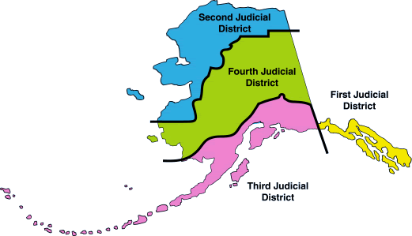
Pretrial District Offices
1st: Juneau
3rd: Anchorage
4th & 2nd: Fairbanks

Slide 37

Cost of Services
COST OF INCARCERATION
The current cost of incarceration is $149.62 a day.
COST OF PRETRIAL SUPERVISION
Projected average daily cost is approximately $4.60.

Slide 38

Alaska Department of Corrections
Pretrial Services Division
Geri Miller-Fox
Director, Alaska Pretrial Services Division
Department of Corrections
geri.fox@Alaska.gov
(907) 269-7405

Slide 39
Alaska Department of Labor
Statewide Reentry Employment Services
Donald Revels

Slide 40
DOLWD Commissioner: Heidi Drygas
Director: Ed Flanagan
Statewide Reentry Employment Coordinator: Donald M. Revels
Supervisor Assistant Director: James Harvey

Slide 41
Mission Statement
Provide labor exchange, employment and training services, and unemployment insurance to Alaskans and Alaska businesses, thereby advancing opportunities for employment and providing economic stability for communities in Alaska.

Slide 42
Services
Operate the Alaska Labor Exchange system (ALEXsys), an online no-fee labor exchange system that connects job seekers with employers.
Operate job centers across the state to provide services to job seekers and employers and promote long-term employment for Alaska’s workforce.
Provide job training and counseling services to qualified job seekers and veterans.

Slide 43
Services continued
Provide temporary unemployment insurance benefits to eligible unemployed workers while they are seeking employment.
Assist unemployment insurance claimants and adjudicate claims.
Collect employment security tax contributions and maintain the integrity of the Unemployment Insurance Trust Fund from which benefits are paid.
Provide adult basic education services to adults who need a high school diploma or General Educational Development (GED) certificate.

Slide 44
Employment & Training
Alaska Career Ready, WorkKeys, Career Ready 101
Apprenticeships
DEI and T2W
EO/ADA Equal Opportunity/Americans with Disabilities Act
Fidelity Bonding
Foreign Labor Certification
MASST Mature Alaskans Seeking Skills Training
Rapid Response (public)
Rapid Response (internal)
Seafood
STEP State Training and Employment Program
Trade Act (TAA)
Veteran Services
WIOA Workforce Investment Act
WOTC Work Opportunity Tax Credit
Workers Compensation Search

Slide 45
Present & Future efforts in recidivism reduction
Statewide Reentry Employment Coordinator
Collaboration with DOC, DHSS and Reentry Coalitions
LEAP 2/Bridge to Success (Linking to Employment Activities Pre-Release)
Supporting agencies whom efforts are in reducing recidivism
Employment After Incarceration workshops
Building a highway from DOLWD to employers, reentrants and DOC.

Slide 46
Regional managers
Brad Gillespie South Central Region (907) 269-4825
Job Seekers: midtown.jobcenter@alaska.gov
Employers: anchorage.employers@alaska.gov
Rachel O’Brien Gulf Coast Region (907) 335-3000 Job Seekers & Employers: peninsula.jobcenter@alaska.gov
Willie Young Interior Region (907) 451-5967 Job Seekers: fairbanks.jobcenter@alaska.gov
Employers: fairbanks.employers@alaska.gov
Michael Hutcherson Southeast Region (907) 465-4562 Job Seekers: juneau.jobcenter@alaska.gov
Employers: juneau.employers@alaska.gov
Toll-free in Alaska (877)724-2539

Slide 47
Contact Info
Morgen Jaco, Alaska Department of Corrections, morgen.jaco@alaska.gov
Marian Lilley, Alaska Department of Corrections
  marian.lilley@alaska.gov
Geri Fox, Alaska Department of Corrections
  geri.fox@alaska.gov
Kate Sumey, Alaska Court System Therapeutic Courts
  ksumey@akcourts.us
Donald Revels, Department of Labor
  donald.revels@alaska.gov

