Slide 1
Risk, Need & Responsivity
Tammy Axelsson & Amy Abbott
March 8, 2017
Notes:
Good morning. [Introduce the team] We attended the LSI-R instructor course in 2009 and since then we have provided formal training to the last three PO academies. While DPP has done an excellent job of training our new officers, we need to improve quality assurance across the department and provide veteran staff with ongoing training.
LSI-R quality assurance workgroups have published recent studies. Several recommendations have been made to in an effort to achieve greater scoring accuracy.
1. It is recommended we replace the previous expectation that supervisors perform quality assurance themselves with an expectation that they implement a peer driven quality assurance model within their work units. Peer discussion and coaching within the office keeps everyone engaged in the process and drives constant improvement.
2. It is critical for supervisors to be actively involved in the LSI-R process. This is not to say supervisors themselves must become resident experts of the tool, but supervisors need to let the staff know that we are committed to the fidelity of the classification process.
Today we are going to facilitate a booster training of the tool itself. We will touch on quality assurance throughout the day, but that is not our main focus.

Slide 2
Objectives
Identify the Risk-Needs-Responsivity Principle
Identify the 8 Guiding Principles for Effective Correctional Intervention
Identify the fundamental concepts underlying the LSI-R risk assessment
Gain a basic understanding of how to implement case plans and supervision strategies based on the LSI-R score and needs identified thereby

Slide 3
Principles of Effective Correctional Intervention
Principles | Description
Risk Principle | Devote time, energy and resources to moderate and high risk cases.
Need Principle | Target the criminogenic needs of moderate and high risk offenders (i.e. the dynamic risk factors that, when changed, will change the probability of an offender’s recidivism).
Responsivity Principle | General: Design your efforts around behavioral and cognitive-behavioral techniques. Specific: Tailor your efforts to the individual abilities (strengths), style, culture and personality of the client.

Slide 4
Risk Principle
Remember three important points:
Use a validated risk instrument to determine risk for recidivism and who to target for programs.
2) More effective target high risk and lessen service to low risk to avoid making them worse.
3) Vary intensity of programming based on risk.
Notes:
The LSI was initially tested on primarily Caucasian populations. Researches continue to investigate the applicability of the LSI-R to specific racial populations.

Slide 5
Need Principle
Remember:
Let the risk assessment identify areas that produce risk.
CRIMINOGENIC NEEDS:
Dynamic areas of risk that, when targeted strategically, greatly reduce the risk of recidivism.
Notes:
The LSI was initially tested on primarily Caucasian populations. Researches continue to investigate the applicability of the LSI-R to specific racial populations.

Slide 6
Responsivity Principle
This is about removing barriers and using real interventions.
This is about tailoring responses to an individual’s needs, stage of motivation, learning style and abilities.
Notes:
The LSI was initially tested on primarily Caucasian populations. Researches continue to investigate the applicability of the LSI-R to specific racial populations.

Slide 7
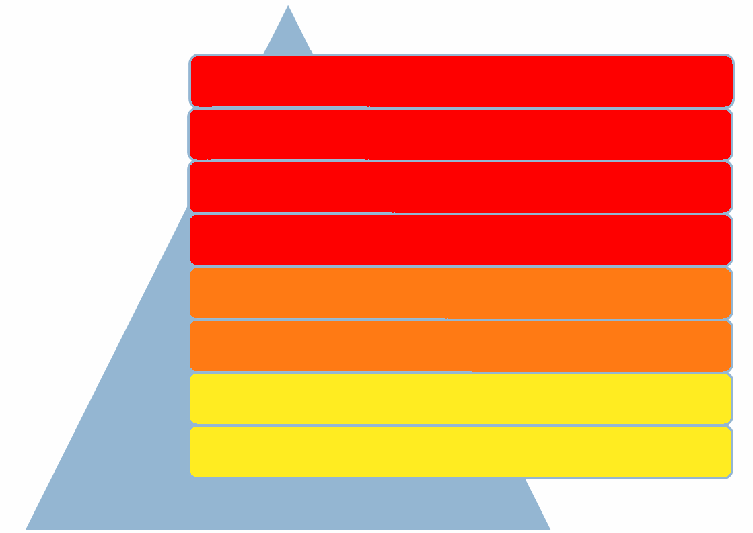
Central Eight Criminogenic Needs
Antisocial Attitudes
HX Antisocial Behavior /Low Self-control
Antisocial Peers
Criminal Personality Makeup
Disfunctional Family Relations
Substance Abuse
School/Work
Leisure/Recreation
Notes:
Risk factors can be divided into those that are static (e.g., age at first arrest; priors) and dynamic (e.g., substance abuse, criminal peers).
The dynamic factors that are most directly linked to criminal behavior are called criminogenic needs. Targeting these criminogenic needs influences the risk for recidivism. Needs tell us WHAT services to provide the offender.

Slide 8
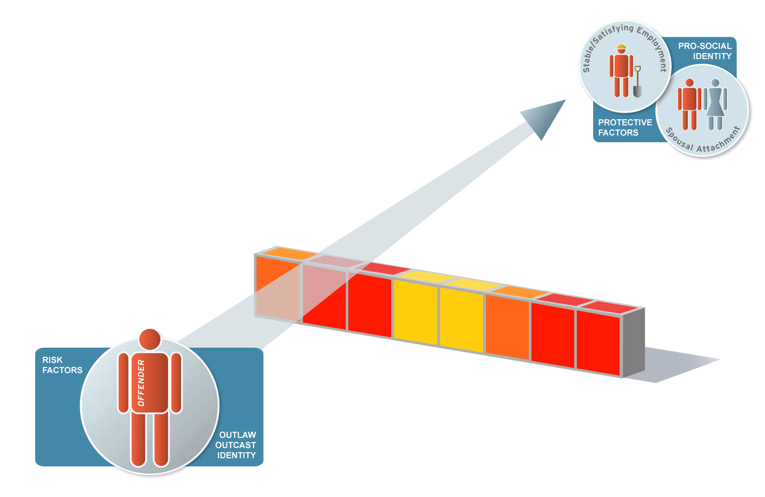
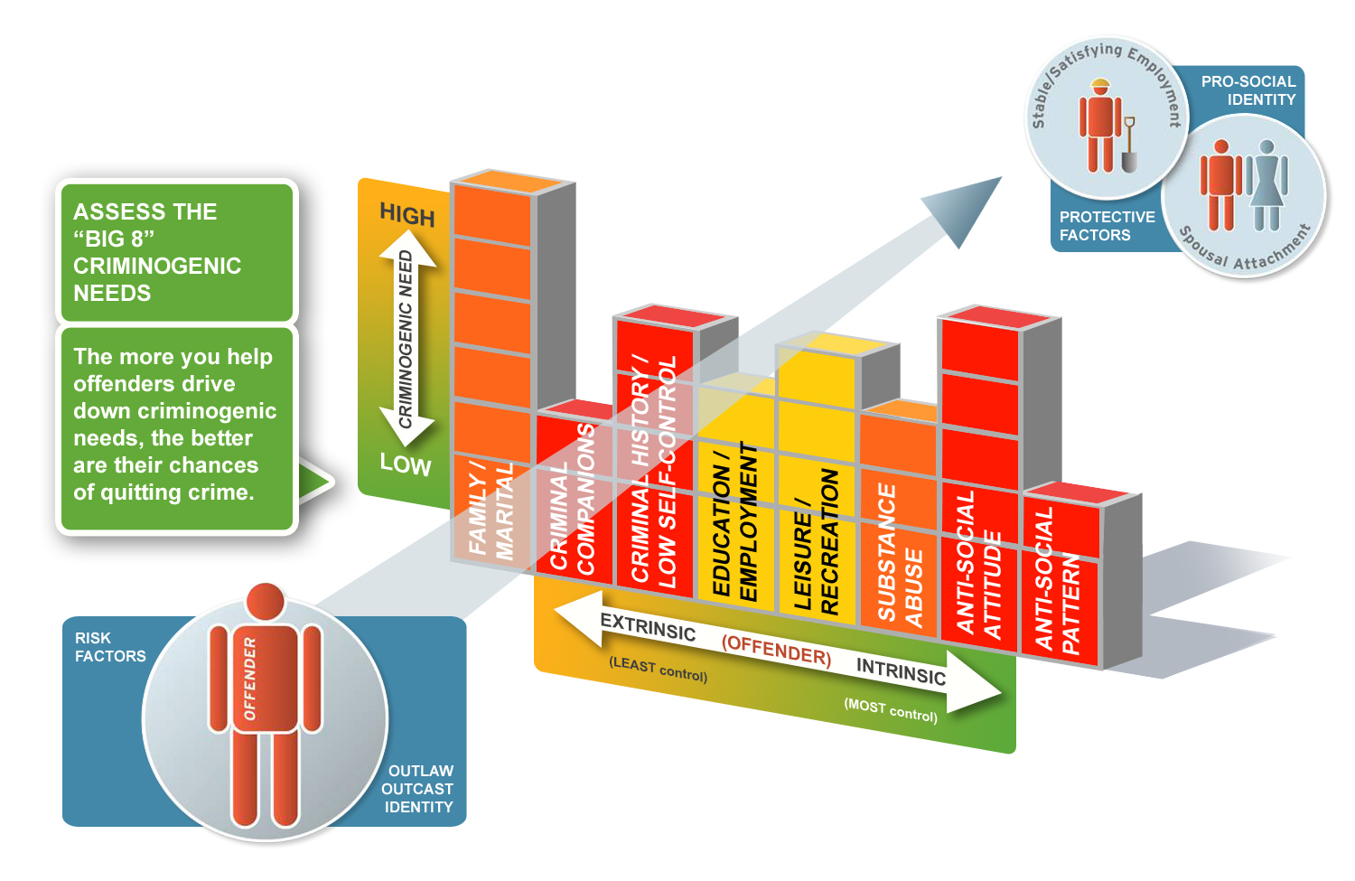
Recidivism Wall:
Impediment to More Pro-social Thinking & Behavior
Notes:
PO’s are the most immanently well-suited professionals for guiding offenders through this wall.

Slide 9
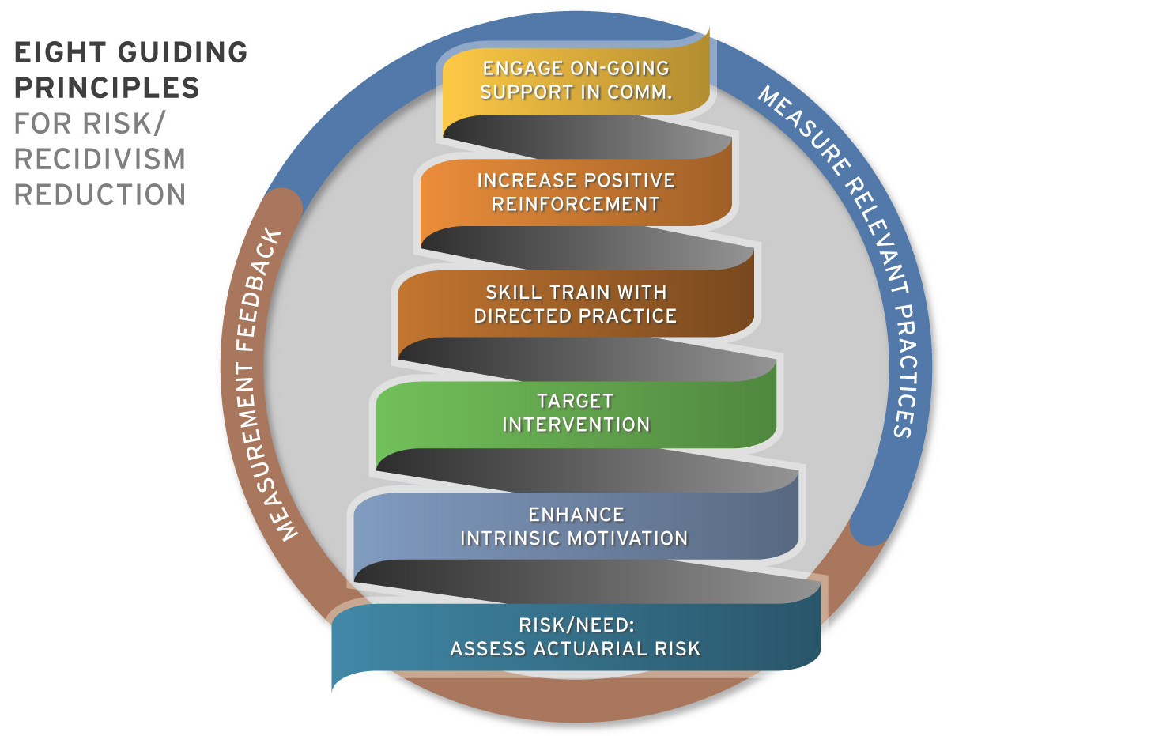
Notes:
These strategies are most commonly found in the ‘What Works’ literature and when dealing with an individual offender, there is a definite sequential logic within the set.
The basis for these strategies starts with efficiently delineating the actuarial risk level of each offender, along with their particular intervention target features (I.e., their criminogenic needs). In short, we begin to operationalize the risk and need principles. Cut-off points on the LSI-R scores establish the level of supervision and programming resources available. Next the LSI interview protocol will also serve to nicely narrow the criminogenic focus in each case.
Next, (though this particular strategy can begin simultaneously with the former) we utilize newer Motivational Interviewing skills (reinforced through QA) to assist the offender in exploring and resolving ambivalence for changing their criminogenic behaviors and attitudes. Soliciting offender input through formal mechanisms (offender sef-report tools) or in the ample informal opportunities provided over the course of supervision, directly contributes to increasing an offender’s motivation for change.
Third, it is important to facilitate treatment intervention referrals that are responsive to both the offender’s criminogenic needs and motivational stages, when possible, but in terms of actual service delivery, we promote programming that concentrates on offender skill rehearsals, role plays and other cognitive/behavioral exercises rather than didactic processes or ‘chat’ therapies. More specifically, we emphasize building problem-solving, coping skills and the use of cognitive skill-building curriculums.
Next, if the newly required skills are not adequately reinforced they are too quickly lost, therefore, optimizing the richer reinforcements for the new coping skills the offender is (or isn’t) acquiring is recommended. Examples of these reinforcements can be found in the positive and negative sanctions levied through the courts, or internally within the agency, progress in decreased supervision obligations, or, more informally, when an agent communicates recognition and affirmation of progress.
The fifth stratagem is assisting the offender in re-orientating to their local community and neighborhoods where ultimately they must obtain ‘natural’ reinforcement for their new pro-social behaviors and attitudes. This is a process of encouraging, referring and net-working to increase the offender’s positive linkages to their local communities (e.g., home, work, school, family) on the one hand; while on the other hand, helping the offender identify triggers and high-risk situations that they need to more effectively navigate within their personal worlds. By better engaging pro-social support of others in sports, 12-step programs, church and education settings, offenders acquire increased reinforcement for their emerging new skills and perspectives that the need to sustain a new, more pro-social orientation.
Finally, good objective case information (information controls) leads to follow-through and accountability, the core value in evidence-based practice. This occurs at two levels: first, the individual offender can be better brought into accountability when their responsibilities are delineated through specific case information, logical problem-solving and concrete steps and timeframes; second, information that can be aggregated and systematically shared within and across agencies is necessary for the agent and the larger organization to successfully mobilize more effective resources for reducing recidivism in the future. This last stratagem therefore, intersects and vertically binds all the others in a continuous on-going cycle of improvement.

Slide 10
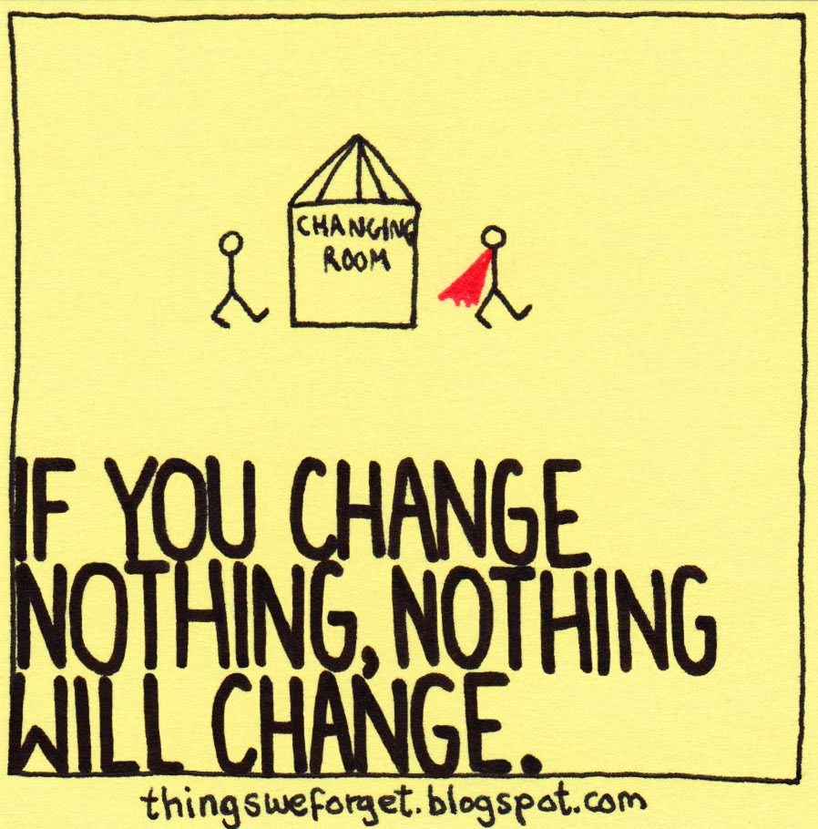

Slide 11
Social Learning Theory
Voluntary behavior is learned and therefore can be unlearned
Behavior that is reinforced will continue unless the reinforcement is either:
Withdrawn or
An alternative reinforced behavior is learned in its place
Notes:
Social Learning Theory is learning by observation. Behavior can be learned, and therefore it can be unlearned. Social Learning Theory is the basis from which the LSI was developed.
Modeling is the super highway for human being to learn. It’s called vicarious reinforcement and two essential elements are required: 1) the subject is frequently exposed to someone they value or think is cool; 2) they see that individual get positively reinforced for a particular behavior that they (the subject) do not yet have. The subject will learn almost through osmosis.
How does this tie back to the LSI-R? Line staff will come to you with questions about how to score a certain item. It is important to tie individual circumstances back to STL whenever possible. ATTITUDES CAN AND DO CHANGE UNDER THE RIGHT CIRCUMSTANCES.

Slide 12
Criminal History
Notes:
All the items in the Criminal History subscale are relatively static. The unit of analysis in the first three items is sentences, where charges or counts a client was convicted for are not counted but just the times they received official sanctions is. Item four the unit shifts to charges. Items 1 – 4 apply to adult only offenses. Item five is for juvenile and items 6-10 are for both juvenile and adult records. Charge laid in item 9, refers to any new offense or revocation while the client was under supervision. Escape (#7) only applies to residential settings where all the other residents were ‘correctional customers’ – it does not apply to breaking electronic tether or monitoring, or jumping bail.
Remind participants that upon scoring this subscale it can be viewed as a static risk indicator or a proxy for the dynamic issue low self-control: the higher the scale the more likely the individual has problems with low self-control. Probe for accident proneness if there are any doubts.

Slide 13
Education/Employment
Notes:
The first rater items (18-20) occur in this subscale as well as the first tricky if/then rules (11/19, 19, 20), be sure to review this with participants.
At the conclusion of the subscale 20 of the 54 items should have been completed. Thus the number 20 can be used as a marker for mapping where one is in the LSI. For example its relatively easy to recall that the next subscale, financial problems contains only two items, family only four and accommodation 3 (2 + 4 + 3 = 9 or 29).

Slide 14
Financial
Notes:
It may help participants to provide them some general anchors for item 21: Clients that are living hand-to-mouth warrant being rated a 0 (and scored) because the implication is that they have routine problems with food, shelter, clothing and transportation. Clients that have intermittent issues with the latter problems would be rated 1 (and scored). Clients that are relatively free of problems of food, shelter, clothing and transportation and not dependent on others are best rated either 2 or 3. A rating of 3 is reserved for people that have insurance and some retirement plan.

Slide 15
Family/Marital
Notes:
Item 23 is often under probed, nevertheless, go with whatever level satisfaction the client reports overall unless there is a significant life/ health safety issue. If both parents are deceased rate a 0 (and the items scores because dead parents cannot provide much current or prevailing pattern pro-social reinforcement).

Slide 16
Accommodation
Notes:
For item 27 go with what the client reports overall unless there is a significant life/ health safety issue. Areas that might qualify as police ‘hotspots’ should qualify for high crime areas (item 29).

Slide 17
Leisure/Recreation
Notes:
Organized means planned and routinely anticipated.

Slide 18
Companions
Notes:
Someone that scores on item 32 as an isolate should clearly prefer their own company above that of all others. Isolates should therefore frequently be eligible for scoring on 35 and 36 as well. Gang members on the other hand, who often could also score on 35 and 36, would not score on item 32, but they would always score on 33 and 34. People are generally assumed to have more acquaintances then friends, thus the if/ then rule if 34/ then 33 should score.

Slide 19
Alcohol/Drug Problem
Notes:
The key to mastering the scoring for this subscale is realizing that objectively, in order for someone to have a problem with either alcohol or other substances (drugs), they must have experienced some disruption or negative consequences as a direct result of use. Items 41 – 45 are categories of symptoms or evidence of disruption commonly resulting from AOD abuse. If a client is scored on 39 or 40 (current problems) they should be scored on at least one of the 41 – 45 items.

Slide 20
Emotional/Personal
Notes:
Scoring this subscale appears to give various jurisdictions more trouble than any other domain in the LSI-R. There are three possible causes which if openly discussed with participants may help them initially implement their assessments with more fidelity and fewer inter-rater reliability problems in this area. First, this is the only scale that scores up two very different kinds of risk factors in the same domain; items 46 and 47 are to be scored if there are moderate or severe problems with EITHER emotional instability OR evidence of a potentially very stable trait – psychopathy. This dual role for the emotional/personal scale can cause some confusion if not explained properly. Secondly, and perhaps of primary importance, is that independent raters listening to LSI-R interview tapes frequently find items in this scale are insufficiently probed; there may be a hesitancy on the part of agents who are conducting the interview to explore the emotional life of offenders they are assessing. This reluctance is understandable and to some degree natural to our culture, however, it is something that can be worked through, especially with a bit of peer coaching and practice. The third and final cause of issues in this area, and this applies to the next subscale (attitudes/Orientation) as well, is what is the syndrome referred to as scoring-on-a-curve whereby people get rated compared to the norms of the group they are in. This happens when agents or PO’s become so acculturated to the population they are working with that they unconsciously and naturally scoring them based on what they have come to see as the norms of the population of offenders. In another words, an offender with emotional problems or antisocial attitudes that would barely be acceptable say in a PTA meeting, or church community, might look quite acceptable and pro-social compared to other high risk parolees, and get down-scored accordingly. Regardless of the cause, aggregate scores for the Emotional/Personal Problems subscale often suggest that there are few if any problems in this area for a sampled population and other, more specific research in the area of offender MH simply doesn’t support this picture.

Slide 21
Attitudes/Orientation
Notes:
On item 51 probe around intention to support themselves gainfully and legitimately; would this individual consider, even for a second, returning someone’s wallet (with money in it) that they found? Do they have an established pattern of trying to support themselves legitimately? Is it acceptable to the individual to live-off the misfortune of others?
Item 52 is about the individual’s interest in beating the system (marijuana ranch on Maui). This signifies a lack of stake in conformity for conventional society with a potential accompanying commitment to their own self-interest, i.e., less opportunities for pro-social experience and activities.

Slide 22
Chance of Recidivism:
LSI-R Total Risk Score:
High Risk/ Needs
41 - 54
76 %
Medium/High Risk/ Needs
57 %
34 - 40
Moderate Risk/Needs
24 - 33
48 %
Low/Moderate Risk/ Needs
14 - 23
31 %
Low Risk/Needs
0 - 13
12 %
22
Notes:
When assessing risk, we need a valid tool that predicts recidivism. A valid tool, like the LSI will show a stair-step relationship with recidivism: higher the risk, greater the likelihood for recidivism.

Slide 23
Quick RNR Recap
RNR is about:
Assessing risk
Targeting Needs
Delivering with responsivity
Notes:
The LSI was initially tested on primarily Caucasian populations. Researches continue to investigate the applicability of the LSI-R to specific racial populations.

Slide 24
Tell Me How
Remember, we should interact with those on a correctional track in a manner supportive of change.
Role model interaction that is collaborative and respectful.
Use positive reinforcement in a 4-5:1 ratio
Notes:
The LSI was initially tested on primarily Caucasian populations. Researches continue to investigate the applicability of the LSI-R to specific racial populations.

Slide 25
Tell Me More
Hold people accountable for every violation. Respond to every behavior both positive and negative
Help change thinking, manage emotions and build prosocial skills.
Help with problem solving. Go over what-if scenarios.
Notes:
The LSI was initially tested on primarily Caucasian populations. Researches continue to investigate the applicability of the LSI-R to specific racial populations.

