Slide 1
The Core Competencies
Effective Communication: The knowledge and skills necessary to engage in effective communication in diverse contexts and formats.
Creative and Critical Thinking: The knowledge and skills necessary for critical exploration of issues, artifacts, and events in order to creatively design, evaluate, and implement a strategy to answer complex questions or achieve a desired goal.
Intercultural Fluency: The knowledge and skills necessary to promote effective and appropriate interaction in a variety of cultural contexts, particularly in terms of the diverse populations of Alaska.
Personal, Professional, and Community Responsibility: The knowledge and skills necessary to promote flourishing, professional excellence, and community engagement.

Slide 2
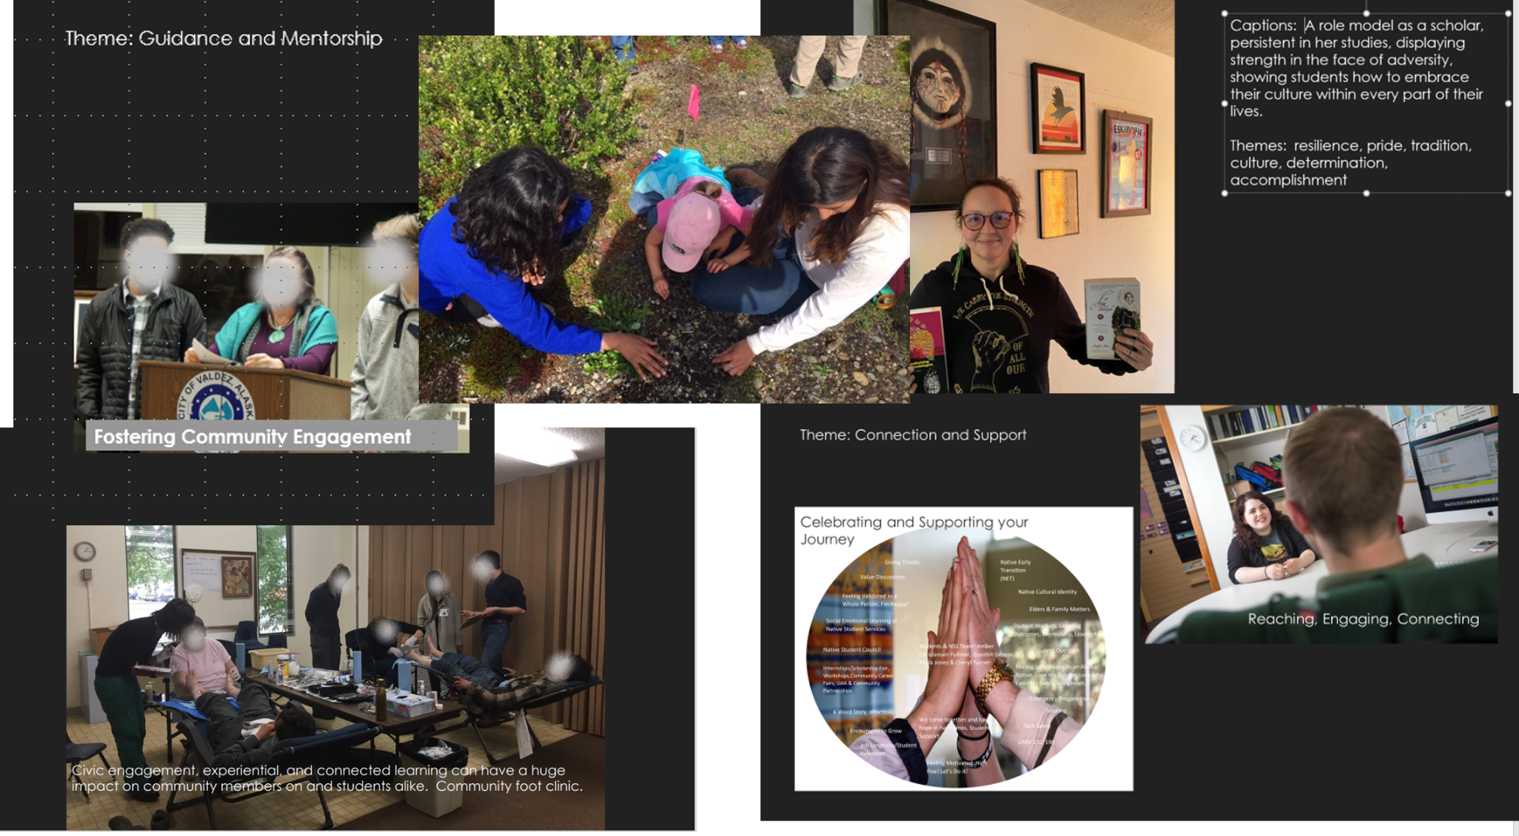
PhotoVoice Example

Slide 3
November 2020 Open Forum: Personal, Professional and Community Responsibility Emerging Themes from the PhotoVoice Process
Role modeling
Ethics
Place-based learning
Applied learning
Civic engagement
Community-based learning
Leadership Safety
Whole person
Project-based learning
Integration of culture
Building relationships
Team work
Connection with others
Passion for your work
Sense of purpose
Importance of practicing
Student engagement
Resilience

