Slide 1


Institutional Accreditation - Year of Self Reflection -
May 8, 2025 Annual Assessment Retreat: How do we know, and what do we do about it?
UA is an AA/EO employer and educational institution and prohibits illegal discrimination against any individual: www.alaska.edu/nondiscrimination

Slide 2
UAA’s Accreditation and What that Means
The University of Alaska Anchorage has been accredited by the Northwest Commission on Colleges and Universities (NWCCU) since 1974. This single accreditation status applies to all UAA campuses, including Anchorage, Kenai Peninsula College, Kodiak College, Matanuska-Susitna College and Prince William Sound College and their extended sites.
Accreditation of an institution of higher education by the NWCCU indicates that it meets or exceeds criteria for the assessment of institutional quality evaluated through a peer review process. It has available the necessary resources to achieve its stated purposes through appropriate educational programs, is substantially doing so, and gives reasonable evidence that it will continue to do so in the foreseeable future.
Accreditation by the NWCCU is not partial but applies to the institution as a whole.

Slide 3
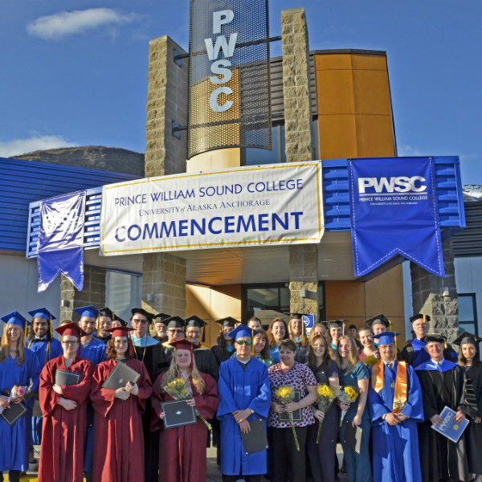
Why is Institutional Accreditation Important?
Recognition of UAA certificates and degrees by employers, licensing agencies, and other institutions
Acceptance of UAA transfer credits
Access to Federal Financial Aid through Title IV
Opportunity for reflection and continuous improvement

Slide 4
The NWCCU 7-Year Accreditation Cycle
Year one (2019-2020): Development of Core Learning Competencies and Student Achievement Metrics by the UAA Community
Year six (2024-2025): Policies, Regulations, and Financial Review (PRFR) (Standard 2) - Year Six Report and Review
Year two (2020-2021): Kick off the implementation of one Core Learning Competency per year
Year seven (2025-2026): Evaluation of Institutional Effectiveness (EIE) (Standard 1) - Year Seven Report and Site Visit
Year three (2021-2022): Mid-Cycle Evaluation - Year Three, Report and Visit

Slide 5
UAA’s Accreditation Definition of Mission Fulfillment
Year 7 is all about Mission Fulfillment. UAA articulates and demonstrates Mission Fulfillment for institutional accreditation with We put students first, aspiration #1 of UAA 2027.
Students develop and achieve UAA’s Core Learning Competencies.
Students persist, are retained, and graduate at increasing rates.
Gaps in student learning and achievement are narrowed.
Progress on Mission Fulfillment: https://www.uaa.alaska.edu/academics/office-of-academic-affairs/institutional-effectiveness/departments/institutional-research/mission-fulfillment.cshtml

Slide 6
Quick Refresh on Where We Are in the Process
At our March Open Forum we reflected on how well we have done in meeting our mission relative to the goals we set AND we started talking about where we go from here.
Provost Runge will say a few words about what we learned and heard in March.

Slide 7
Advancement Case Study
Today’s Open Forum asks us to think about and give examples of how we use evaluation, in all its forms, to inform our planning and resource allocation processes.
Tanya Pont, Executive Director of University Advancement, will talk about a recent conversation in Advancement on this topic.

Slide 8
Overview of This Year’s Regular, Institutional Processes
UAA has several regular, systematic evaluation processes. As an example, this year:
Academic Program Review - 34 degrees and certificates were reviewed
Program Student Learning Outcomes Assessment - 54 reports were submitted
Specialized Accreditation – Approximately 10 Self Studies and/or Site Visits
Services Review – 9 functional areas
All of these end up with something to continue to work on and improve, and they guide future resource allocation, whether it is time, effort, or new funding.

Slide 9
Breakout
Starting from a place of appreciation…
Evaluation processes can seem like something outside of you, objective, maybe even cold and distant. But NWCCU allows us to come up with our own processes, they do not prescribe them. That means that we have responsibility and agency, it means someone in the room might have put their best effort into developing a current process, and it also means that together we can improve processes.

Slide 10
How do we know? What do we do about it?

Slide 11
Breakout 2
Breakout Questions
What do your evaluation processes look like?
How do they provide data and information for decision making, planning, and resource allocation?
How well is it working?
What are some examples of improvements made based on what you learned from your evaluation processes?

Slide 12
Breakout 32
FIVE MINUTES LEFT FOR BREAKOUT SESSION!

Slide 13
Report Out

Slide 14
What values do you/we have around evaluation?

Slide 15
More than anything, NWCCU will be looking for example from you!

Slide 16
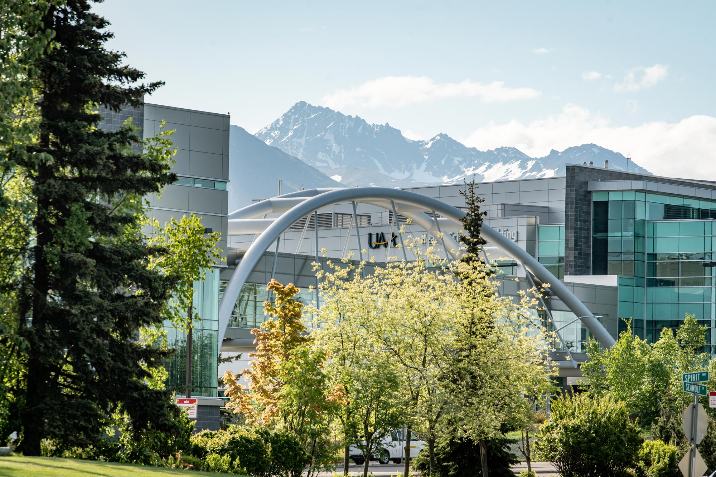
Wrap Up and Next Steps

Slide 17

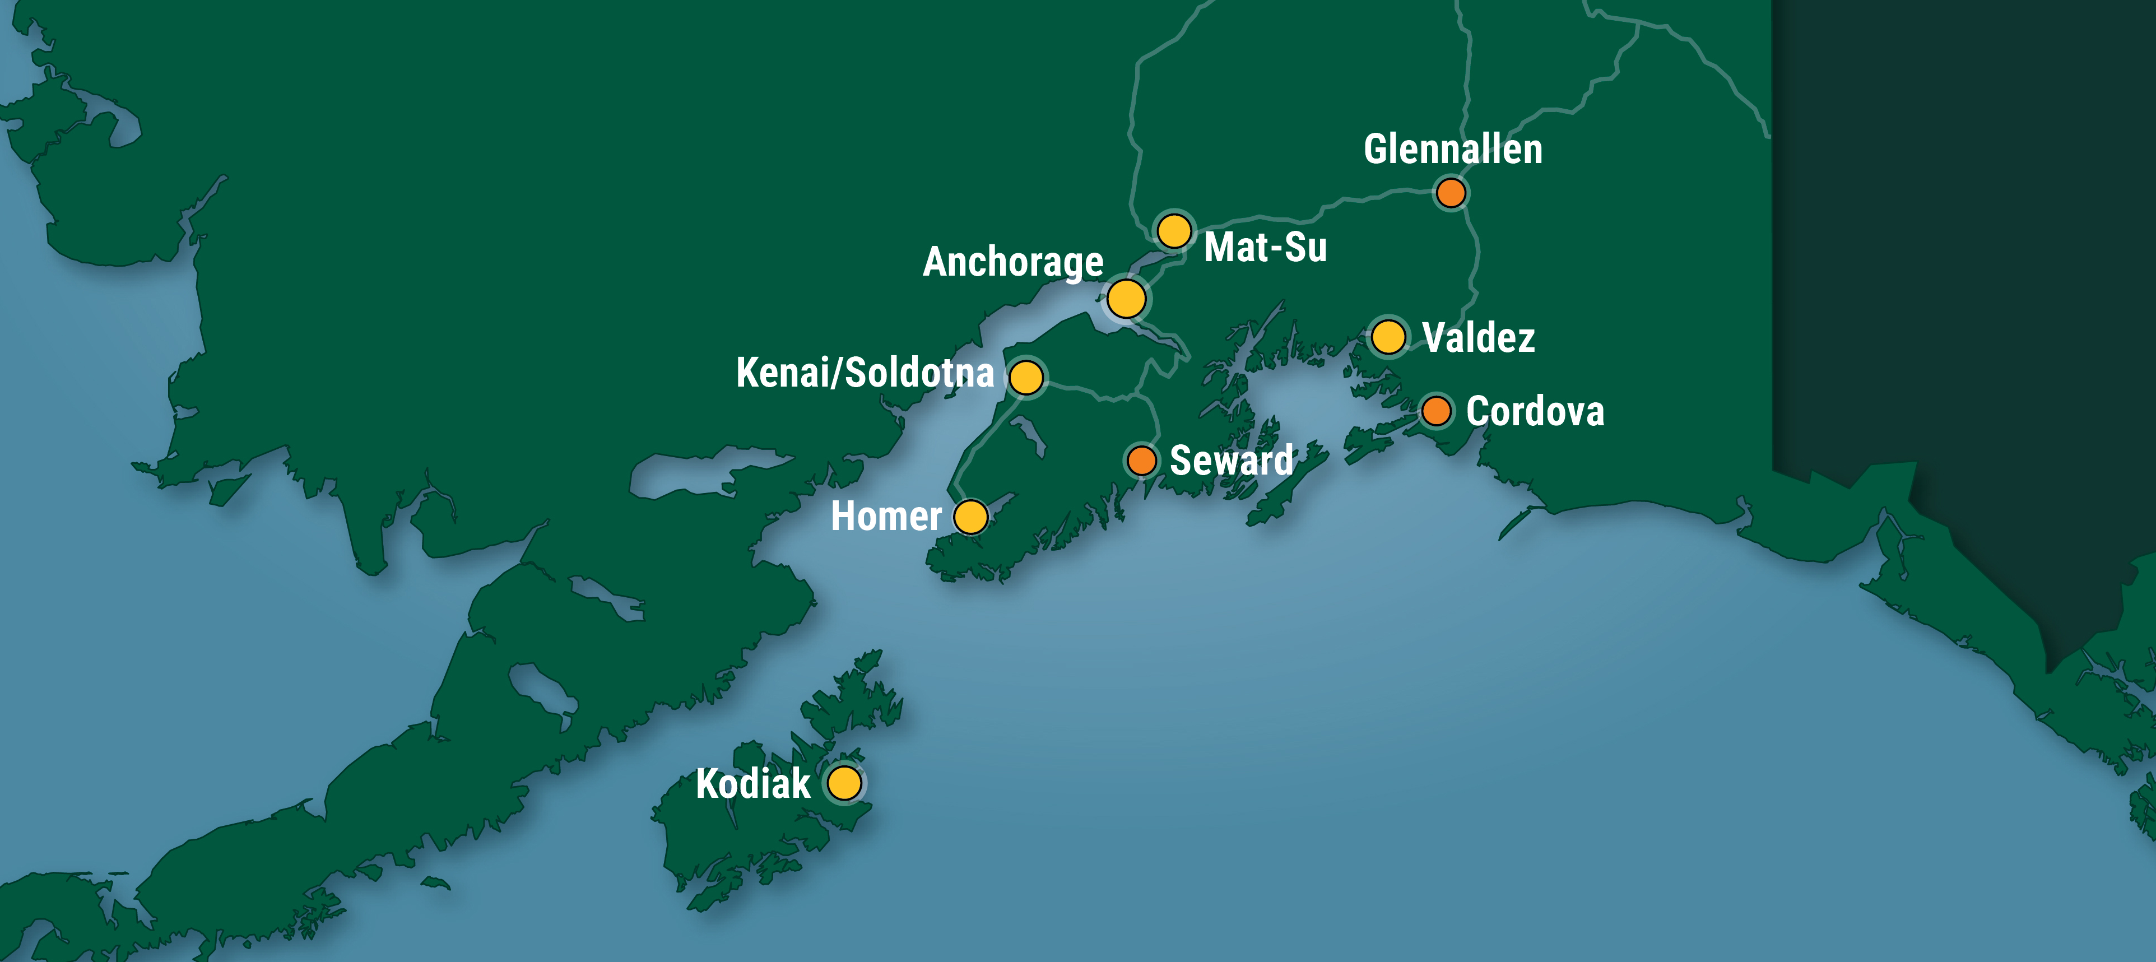
Thank You!

