Slide 1
Core Competencies
Co-Curricular
Major
General Education
Notes:
Another way to think about it is the core – have a core experience regardless of pathway, major, but something that is consistent about being at this institution – that will happen regardless – you can’t get out of here without it – but you will also get other things ☺
What are learning frameworks, core competencies, and/or institutional learning outcomes and what do they allow you to do?
Learning frameworks allow us to all agree on the learning we are striving and designing towards, not how we will get there, but to align our practices.
Mapping is one thing, but if we all map to whatever learning we like, how can we talk to each other and our learners across the system?
It sets us up to validated evidence from a variety of places based on a shared framework or evaluative criteria.
Help us find our point of connection

Slide 2
Core Competencies
What are core competencies?
Cross-Cutting (not disciplinary focused)
Cross-Institutional (Curricular and Extra Curricular)
Meaningful to Our Students and Communities
Assessable
Comparable to Peers
Realistic AND Aspirational

Slide 3
UAA’s Core Competencies
Effective Communication 2. Critical and Creative Thinking 3. Intercultural Fluency 4. Personal, Professional, and Community Responsibility The knowledge and skills necessary to promote personal flourishing, professional excellence, and community engagement.
Notes:
Terry – Note that two we are already pros at; two new ones that are meaningful to the community; #4 selected for pilot based on broad process; Tied identity, meaning that we need to model these as an institution. Descriptive and Aspirational

Slide 4
Personal, Professional and Community Responsibility Emerging Themes
Role modeling
Ethics
Place-based learning
Applied learning
Civic engagement
Community-based learning
Leadership Safety
Whole person
Project-based learning
Integration of culture
Building relationships
Team work
Connection with others
Passion for your work
Sense of purpose
Importance of practicing
Student engagement
Resilience

Slide 5
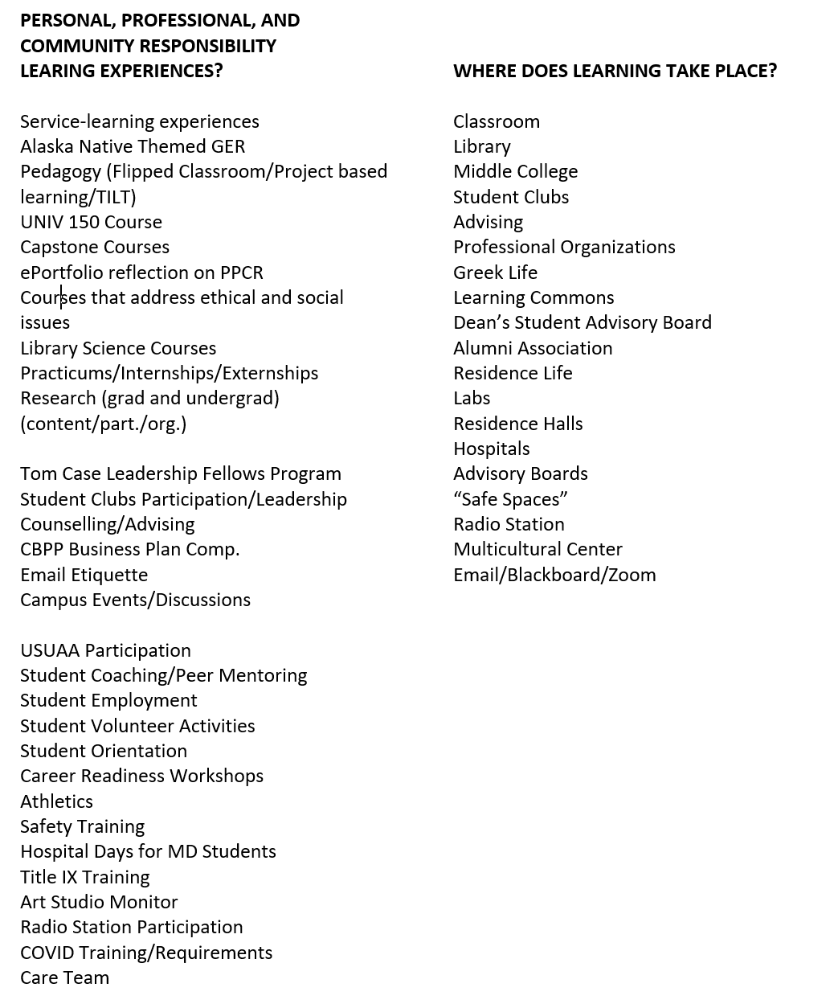
Personal, Professional, and Community Responsibility Learning Experiences

