Slide 1
Personal, Professional, & Community Responsibility (PPCR)
Results from the Assessment Report submissions October 2021

Slide 2

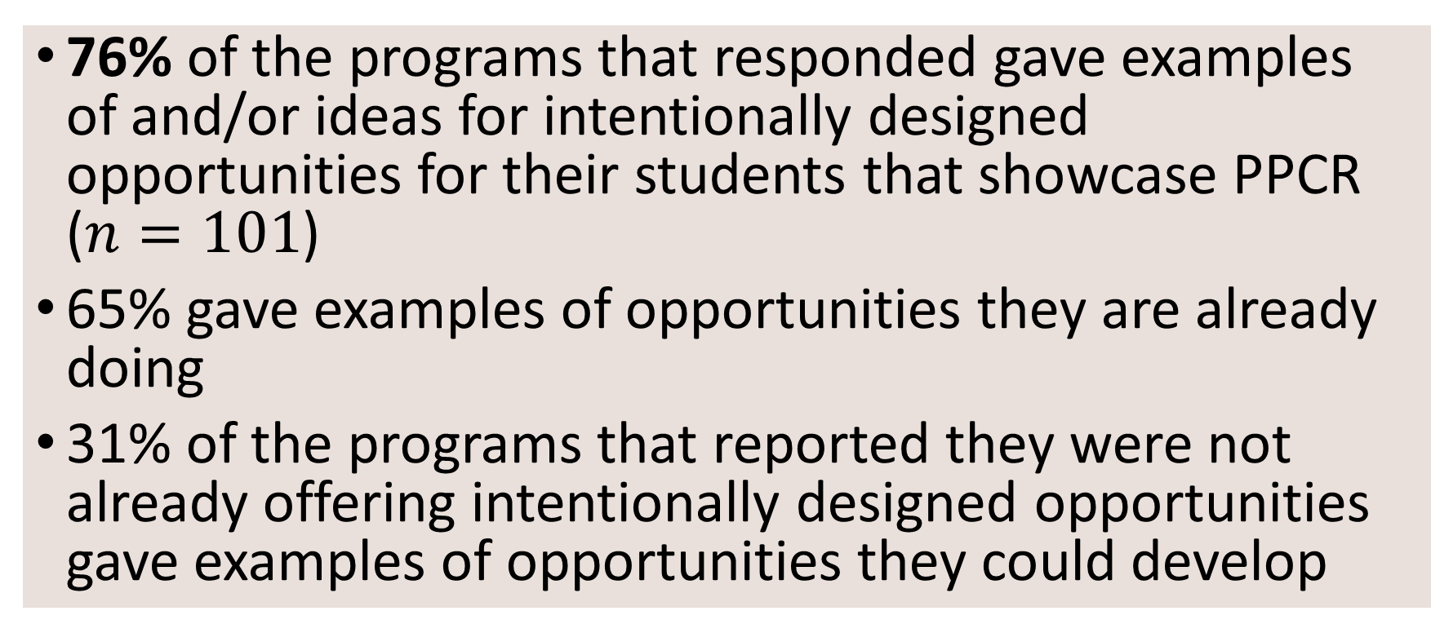
PPCR in Academic Programs at UAA
76% of the programs that responded gave examples of and/or ideas for intentionally designed opportunities for their students that showcase PPCR ($n=101$)
65% gave examples of opportunities they are already doing
31% of the programs that reported they were not already offering intentionally designed opportunities gave examples of opportunities they could develop

Slide 3
Personal Responsibility
Self-assessment
Goal setting and tracking
Reflection
Learning/Skill-building
Personal ethics
Problem-solving and decision-making skills

Slide 4
Professional Responsibility
Industry standards – knowledge and proficiency
Internships/practicums
Fellowships
Industry-specific codes of ethics
Field research/research projects
Safety
Planning and delivering professional development

Slide 5
Community Responsibility
Volunteering
Internships/practicums
Community engaged projects
Communication
Relationships/connections

Slide 6
References
Background Image: https://pixabay.com/photos/lens-ball-glass-ball-equality-7071808/

